Slide 1
A Comparative Cytotoxic Study of Berberis aristata Crude Extract on HeLa and K562 Cell Lines: An Integrated In-Vitro and In-Silico Approach
Department of Genetics
School of Sciences
Presented By: SHANSHANK GOWDA and SONIA BIJU
Guided By: Dr. PROMA CHAKRABORTY

Slide 2
CONTENTS
Introduction
Objectives
Methodology
Results and Discussion
Conclusion
References

Slide 3
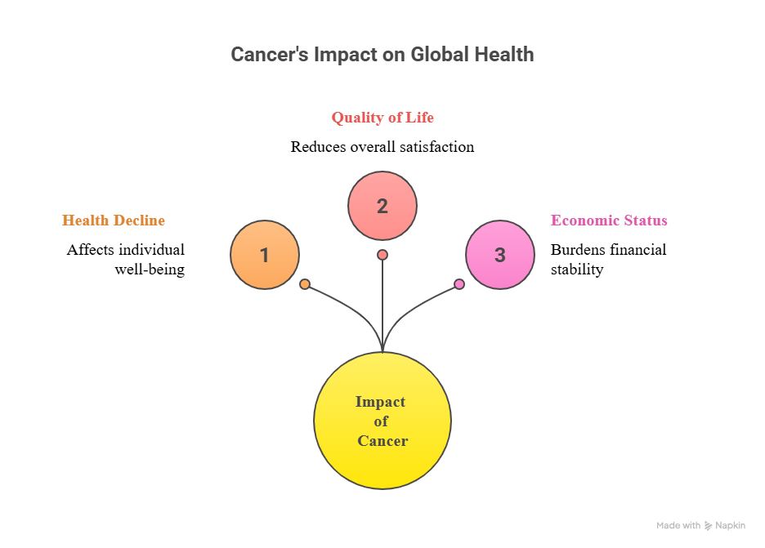
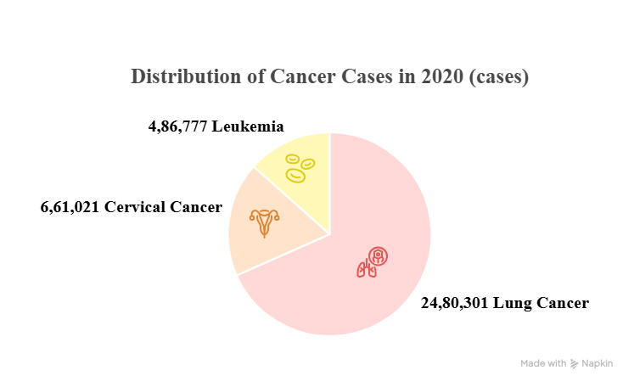
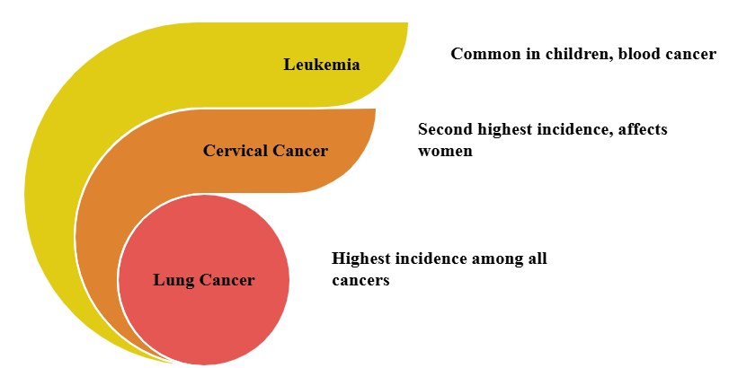
Introduction
Cancer Statistics Globally (2020)
Ranks 13th
Ranks 8th
CANCER
Ranks 1st
(48,419 cases)
(123,907 cases)
Cancer Statistics India
(2020)
(98,278 cases)

Slide 4
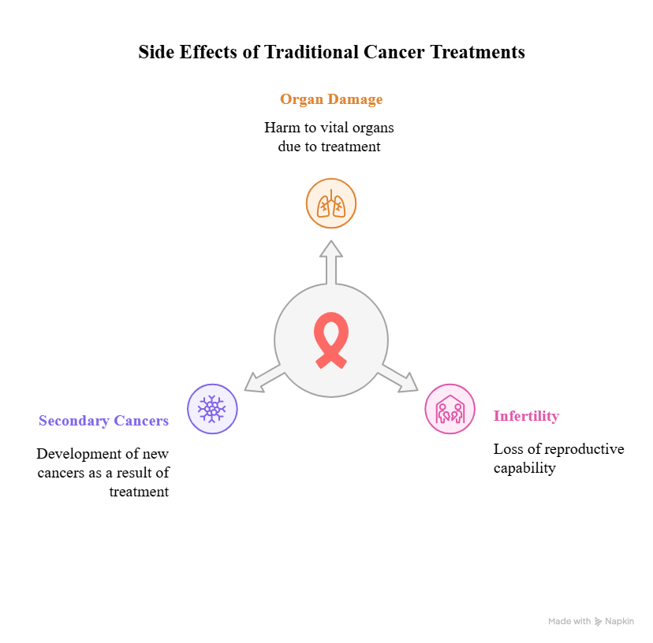
Introduction cntd…
Limitations of Using Convectional Method to Combat Cancer

Slide 5
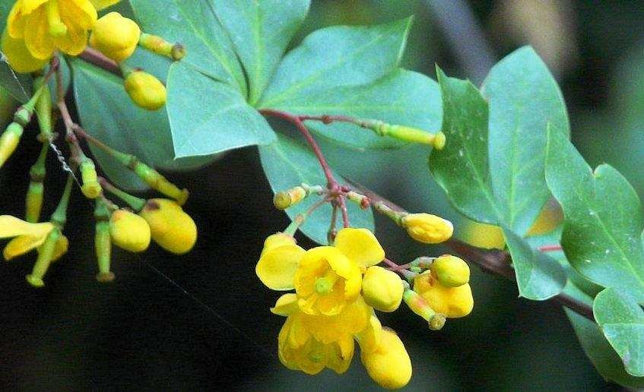
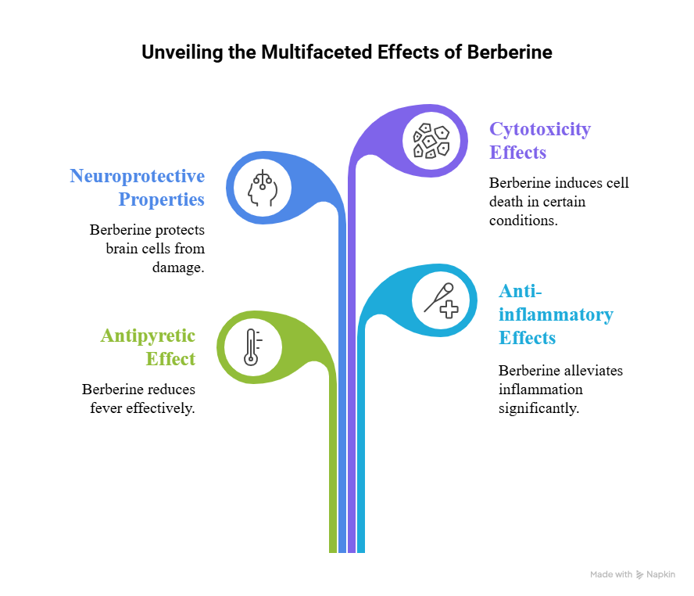
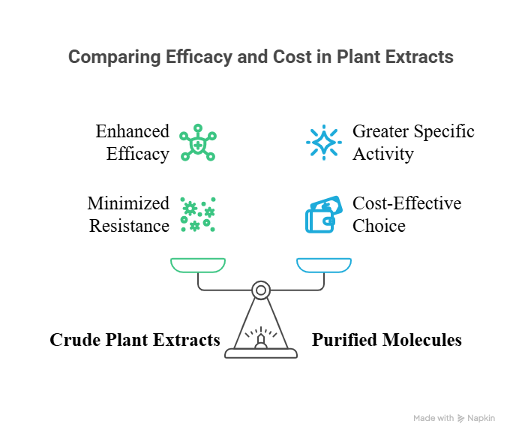
Opting Berberis aristata to treat cancer
Figure 1: Berberis aristata plant [Karthikeyan et al (2019)]

Slide 6
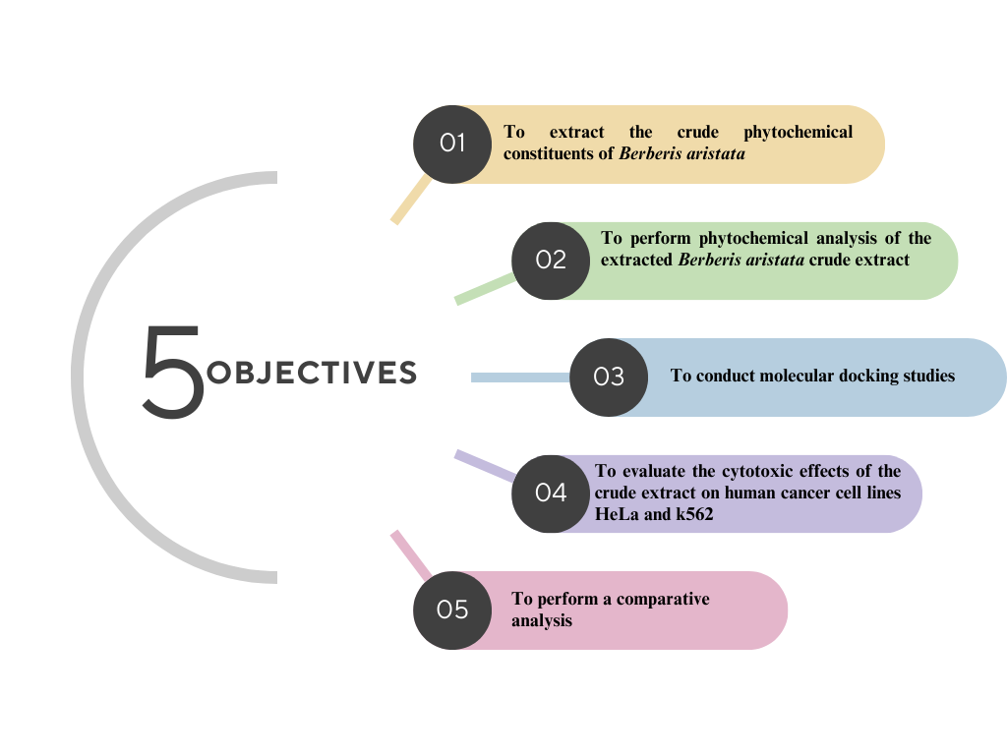

Slide 7
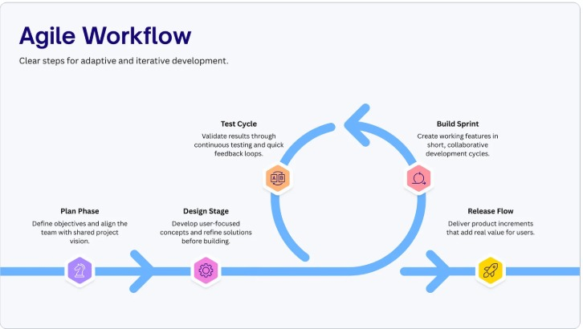





RESEARCH METHODOLOGY
Phytochemical Analysis
Molecular Docking
Molecular Docking for BCR-ABL and EGFR using AutoDock Vina
Analysis using Biochemical assays
Product
MTT Assay
Extraction
Bark of Berberis aristata
Crude extraction using Soxhlet Extraction method
MTT Assay on HeLa and K562 cell lines

Slide 8
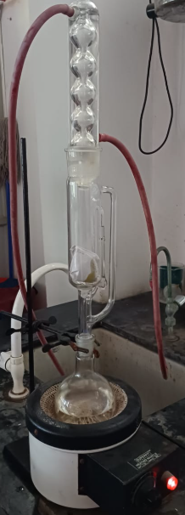
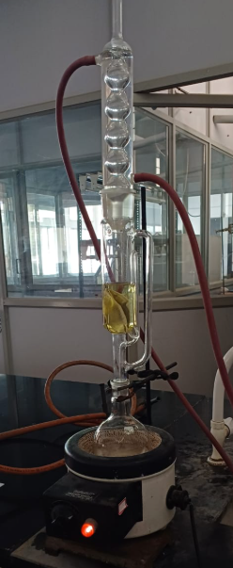
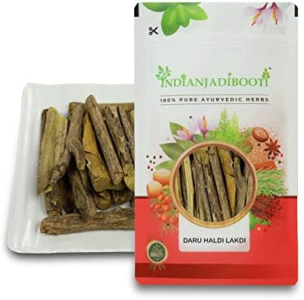
RESULT AND DISCUSSION
1. Procurement of Berberis aristata
2. Soxhlet extraction of Berberis aristata
Figure 2: Dried bark of Berberis aristata procured from local Ayurvedic store
Figure 3: Soxhlet extraction equipment used to extract phytoconstituents from plant material.

Slide 9
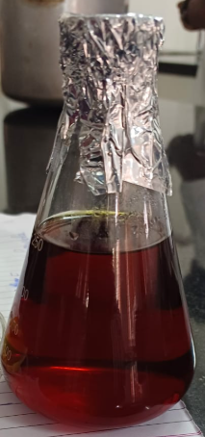
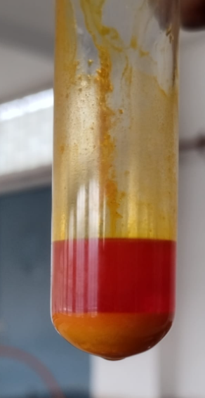
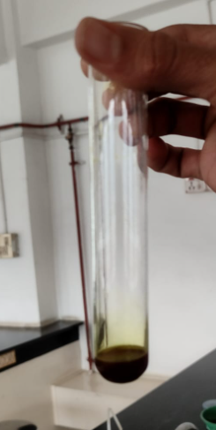
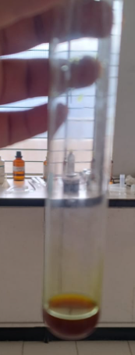
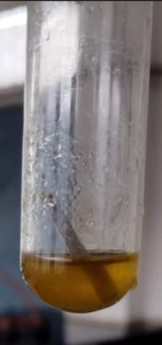
RESULT AND DISCUSSION
3. Crude Extraction of Berberis aristata
4. Phytochemical Analysis
A
B
C
Figure 5: Results for phytochemicals (A) Dragendorff’s test, orange ppt indicates presence of alkaloids; (B) and (C) Ferric test indicating presence of salicyclic acid and tannins respectively (D) Shinoda test, yellow colour indicates presence of flavones or isoflavones
D
Figure 4: Crude ethanolic extract of Berberis aristata in Erlenmeyer flask after extraction

Slide 10
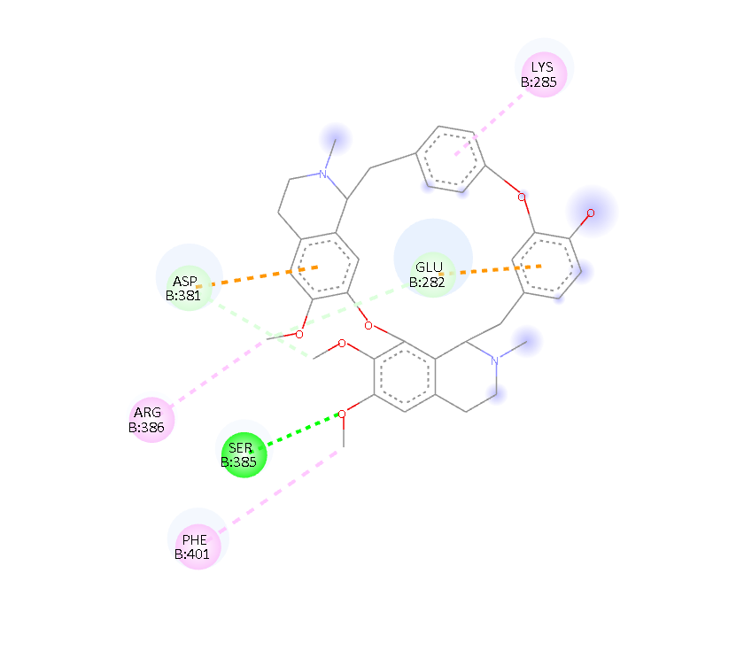
RESULT AND DISCUSSION
5. Molecular Docking for BCR-ABL
Table 1: List of compounds and its binding energy with BCR-ABL
Compound | Binding Energy (kcal/mol)
Berberine | -7.4
Palmatine | -7.8
Berbamine | -9.1
Quercetin | -7.3
Kaempferol | -7.4
Gallic acid | -5.2
The crude extract of Berberis aristata forms bonds on positions GLU282, LYS285, ASP381, SER385, ARG386 and PHE401 with BCR-ABL protein

Slide 11
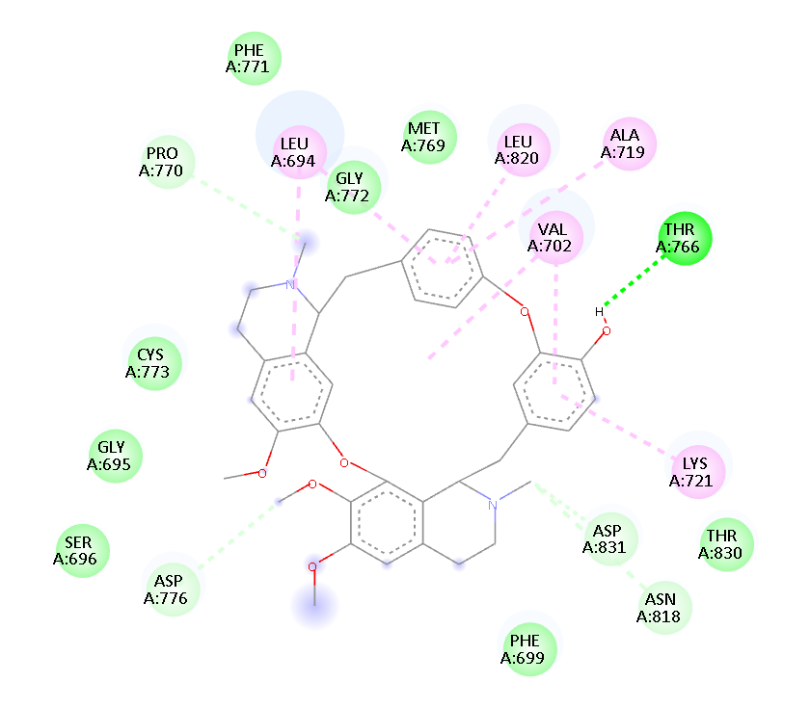
RESULT AND DISCUSSION
6. Molecular Docking for EGFR
Table 2: List of Compounds and its binding energy with EGFR (Epidermal Growth Factor Receptor)
Compound | Binding Energy (kcal/mol)
Berberine | -7.3
Palmatine | -7.2
Berbamine | -8.4
Quercetin | -7.8
Kaempferol | -7.6
Gallic acid | -5.3
The crude extract of Berberis aristata forms bonds on positions LEU694, GLY695, SER696, PHE699, VAL702, THR766, MET769, PRO770, PHE771, GLY772, CYS773, ASP776, ALA719, LYS721, LEU820, ASN818, THR830, ASP831 with EGFR protein

Slide 12
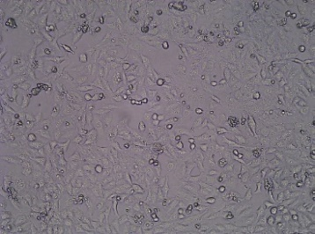
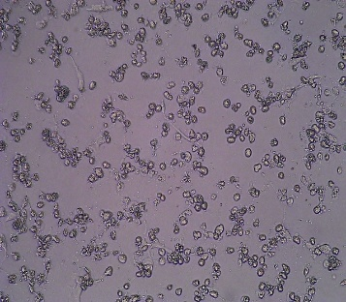
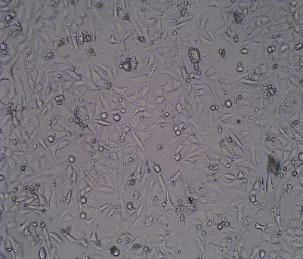

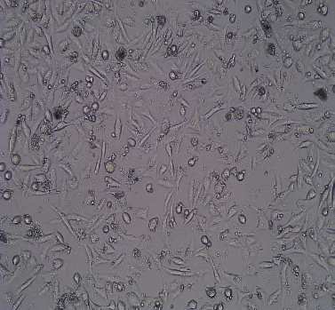
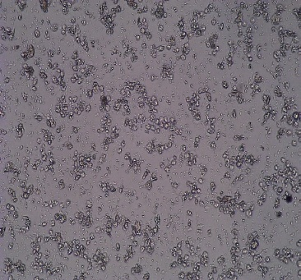
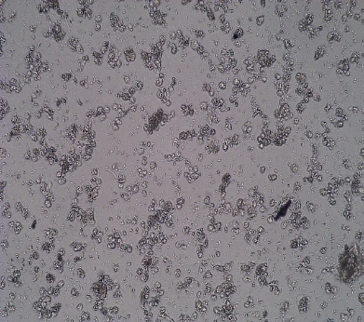
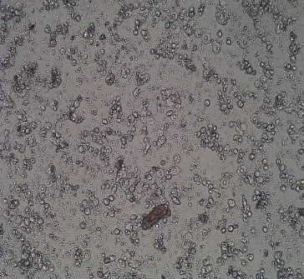
RESULT AND DISCUSSION
7. Microscopic Analysis for HeLa cell lines
(a)
B
C
(b)
Berberis aristata vs HeLa
D
E
F
IC₅₀ value = 205.12 ± 0.92
G
Figure 6: (a) Microscopic Observations of HeLa cell lines treated with different concentrations. [A] UTD: Untreated; [B] STD: Standard (Camptothecin); [C] 100 μg/mL; [D] 200 μg/mL; [E] 300 μg/mL [F] 400 μg/mL [G] 500 μg/mL concentrations of Berberis aristata crude extract; (b) Graphical representation of treatment of HeLa cell lines with varying range of concentrations

Slide 13
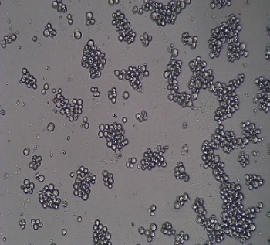
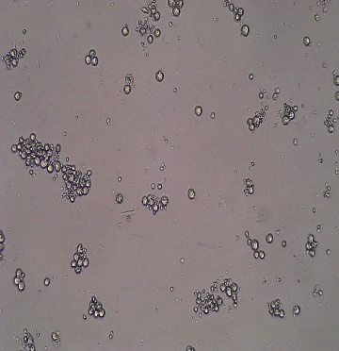
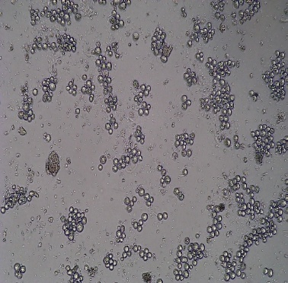
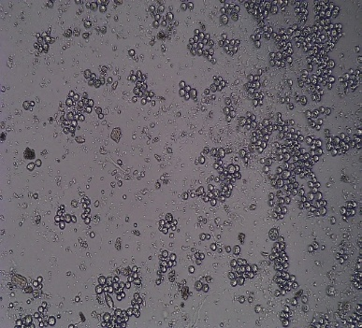
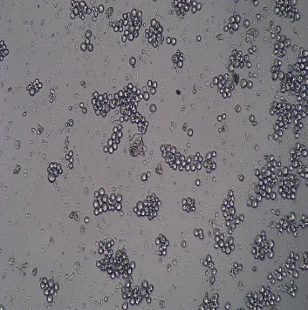
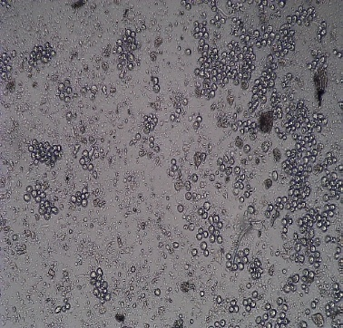
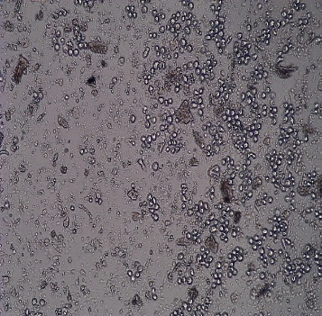
RESULT AND DISCUSSION
8. Microscopic Analysis for K562 cell lines
UTD
STD
100µg/ml
UTD
STD
100µg/ml
(a)
A
B
C
(b)
200µg/ml
200µg/ml
300µg/ml
400µg/ml
300µg/ml
400µg/ml
D
E
F
IC₅₀ value = 713.82 ± 13.34
Berberis aristata vs K562
500µg/ml
500µg/ml
G
Figure 7: (a) Microscopic Observations of k562 cell lines treated with different concentrations [A] UTD: Untreated; [B] STD: Standard (Camptothecin); [C] 100 μg/mL; [D] 200 μg/mL; [E] 300 μg/mL [F] 400 μg/mL [G] 500 μg/mL concentrations of Berberis aristata crude extract; (b) Graphical representation of treatment of K562 cell lines with varying range of concentrations

Slide 14
RESULT AND DISCUSSION
9. Comparative Analysis
Figure 8: The bar chart depicts the relative impact of Berberis aristata crude extract on the viability of two cancer cells; HeLa (cervical cancer) and k562 (chronic myeloid leukemia) concentrations between 100 to 500 µg/mL and control. The y-axis is taken for the percentage cell viability, and the x-axis is taken for the extract concentrations in µg/mL

Slide 15
REFERENCES
Ai, X., Yu, P., Peng, L., Luo, L., Liu, J., Li, S., ... & Meng, X. (2021). Berberine: a review of its pharmacokinetics properties and therapeutic potentials in diverse vascular diseases. Frontiers in pharmacology, 12, 762654.
Kopustinskiene, D. M., Jakstas, V., Savickas, A., & Bernatoniene, J. (2020). Flavonoids as anticancer agents. Nutrients, 12(2), 457.
Neag, M. A., Mocan, A., Echeverría, J., Pop, R. M., Bocsan, C. I., Crişan, G., & Buzoianu, A. D. (2018). Berberine: Botanical occurrence, traditional uses, extraction methods, and relevance in cardiovascular, metabolic, hepatic, and renal disorders. Frontiers in pharmacology, 9, 557.
Leitzmann, C. (2016). Characteristics and health benefits of phytochemicals. Forschende Komplementärmedizin/Research in Complementary Medicine, 23(2), 69-74.
Rasoanaivo, P., Wright, C. W., Willcox, M. L., & Gilbert, B. (2011). Whole plant extracts versus single compounds for the treatment of malaria: synergy and positive interactions. Malaria journal, 10(Suppl 1), S4.
da Silva, O. S., de Oliveira, R. L., de Carvalho Silva, J., Converti, A., & Porto, T. S. (2018). Thermodynamic investigation of an alkaline protease from Aspergillus tamarii URM4634: a comparative approach between crude extract and purified enzyme. International journal of biological macromolecules, 109, 1039-1044.

Slide 16


