Slide 1
“A TERATOLOGICAL STUDY OF FAULTY NEURAL TUBE CLOSURE AND NEURO-PROTECTION IN Gallus gallus domesticus”
Department of Genetics
School of Sciences
Presented By: Umme Javeria
Guided By: Ms. BUVANESHWARI S

Slide 2
CONTENT
Introduction
Objective
Methodology
Results And Discussion
Conclusion

Slide 3
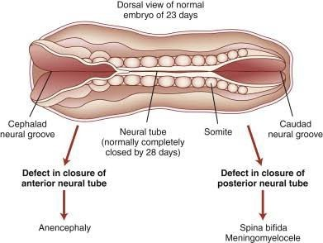
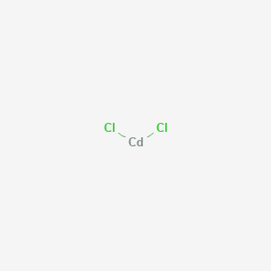
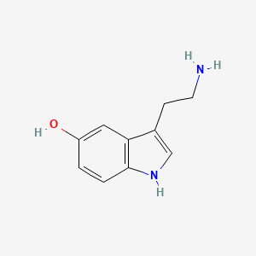
Introduction
Teratogenicity refers to the ability of a substance or agent to cause structural or functional abnormalities in a developing fetus or embryo, which can manifest as congenital malformations, growth retardation, or functional impairments after birth.
Cadmium Chloride
Serotonin
Pubchem- CID 24947
Fig 1.1 . Neural tube defects resulting from defects in closure. Defect in closure of the anterior neural tube causes anencephaly. Defective closure of the posterior neural tube produces a variety of clinical findings, depending on the location and severity of the lesion. These posterior defects are generally referred to as spina bifida.
PubChem- CID 5202

Slide 4
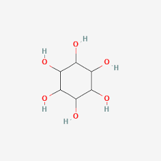
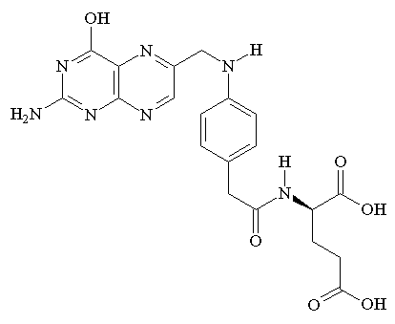
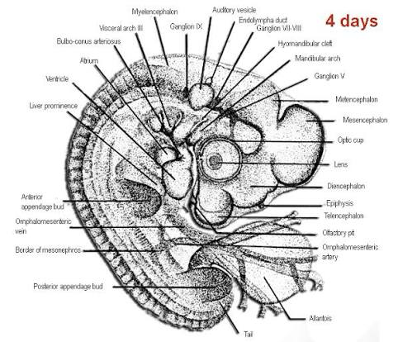
Introduction
A "neuroprotectant for NTD" most likely refers to agents that protect against the neuronal damage associated with neurodegenerative disorders (NDs)
Why Chick embryo
Inositol
Folic Acid
PubChem- CID 892
Dominic Taylor and Paul May., 2008

Slide 5
Objectives
To assess the impact of serotonin in an early embryonic development, particularly neutral tube formation, in a dose-dependent manner.
To evaluate the teratogenic effects of cadmium chloride, a known environmental toxin on the neural an structural development of chick embryo.
To draw correlation between observed embryonic malformations and human congenital disorders such as neural tube defect, spontaneous abortion or developmental delays.
To investigate the embryological influence of inositol as a potential protective agent and compare its effectiveness with that of folic acid
To determine the combined effect of serotonin and cadmium chloride and observe whether they produce additive or synergetic toxicity.
To analyse the neuroprotective role of folic acid, when co-administered with serotonin and cadmium chloride, and assess its ability to prevent or reduce neural tube defects.

Slide 6
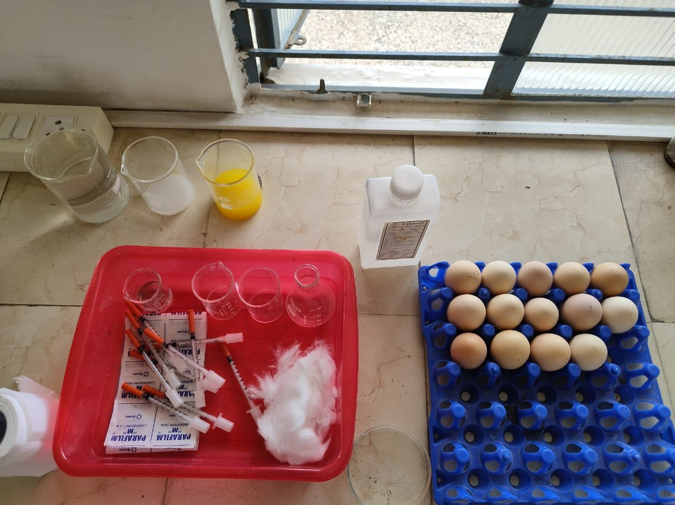
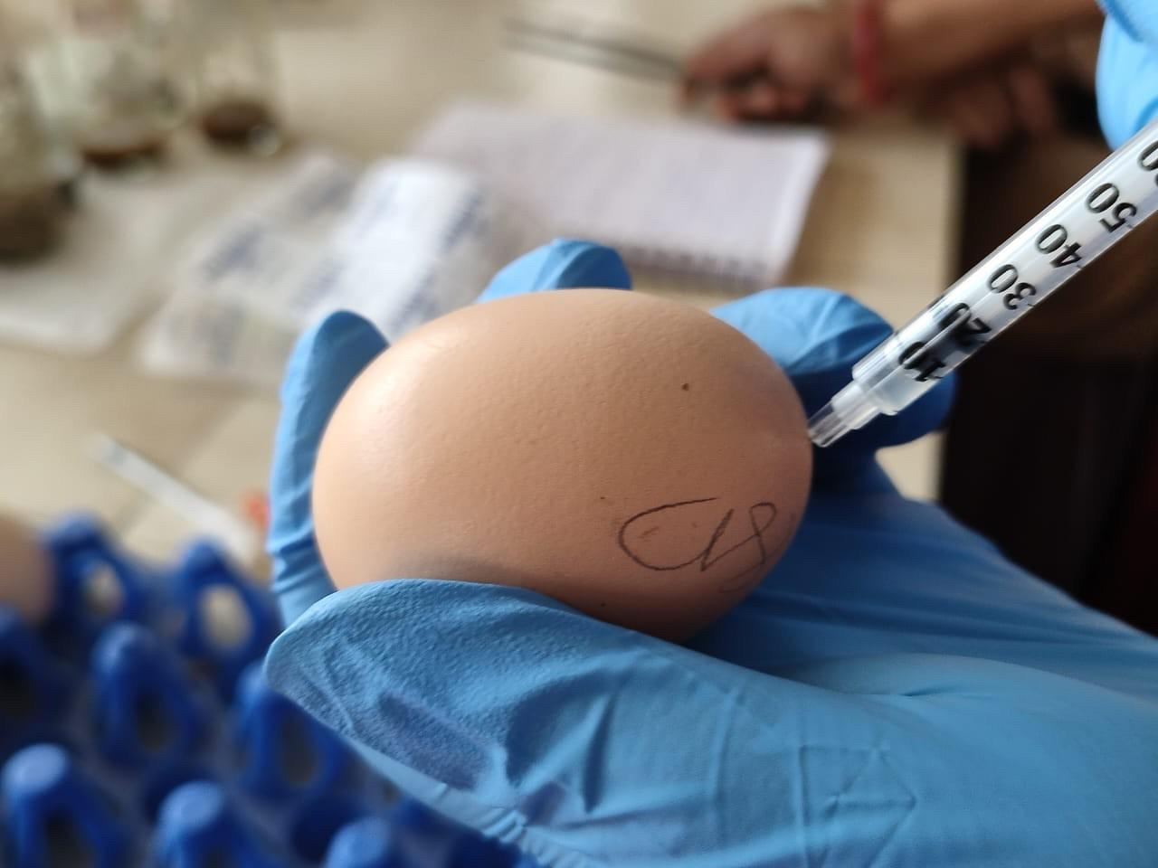
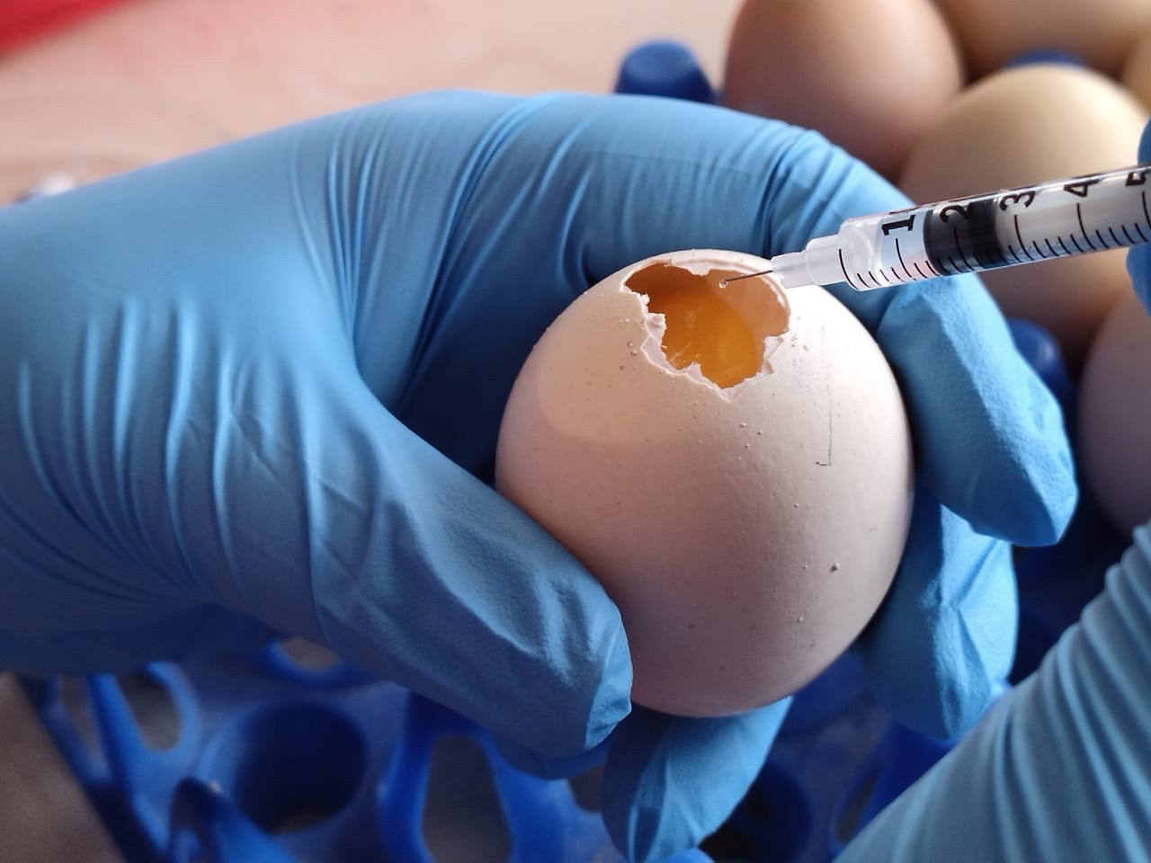
Methodology
Candling
Injection
02
03
04
05
Windowing
Incubation
Embryo retrival
01
06
Microscopic observation
Egg preparation
09
08
07
Staining

Slide 7
Results
Group | Treatment |  |  | Results
1 | Control |  |  | Normal development, no defects
 | Teratogen | Heavy Metal | Supplements
2 | serotonin 10 µL | - | - | Neural tube gap
3 | - | cadmium chloride 10 µL | - | Neural tube closure failure
4 | serotonin 10 µL | cadmium chloride 10 µL | - | Embryo did not survive
5 | serotonin 10 µL | cadmium chloride 10 µL | Folic acid 50 µL | partial rescue, minor defects
6 | serotonin 25 µL | - | - | Intra-bud formation, disrupted vasculature
7 | serotonin 25 µL | cadmium chloride 10 µL | - | Detachment between brain and notochord
8 | serotonin 25 µL | cadmium chloride 10 µL | Folic acid 50 µL | Notochord preserved, mesodermal development inadequate
9 | serotonin 50 µL | - | - | No development, rotten egg
10 | serotonin 50 µL | cadmium chloride 10 µL | - | No development, rotten egg
11 | serotonin 50 µL | cadmium chloride 10 µL | Folic acid 50 µL | No development, folic acid inefficient at high dose
12 | serotonin 10 µL | cadmium chloride 10 µL | Inositol 100 µL | No development
13 | serotonin 25 µL | cadmium chloride 10 µL | Inositol 100 µL | No development
14 | serotonin 50 µL | cadmium chloride 10 µL | Inositol 100 µL | No development

Slide 8
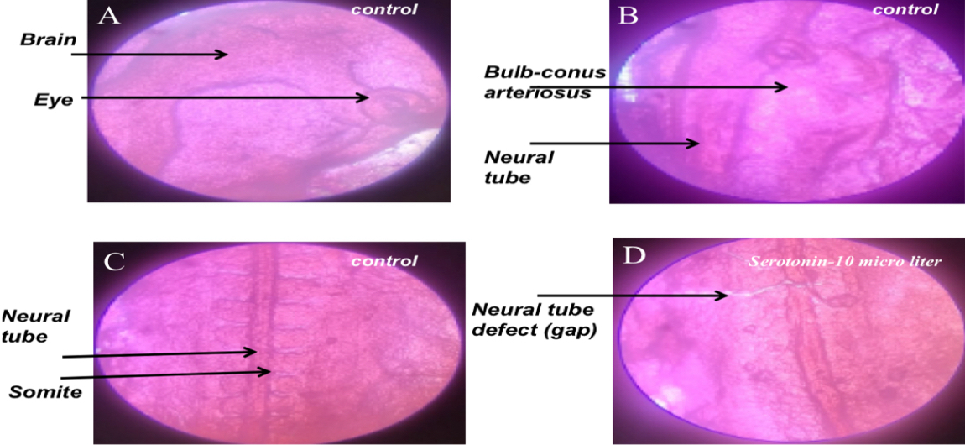

Slide 9
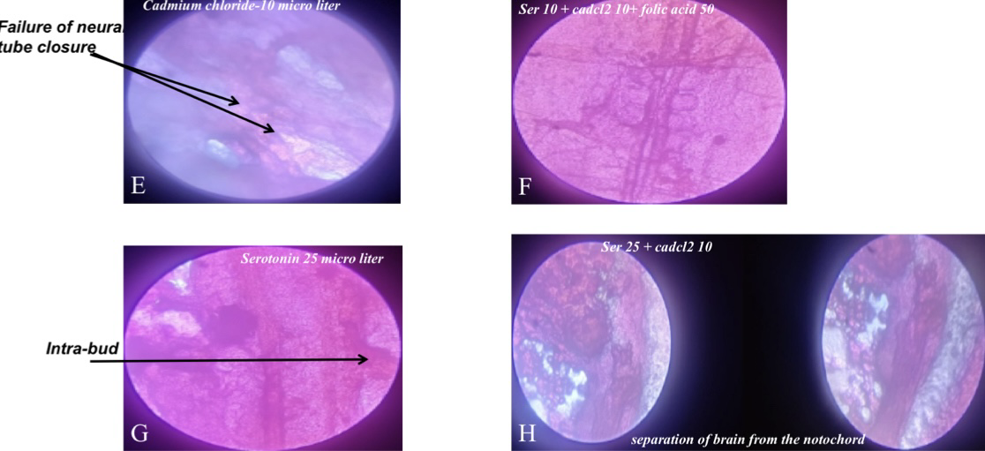

Slide 10
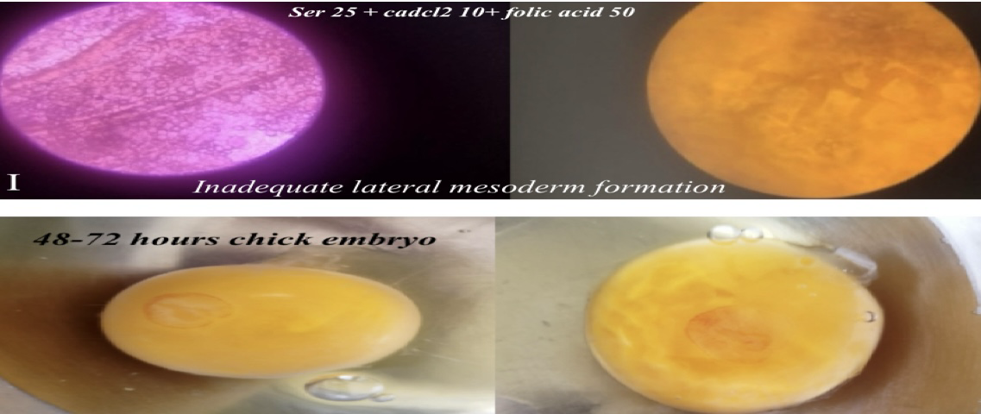
Fig 3.1: Morphological changes in chick embryos (48–72 h incubation) after serotonin, cadmium chloride, and folic acid treatment. Control embryos (A–C) developed normally with normally formed brain, eye, and intact neural tube, and with well-segmented somites and bulb-conus arteriosus visible. (D) Serotonin treatment (10 μL), and not (A–C), produced a focal disruption in the neural tube, which signifies failure of closure at this location. (E) Cadmium chloride (10 μL) produced gross neurulation abnormalities, including failure of neural tube closure. (F) Folic acid treatment (50 μL) with a combination of serotonin (10 μL) and cadmium chloride (10 μL) partially restored the midline continuity, indicating folic acid's protective role against toxin-induced malformation. (G) Increased concentration of serotonin (25 μL) perturbed axial organization, resulting in abnormally developed intra-bud. (H) Simultaneous treatment with high-dose serotonin (25 μL) and cadmium chloride (10 μL) caused over-separation of brain from notochord, which is a sign of general disruption in neural and axial patterning. (I) Supplementing the serotonin (25 μL) + cadmium chloride (10 μL) treatment with folic acid (50 μL) resulted in better neural alignment and fewer gross malformations.

Slide 11
Conclusion
This study demonstrates that serotonin and cadmium chloride significantly disrupt neural tube closure in chick embryos, with dose-dependent increases in abnormalities and embryonic mortality. Even low cadmium exposure was sufficient to cause developmental interference. While folic acid provided partial protection, it was less effective at higher teratogenic doses, and inositol showed no clear neuroprotective role. These findings underline the vulnerability of early pregnancy to toxic exposures, emphasize the importance of maternal nutrition and pharmaceutical safety, and point to the need for further research on co-therapies, dose thresholds, and neuroprotective mechanisms.

Slide 12

GARDENCITY
UNIVERSITY
EãdPHABIB ON MŒ

