Slide 1
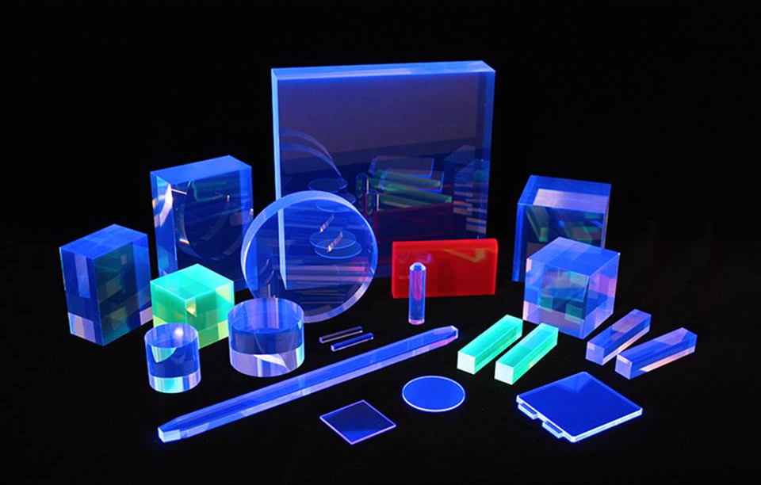
SCINTILLATORS
Franco Camera
Università di Milano
Dipartimento di Fisica
BOLOGNA Summer School: Physical Sensing and Processing 17-21 July 2023

Slide 2

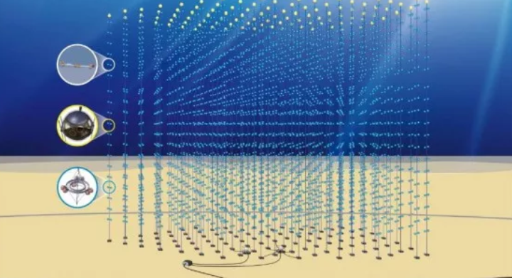
Ionizing
Radiation
Scintillatore
‘BIP’
Signal
Not visible to the human eye
Sensor
Basically, a scintillator is a sensor of ionizing radiation
There are several scintillator materials, some of them have particularly ‘good’ properties, and,
therefore, they are used in specific applications but in general:
Water is a scintilllator --------------------------------------- ‘Km3’
Earth Atmosphere is a scintillator ------------------------ Northern Lights
------------------------ ‘Auger’

Slide 3
The way to use and the performances of a scintillation detector depends on the information it is expected to provide:
Some examples:
- Deposited Energy
Particle identification (gamma, proton, neutron, alpha, … )
Angular distribution of the radiation (for example beta+ decay)
Time information - Coincidences
Radiation monitor or trigger:
Some applications:
Oil research (temperature dependence of the scintillation light,…)
Medical physics (PET, TAC, Medical Imaging, …)
Energy (radioactive waste)
Explosive search and mine removal

Slide 4
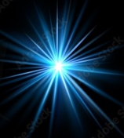
Working principle of a scintillator
Scintillator
Emitter
(ionizing radiation)
Applications
Visible Lights => Electric Signal
Gamma ray
Data
Electric
Signal
PMT or SiPM or APD or ….

Slide 5
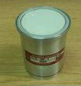
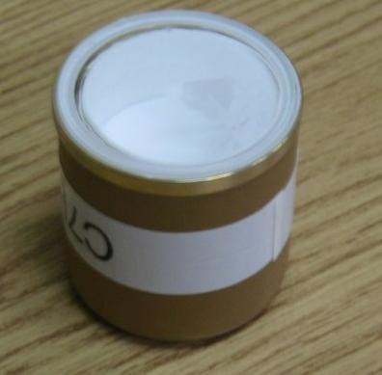
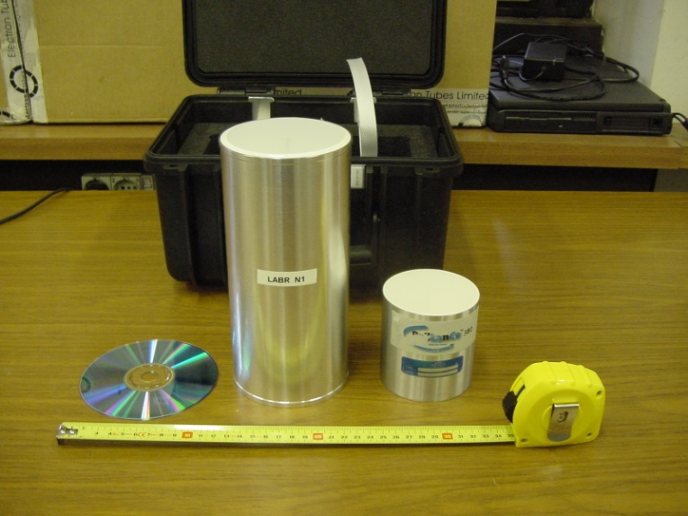
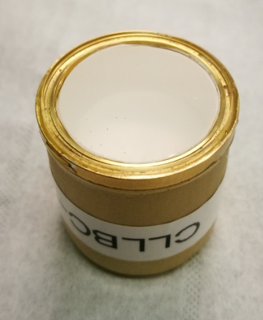
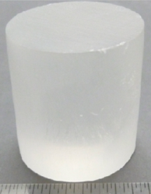
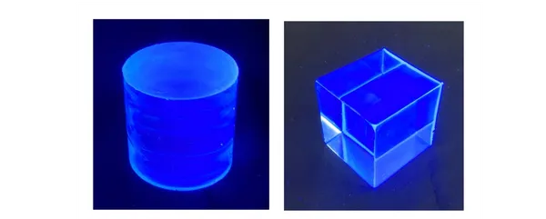
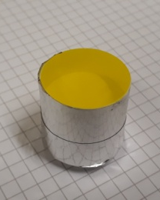
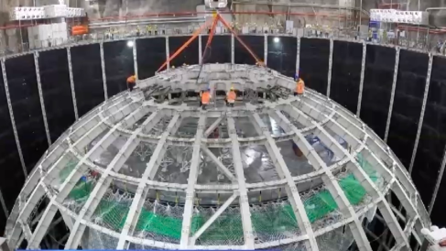
Some general rules:
- The scintillator MUST be transparent to its scintillation light
- Otherwise the scintillator MUST be small in volume.
- Otherwise the response of the scintillator will depend on the
position of interaction of the radiation.
Organic scintillators
Inorganic scintillators
        - Doping technique
CeBr₃
CLYC
20 cm
8 cm
CLLBC
TLYC
1 cm
zero
Organic Glass Scintillator
It is important to remind that scintillators produce light whether or not they are used as detectors. In other words to produce scintillation light no particular process, treatment or applied power is needed.
Liquid Scintillator

Slide 6
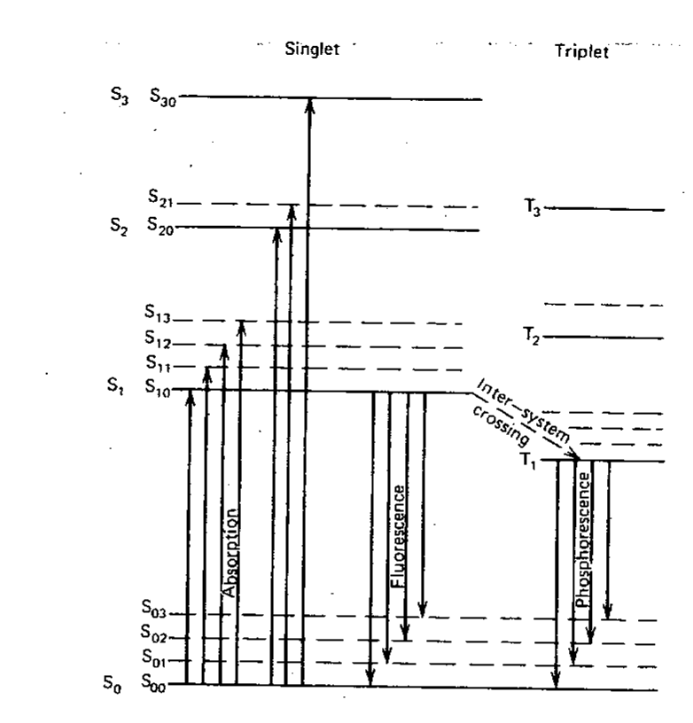
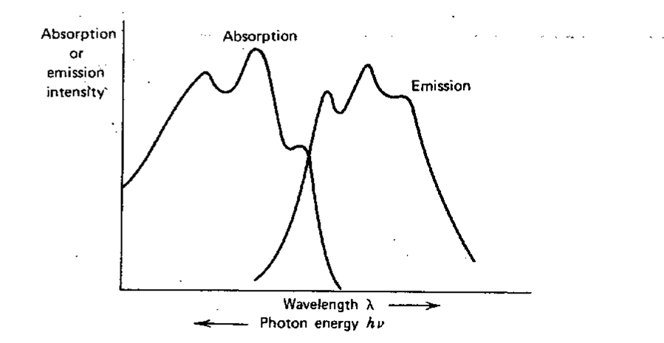
Organic Scintillators
Ground state
=> Roto-Vibrational states (~ 0.15 eV)
π electronics structures (~ 3-4 eV)
Glenn Knoll Radiation detector and measurements John Wiley & sons

Slide 7
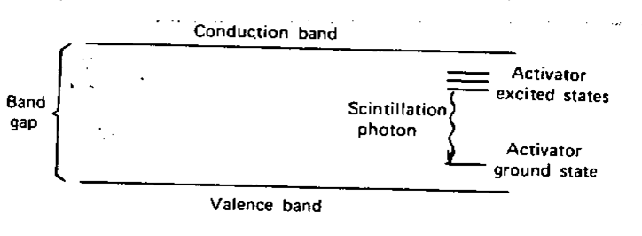
Inorganic Scintillators
A dopant (activator) is added.
This dopant creates energy states between the valence and conduction bands. These states create a privileged decay path for the electron-hole pair.
LaBr3 has Ce
NaI has Tl
…………………..
A ionizing particle deposits some energy in the crystal. A ionizing particle creates, therefore, particle-hole excitations. Particles and holes move in the crystal band up to the moment they ‘hit’ an activator site. They de-excite emitting scintillation light which cannot be absorbed as the energy is smaller than the band-gap.
Obviously, this process is slower than that of organic scintillators.
Obviously, it is not necessary to have the same p-h created before to produce scintillation light.
Glenn Knoll Radiation detector and measurements John Wiley & sons

Slide 8

Things are much more complicated than that
CVL emission is in general much faster that STE one
STE => self-trapped excitons
CVL => Core to Valence Luminescence
In general, in BaF₂ scintillator the CVL emission is present in 15% of the events.
V.Khanin et al., Optical Matherials 136(2023)113399

Slide 9
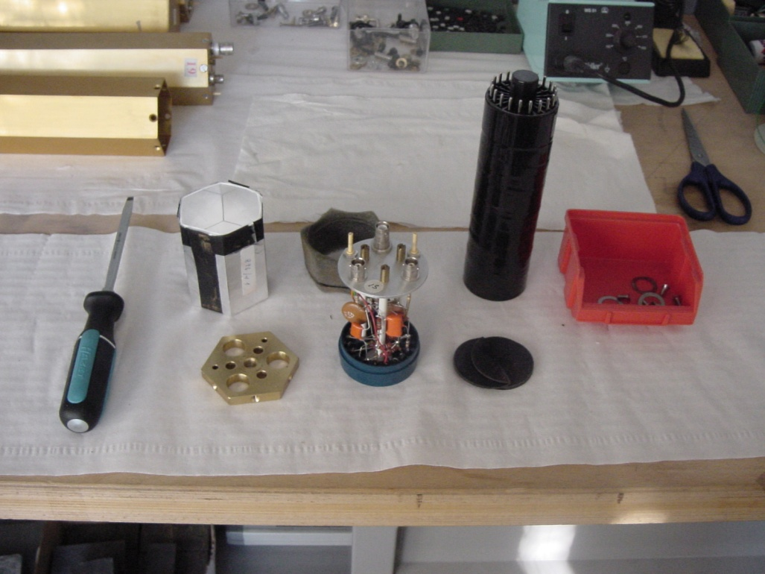
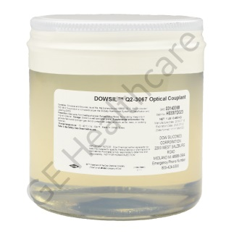





Scintillation Assembly
- The procedure to follow depends strongly on use of the detector.
It is absolutely needed:
To seal the scintillator+light sensor in some light tight housing.
To power the PMT, the SiPM, or the light sensor.
To collect the signal produced by the light sensor.
The light reflector and the optical grease can be very useful but they are not compulsory. The light reflector increases the number of detected scintillation photons but ‘remove’ most of the position sensitivity.
The optical grease avoid the reflection of most of the scintillation photons but aging effects are enhanced (some kind of maintenance should be made regularly). In addition a non uniform thickness can induce a non uniform response of the light sensor and the detector response might depend on the detector position (vertical, horizontal, …).
No optical grease
Air
Crystal
Air
Glass
With optical grease
Crystal
Optical Grease
Optical Grease
Glass

Slide 10
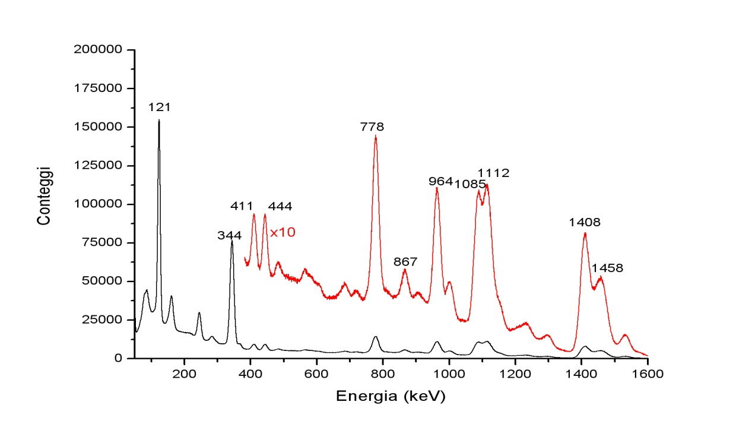
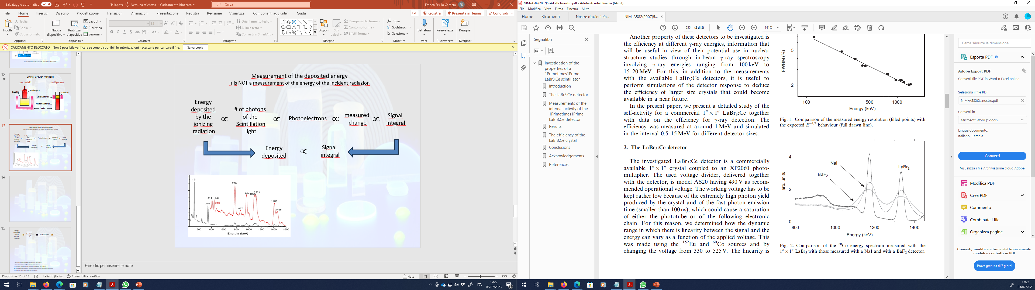
Energy Spectrum
on the x axis there is the amplitude of the electric signal
on the y axis there is the number of times than that amplitude is measured.
Energy spectrum
The signal amplitude (using the calibration procedure) is substituted with the energy of the incident radiation. In the shown energy plot a peak is associated to the energy of the incident gamma radiation.
R.Nicolini et al. Nucl. Instr. and Meth. A 582(2007)554
Energy
deposited
by the
ionizing
radiation
# of photons
of the
Scintillation
light
∝
∝
Photoelectrons
∝
measured
change
∝
Signal
integral
Energy
deposited
∝
Signal
integral

Slide 11
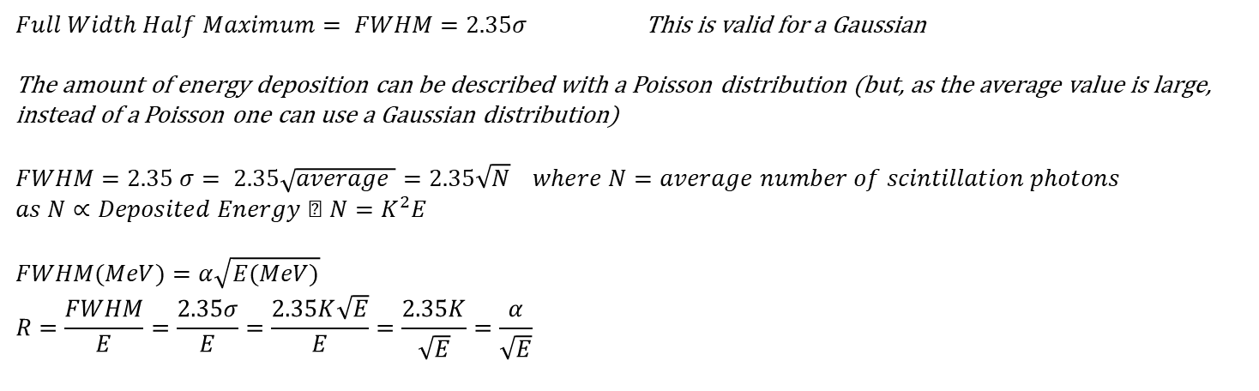
Full Energy Peak
σ
Compton Edge
$Full Width Half Maximum= FWHM=2.35σ$ This is valid for a Gaussian
The amount of energy deposition can be described with a Poisson distribution (but, as the average value is large, instead of a Poisson one can use a Gaussian distribution)
$$FWHM=2.35 σ= 2.35\sqrt{average }=2.35\sqrt{N} where N=average number of scintillation photons \\ as N∝Deposited Energy ⇒ N=K^{2}E$$
$$FWHM(MeV)=α\sqrt{E(MeV)} \\ R=\frac{FWHM}{E}=\frac{2.35σ}{E}=\frac{2.35K\sqrt{E}}{E}=\frac{2.35K}{\sqrt{E}}=\frac{α}{\sqrt{E}}$$
R.Nicolini et al. Nucl. Instr. and Meth. A 582(2007)554

Slide 12
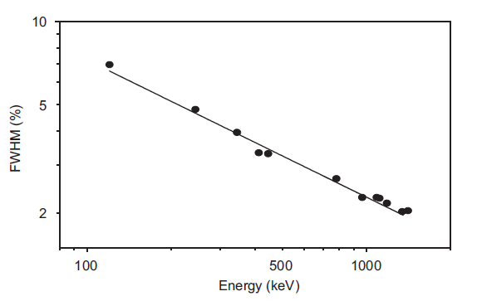
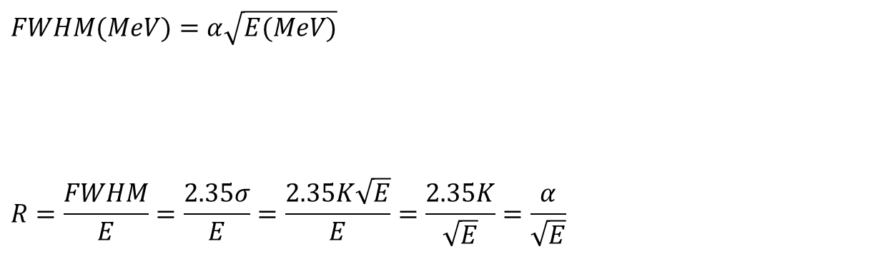
$$FWHM(MeV)=α\sqrt{E(MeV)}$$
$$R=\frac{FWHM}{E}=\frac{2.35σ}{E}=\frac{2.35K\sqrt{E}}{E}=\frac{2.35K}{\sqrt{E}}=\frac{α}{\sqrt{E}}$$
The FWHM increases with the energy of the gamma transition
The ratio FWHM/E (it is an adimensional number, expressed in percentage) decreases with the energy of the gamma transition
R.Nicolini et al. Nucl. Instr. and Meth. A 582(2007)554

Slide 13
The energy resolution of a scintillator should be related to the light yield
BGO ≈ 8,200 photons/MeV
LSO ≈ 28,000 photons/MeV
NaI:Tl ≈ 38,000 photons/MeV
LaCl₃:Ce ≈ 50,000 photons/MeV
CsI:Tl ≈ 60,000 photons/MeV
LaBr₃:Ce ≈ 63,000 photons/MeV
LSO scintillator produces almost 4 times more photons than BGO but the energy resolution is the same
662 keV peak
BGO
LSO
Resolution is affected by the light yield but not only
  resolution is correlated with linearity.
    Linearity is correlated to mobility.
High Hole Mobility ➔ Linear Scintillator

Slide 14
From P. Dorenbos, “Light output and energy resolution of Ce³⁺ doped scintillators,” Nucl Instr Meth, A486, pp. 208-213, 2002.

Slide 15
The Ideal Scintillator relative light output should be 1
W. Mengesha, T. Taulbee, B. Rooney and J. Valentine, IEEE Trans. Nucl. Sci. NS-45, pp. 456-461, 1998.
Linearity is a very important parameter which may influence the energy resolution of a scintillator detector even in the case of high energy gamma rays (E > 10 MeV)

Slide 16
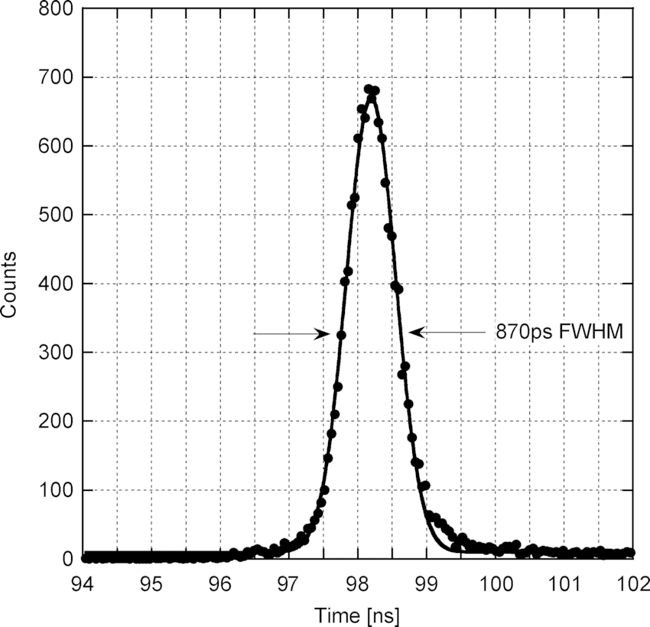
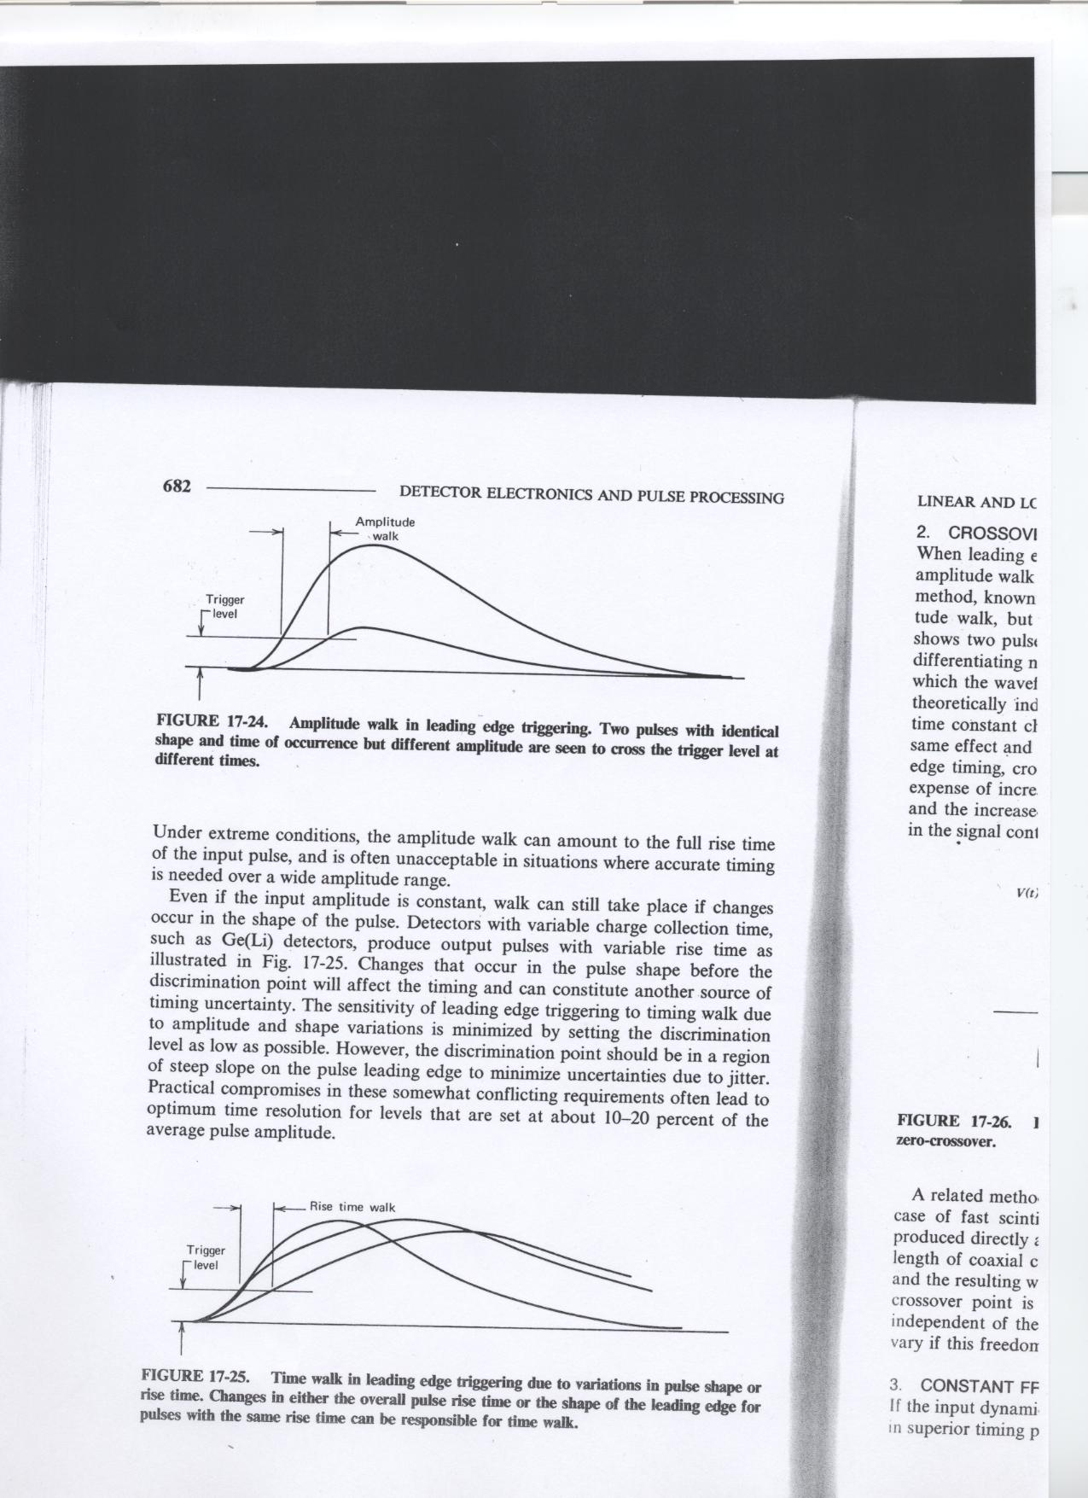

Time Spectrum
on the x axis there is the time difference between two signals
on the y axis there is the number of times that time difference is measured.
Time spectrum
One need a ‘start’ and a ‘stop’ signal.
A peak in the time spectrum clearly shows a fixed time difference between the events. A flat spectrum is related to random coincidences events.
In a very similar way one can produce a
PID spectrum (Particle Identification)
  e.d gamma, p, n, d, t, α, β, …
Angular spectrum.
Dose spectrum.
….
Problem: how to define when something interacted in a detector (scintillator detector)
Amplitude time walk
Time jitter
The Amplitude time walk and the Time Jitter effects are reduced by the Constant Fraction Discriminator algorithm
Using a scintillator detector the time information is of the order of few nanoseconds.

Slide 17
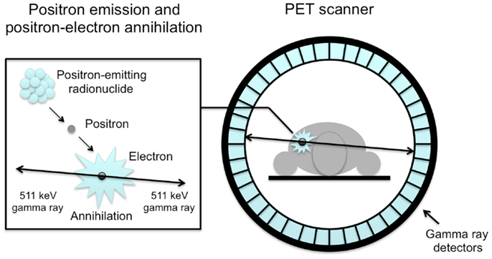
An improvement of the time resolution of a scintillator detector will permit the increase of the resolution of a time of flight PET scanner.
d
DET 1
DET 2
d₁
d₂
d=d₁+d₂ c = costant ΔT=T₂ -T₁= d₂/c-d₁/c = (d₂-d₁)/c
d₂+d₁ =d d₂=0.5*(d + c ΔT) => σ_{d2} ∝ σ_{ΔΤ}
d₂ - d₁ = c ΔT d₁=0.5*(d - c ΔT) => σ_{d1} ∝ σ_{ΔΤ}
If σ_{ΔΤ} ≈ 100 ps => σ_{PET} ≈ mm
If σ_{ΔΤ} ≈ 10 ps => σ_{PET} ≈ 0.1 mm

Slide 18
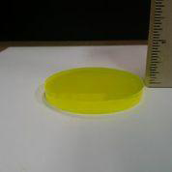
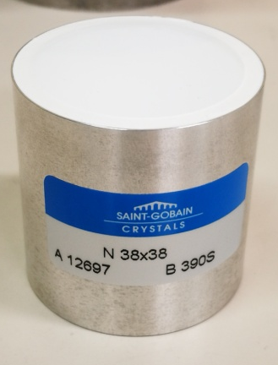
Some Inorganic Scintillators
This lists is not exausitive
GYGAGG
CeBr₃
CLYC
CLLBC
LaBr3
Co-Doped
LaBr3
GAGG
TLYC

Slide 19
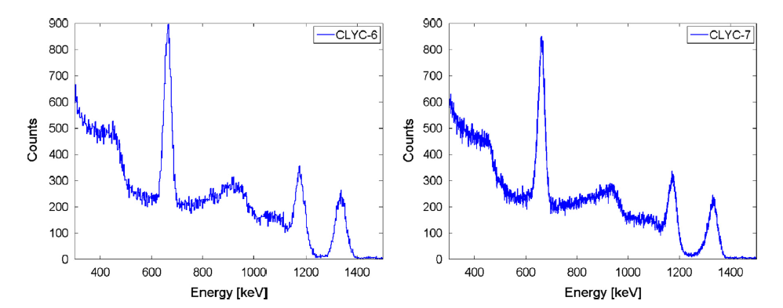
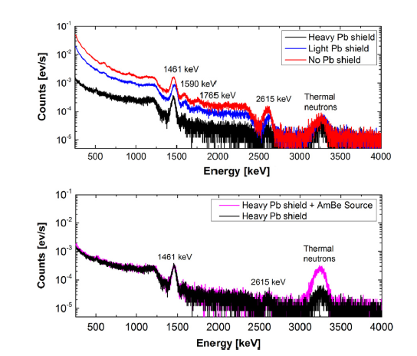
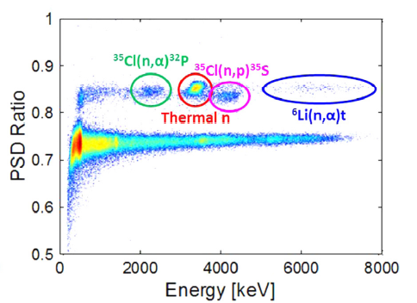
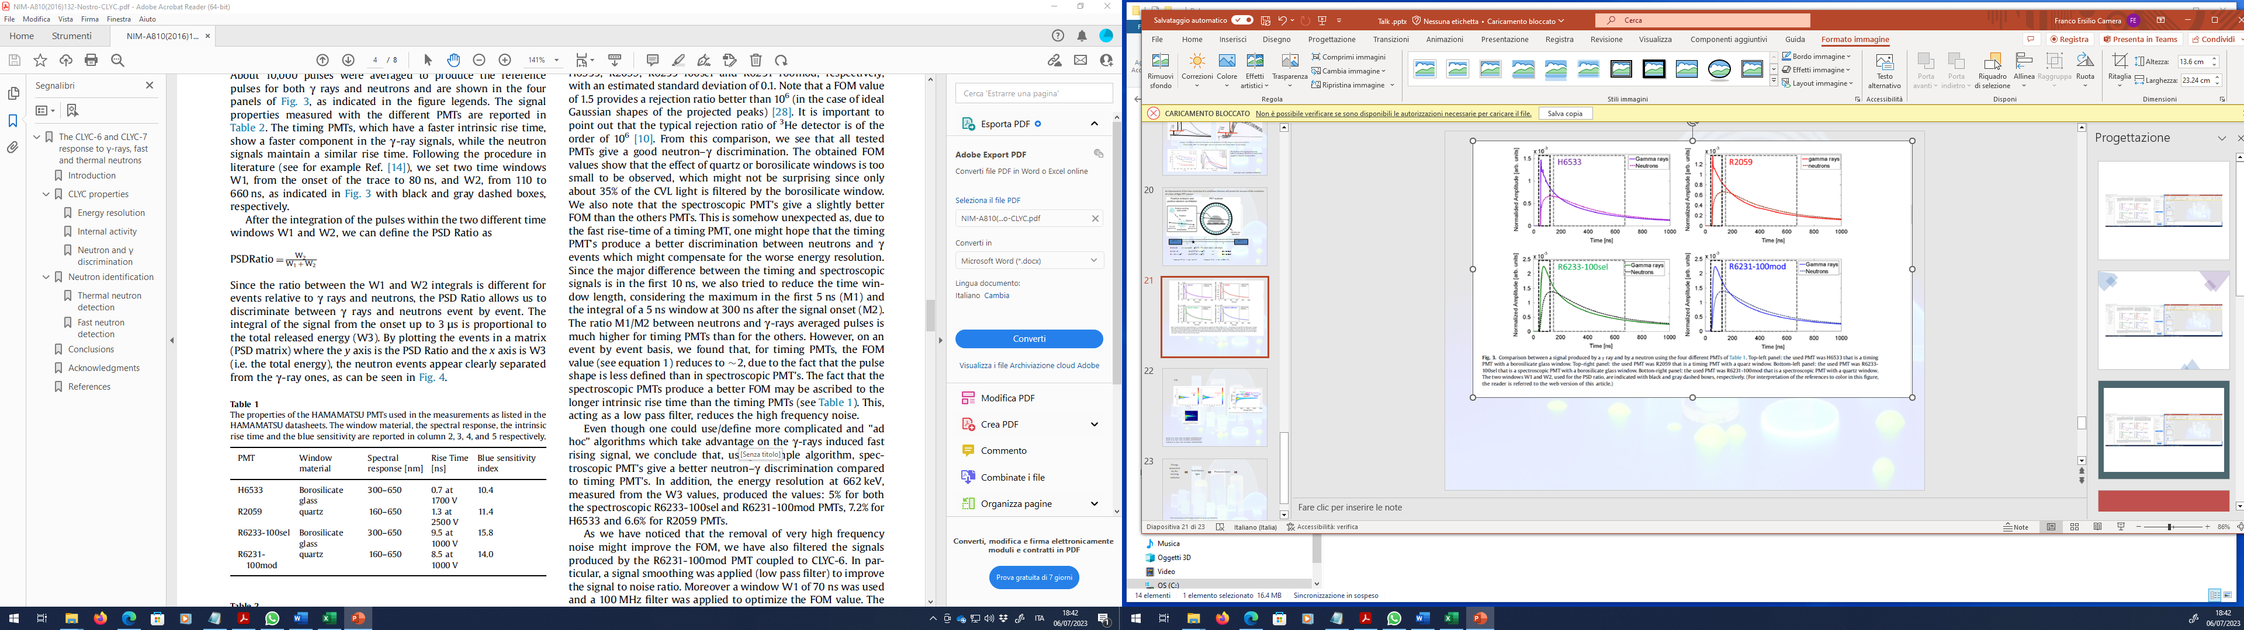
CLYC Performance (Cs₂LiYCl₆)
W = integral of a signal in a specific window
A.Giaz et al., Nucl. Instr. and Meth. A 810(2016)132

Slide 20
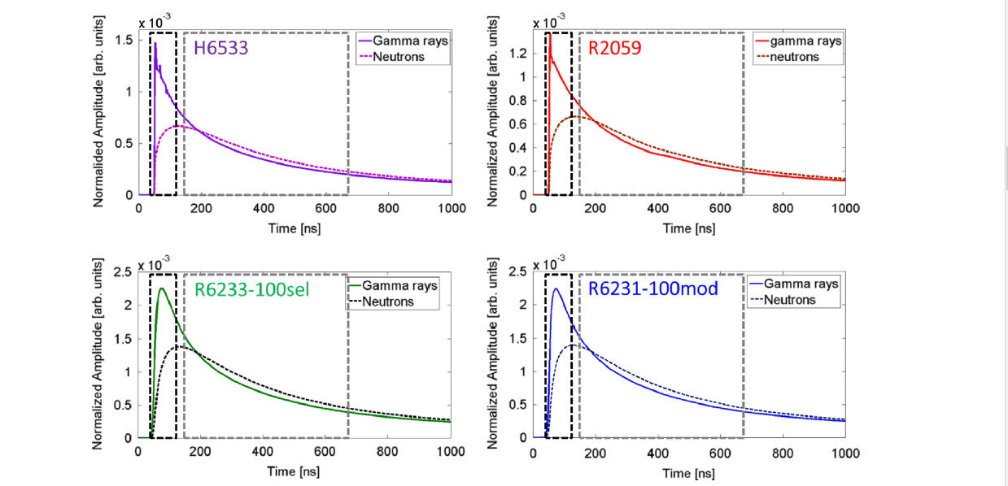
CLYC Signal
W = integral of a signal in a specific window
A.Giaz et al., Nucl. Instr. and Meth. A 810(2016)132

Slide 21
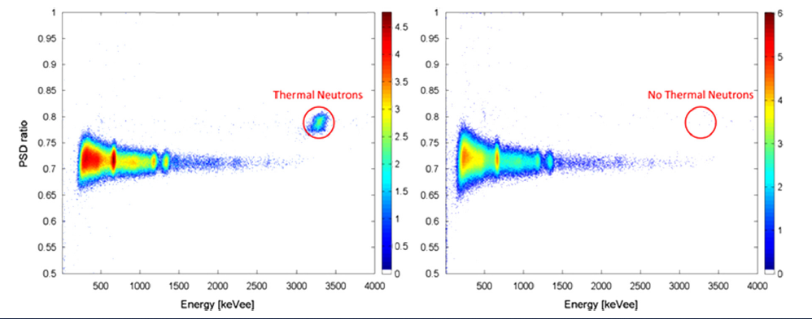
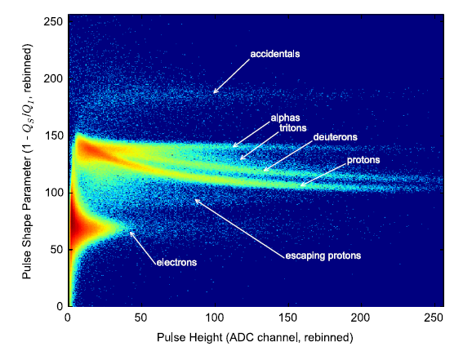
CLYC6
CLYC7
CLLB, CLLBC, TLYC are expected to behave
in a very similar way.
A.Giaz et al., Nucl. Instr. and Meth. A 810(2016)132
A.Giaz et al., Nucl. Instr. and Meth. A 825(2016)51
R.Woolf et al., Nucl. Instr. and Meth. A 825(2015)47

Slide 22
Conclusions
Scintillators produce light indipendently from the fact they are used as detectors.
Scintillators requires a light sensor, a light tight housing and some power.
Scintillators detect ionizing radiation.
In general, a scintillator detector can be cheap and could not need frequent maitenance.
Depending on the information scintillators are expected to provide they can be very small (mm³) or very large (dm³). Scintillators can provide information on:
  The deposited Energy of the incident particles
  The nature of the incident particles (gamma, proton, neutron, alpha, … )
  The angular distribution, the direction, the position of the incident particles
  Time information of the incident particles. They can apply very strict Time Coincidences
Scintillators are frequently used in applications, for example:
  Oil research (temperature dependence of the scintillation light, … )
  Medical physics (PET, TAC, Medical Imaging, …)
  Energy (radioactive waste)
  Explosive search and mine removal

