Slide 1
SUMMER SCHOOL
PHYSICAL SENSING AND PROCESSING
X-ray Tomographic Systems for Cultural Heritage
Maria Pia Morigi
Department of Physics and Astronomy «Augusto Righi» (DIFA)
University of Bologna
Bologna, July 19, 2023

Slide 2
Science & Cultural Heritage
Application of scientific methods and technologies to Cultural Heritage study
WHAT material is it made of?
HOW can we preserve it for future generations?
WHEN was it made?
HOW was it made?
WHERE was it made?

Slide 3

X-ray Computed Tomography
X-ray Computed Tomography (CT) is a powerful non-destructive diagnostic technique, able to give morphological and physical information on the inner structure of the object studied, overcoming an important limit of radiography: the superimposition of elements belonging to different layers of the object.
“Tomography” comes from the Greek word “tómos”, that means “section”. In fact this kind of non-destructive analysis is used to “virtually” cut an object and see inside it.

Slide 4
Attenuation of monochromatic X-ray photons
Beer-Lambert’s law for homogeneous material and monochromatic photons:
I(x) = I₀e^{-μx}
where:
I is the number of photons reaching the detector in presence of the test material
I₀ is the number of photons that would be detected without the test material
μ is the linear attenuation coefficient for a homogeneous material
x is the thickness of the test material.

Slide 5
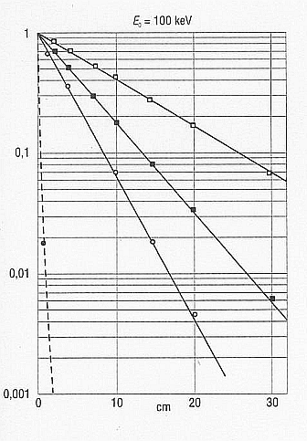
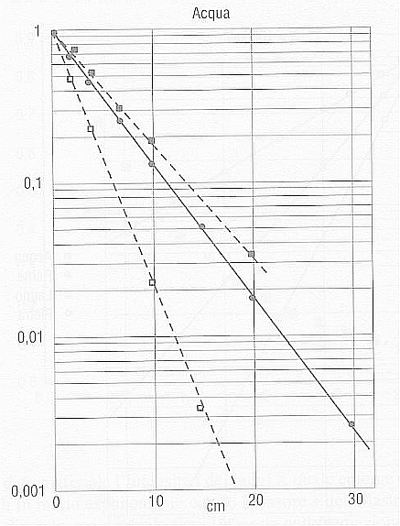
Attenuation of monochromatic X-ray photons
E=100 keV
water
μ depends on:
100 keV
the atomic number of the material
wood
60 keV
the density of the material
water
the energy of the X-ray beam
30 keV
stone
copper
Attenuation in water of monochromatic X-rays for different X-ray energies.
X-ray attenuation (I/I₀) in different materials.

Slide 6
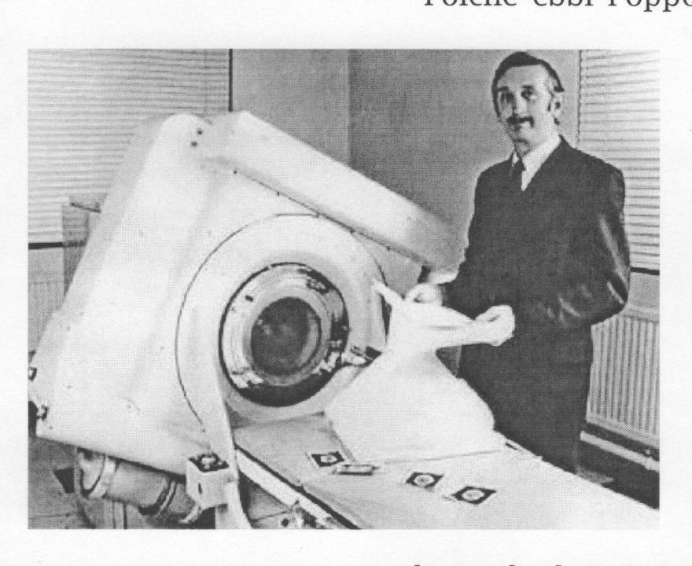
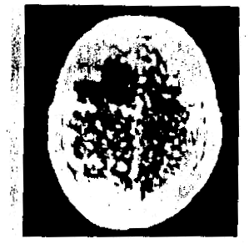
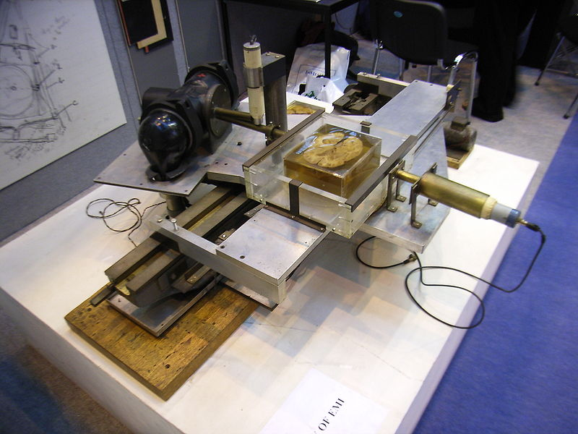
The first CT scanner (1971)
The first CT scanner for clinical use ("EMI Mark I scanner") was developed by the British engineer Godfrey Hounsfield in the research laboratories of EMI (United Kingdom) and installed in 1971 at Atkinsons Morley's Hospital in Wimbledon (London).
.
In 1979 Hounsfield shared the Nobel Prize for Medicine with the physicist Allan Cormack.

Slide 7
Tomographic slices
A tomographic slice is the image of a cross-section of the object under investigation, in which the grey-levels are proportional to the values of the linear attenuation coefficient in that section of the object.

Slide 8
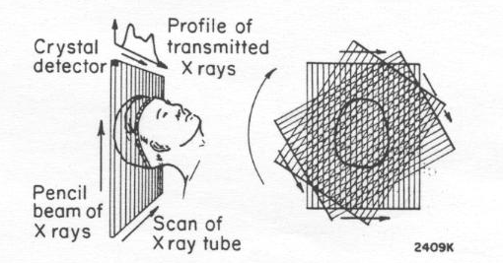
The measurement process (first generation CT scannes)
Principle of the first CT scanner, developed by Hounsfield and designed to study the human brain.
An X-ray tube emitting a pencil-like beam is coupled to a single radiation detector. The two are moved together on a carriage, so that a plane in the head is scanned by a series of parallel rays as the translation takes place. For each ray the fraction of the radiation transmitted is measured and stored in a computer.

Slide 9
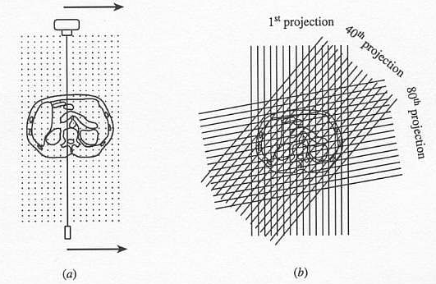
The measurement process
The pencil beam of X-rays is translated across the patient to acquire a projection, that is made up of a large number of pencil-beam attenuation measurements.
The X-ray source and the detector are rotated around the patient and a large number of projections are acquired, each one at a different angle.

Slide 10
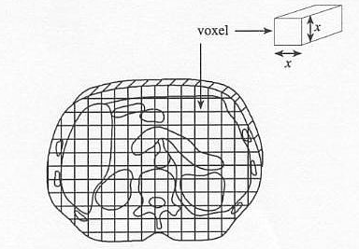
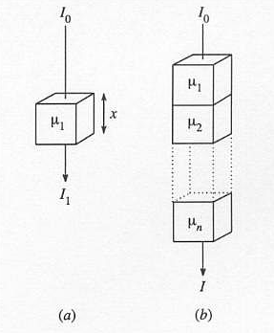
The measurement process
Assuming that the X-ray beam is monoenergetic and has an incident intensity I₀, then the intensity I₁ of the beam transmitted through a small volume of tissue having thickness x and attenuation coefficient μ₁ is:
In traversing from one side of the patient to the other, the X-ray beam will be attenuated by all the voxels through which it passes. The emerging X-ray beam will have an intensity I given by:

Slide 11
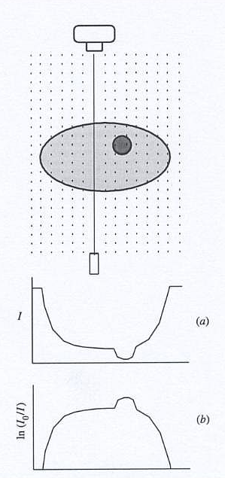
The measurement process
The figure shows the measured X-ray intensities and the corresponding logarithms of the intensity ratios I₀/I for one projection.
Intensity profile
Attenuation profile

Slide 12
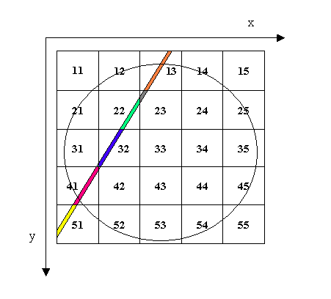
The measurement process
The image shows a cross-sectional view of the object under investigation superimposed upon a rectangular matrix of pixels, which for clarity of presentation has been made very coarse.
Let μ(x,y) be the average attenuation coefficient of the tissues in the pixel (x,y). The radiation transmitted It is related to the incident radiation I₀ by:
The elements of lenght l(x,y) are determined by the geometry of the system and hence can be calculated and stored in the computer.

Slide 13
The measurement process
Our problem is to determine the attenuation coefficient of the object under investigation in each picture element of the slice.
The reconstruction process creates an image that is a map of the X-ray attenuation coefficients of the object in the plane under examination.

Slide 14
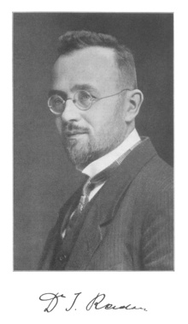
Image reconstruction
The method used on most of the CT scanners is the method of filtered back-projection. The mathematics of filtered back-projection dates back to 1917 with the work of the Austrian mathematician Radon, who theoretically solved the problem of obtaining a section of an object using an infinite set of rays passing through it.
However, as previously stated, it was not until the 1960s that two scientists, the engineer Geoffrey Hounsfield and the physicist Allan Cormack (separately) succeeded in obtaining the section of an object experimentally.

Slide 15
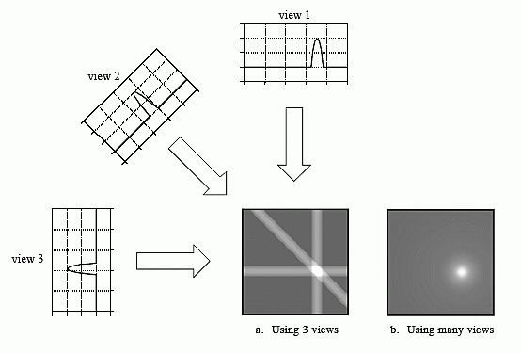
Image reconstruction: simple back-projection
Back-projection reconstructs an image by taking each view and smeraing it along the path it was originally acquired. The resulting image is a blurry version of the correct image.

Slide 16
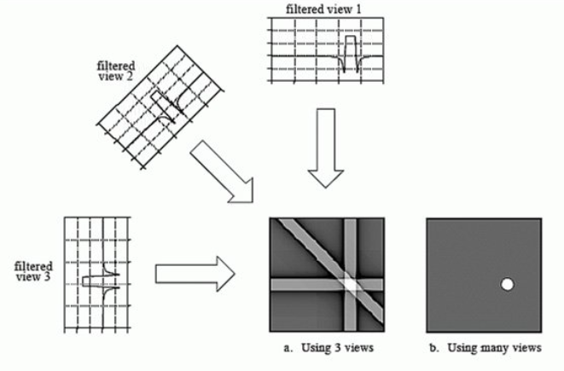
Image reconstruction: filtered back-projection
The image reconstruction process of the FBP algorithm. Each set of projection data, taken at different angles, undergoes convolution filtering before back-projection. This removes the blurring that would result from simple back-projection without filtering.

Slide 17
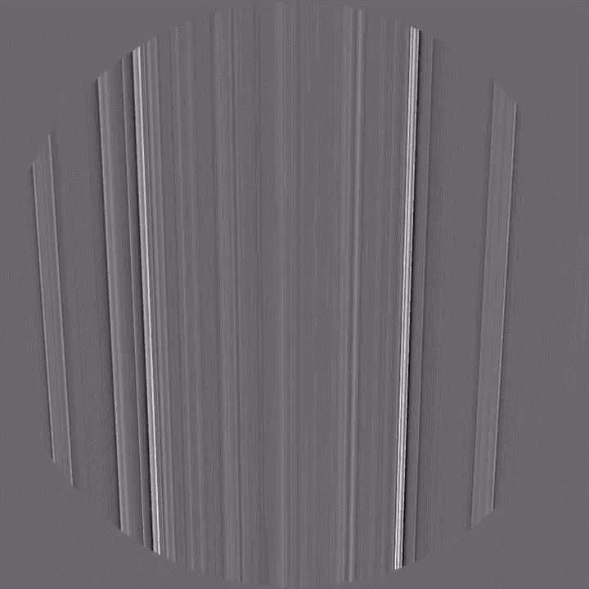
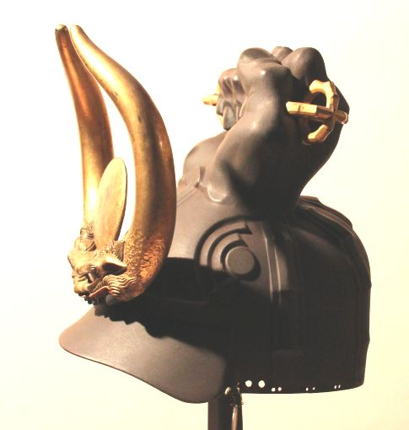
Filtered Back-Projection
Japanese helmet fromn the Stibbert Museum (Florence).

Slide 18
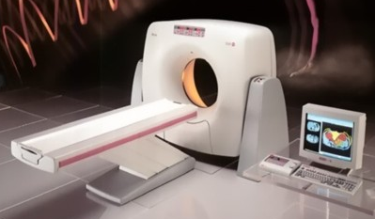
Components of a CT scanner
Computed Tomography implies
a radiation source
a detection system
mechanics
control software
5. reconstruction and rendering software

Slide 19
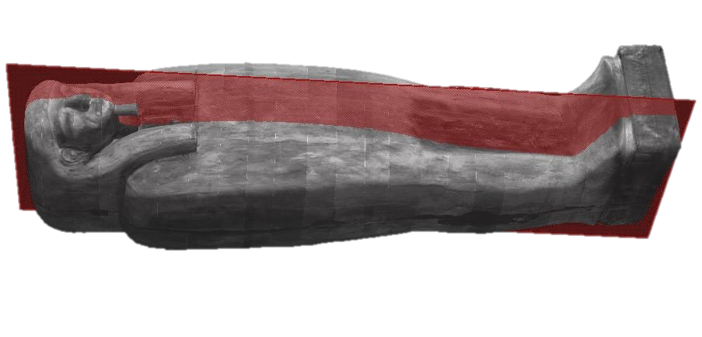

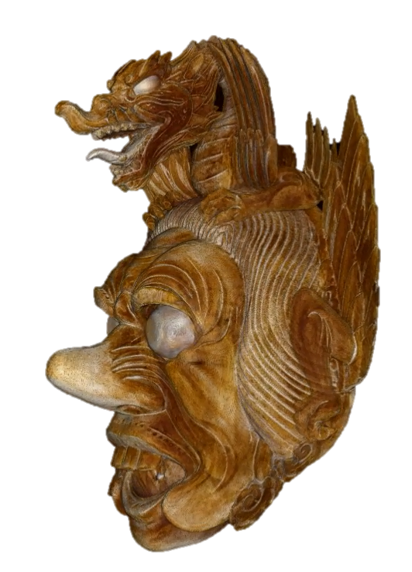
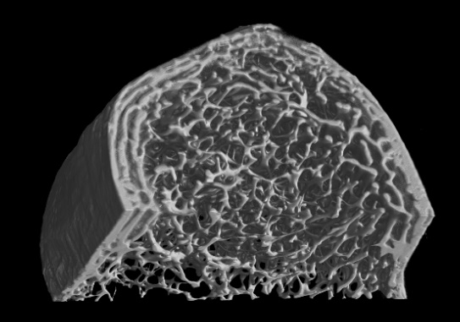
X-ray CT & Cultural Heritage
X-ray CT & Cultural Heritage
DIFFERENT SIZE
m
Increasing size
cm
mm

Slide 20
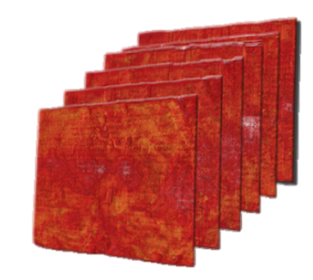
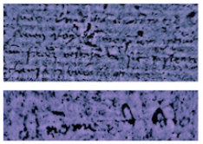

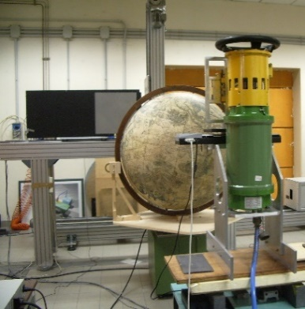
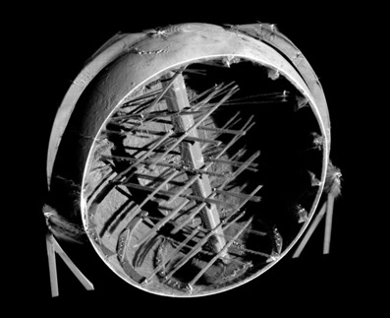
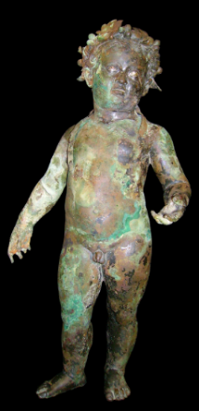
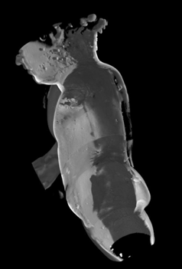
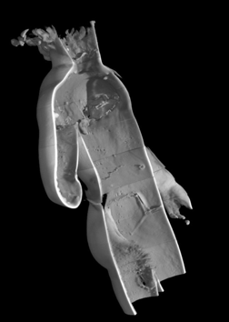
X-ray CT & Cultural Heritage
Paper
Low energy
Increasing energy
Wood
Medium energy
Stone
Metals
High energy

Slide 21
X-ray CT & Cultural Heritage
It is difficult to move the works of art from the place where they are kept.
Therefore it is important to develop equipment that is easy to move, specifically designed for Cultural Heritage analysis on-site.
In the recent past, our research group developed a number of acquisition systems for Digital Radiography and Computed Tomography. We have performed high resolution micro-CT of small objects (voxel size of few microns) and CT of large works of art (up to 2 m of size), using different kinds of X-ray sources and different setups, in order to meet the different needs of various case studies.

Slide 22
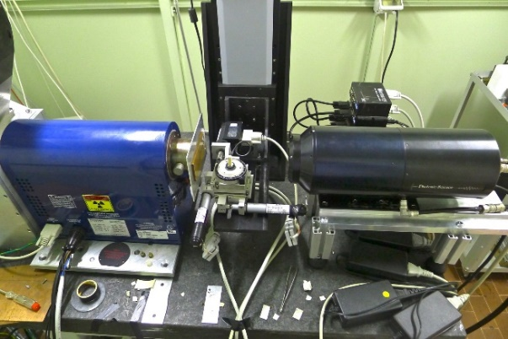
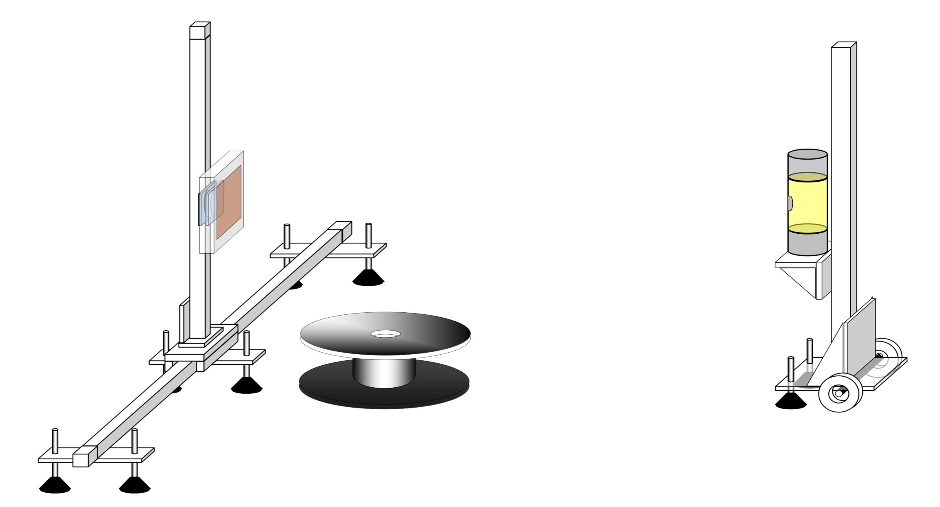
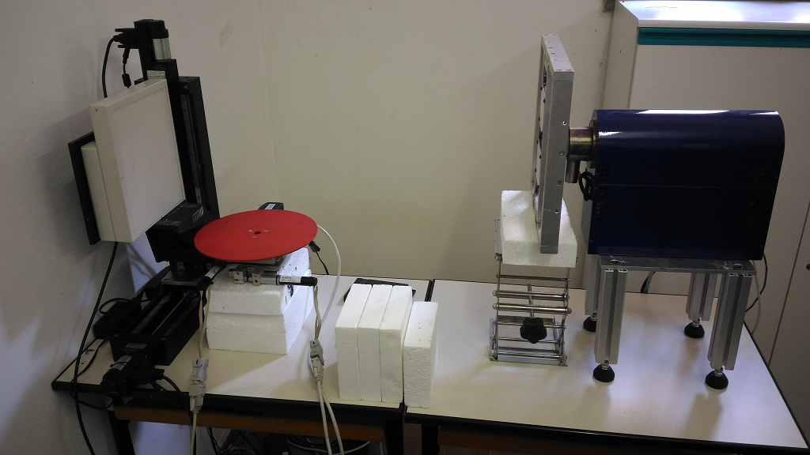
X-ray CT & Cultural Heritage
Micro-CT
CT system for medium-size objects
CT system for large-size objects

Slide 23
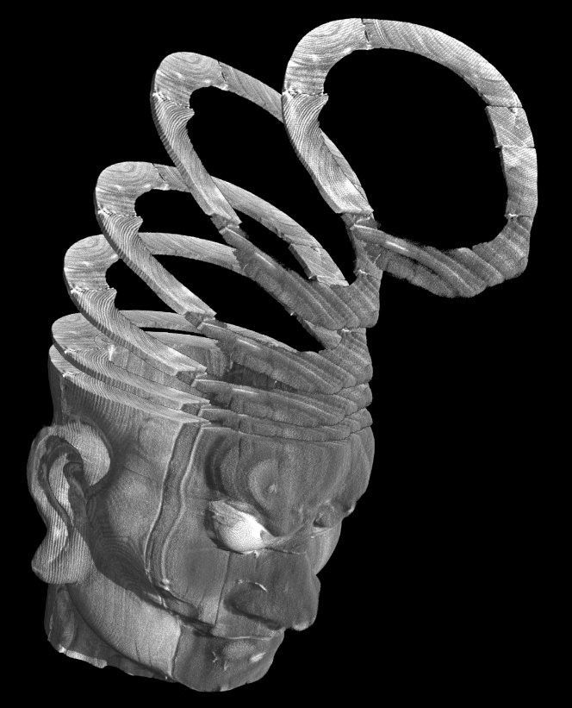
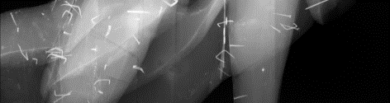
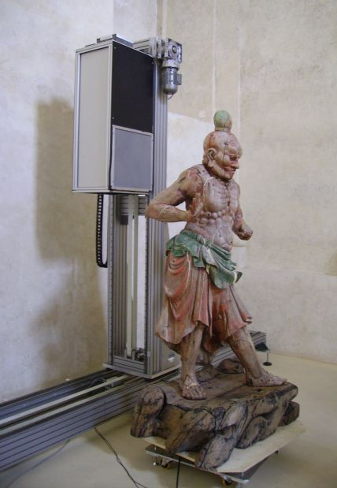
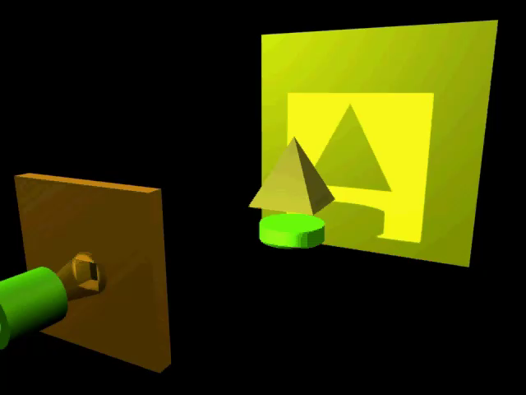
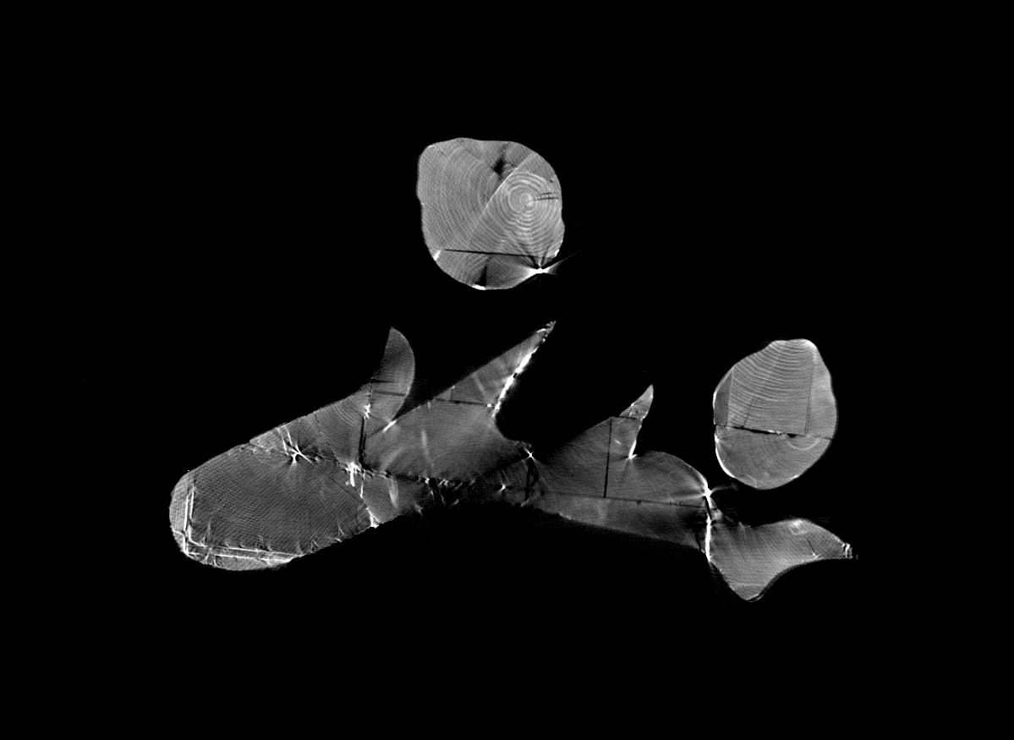
X-ray CT & Cultural Heritage
slice to
rendering 3D

Slide 24
Examples of case-studies
Micro-CT analysis of small samples

Slide 25

Micro-CT system

Slide 26
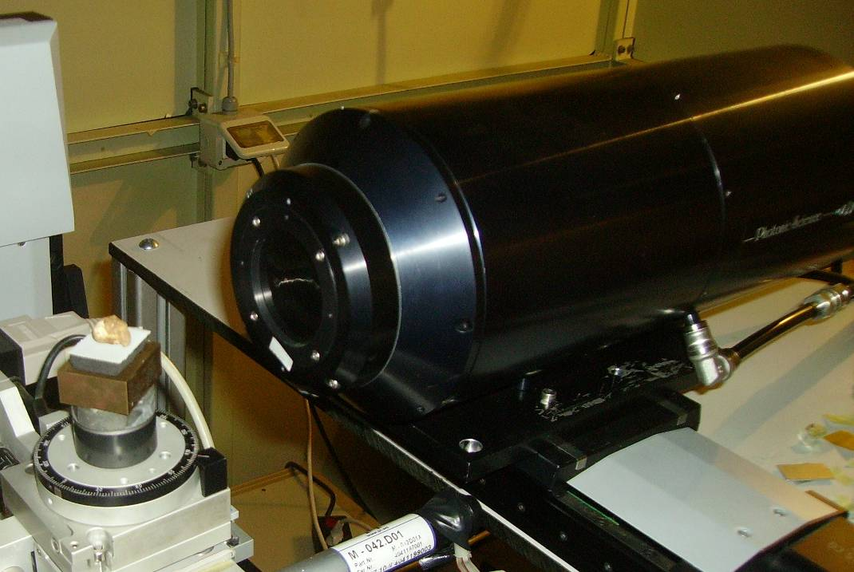
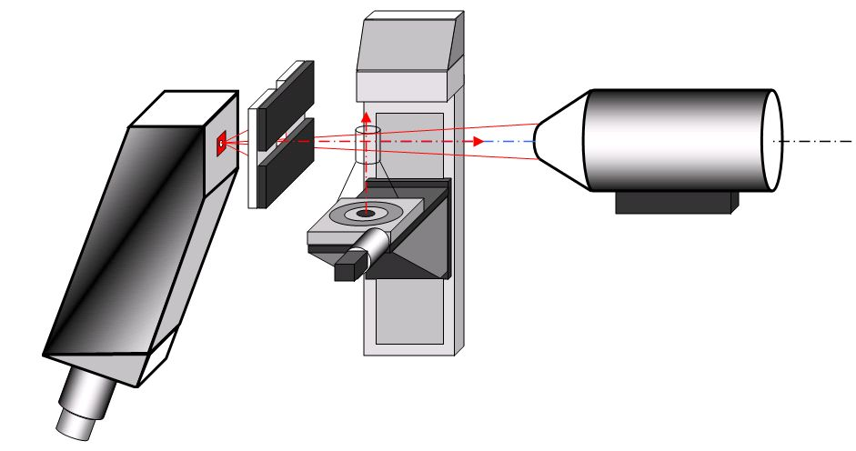
Micro-CT system
X-ray detector
Photonics Science liquid cooled camera CCD Kodak sensor 4008x2672 pixels; pixel size: 9 μm; FOV = 36 x 24 mm² GOS scintillator with 1:1 fiber optics plate
Microfocus X-ray tube
KEVEX PXS10
45-130 kV
0.5 mA
53° beam angle
7-100 µm focal spot

Slide 27

Analysis of human skeletal remains
Trabecular microstructure of a child bone from the Anthropology Museum of UNIBO (voxel size: 10 μm).

Slide 28
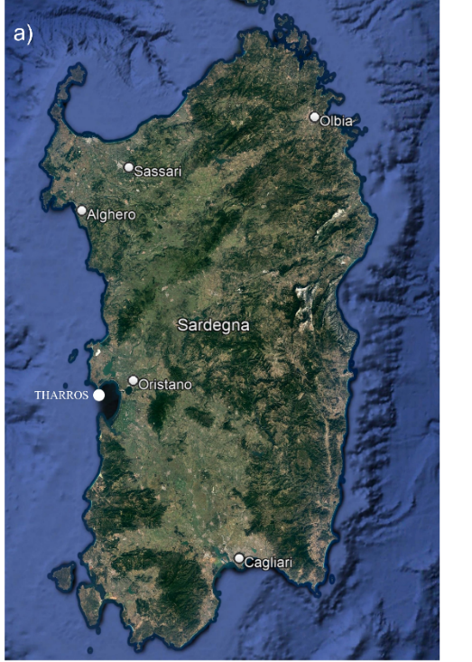
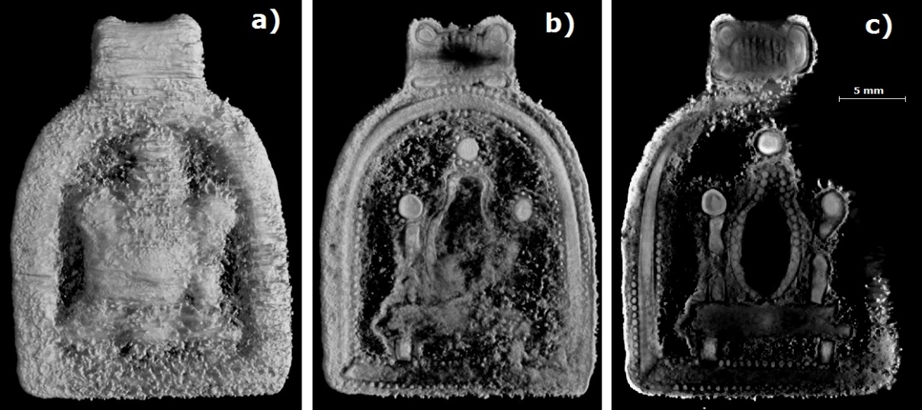
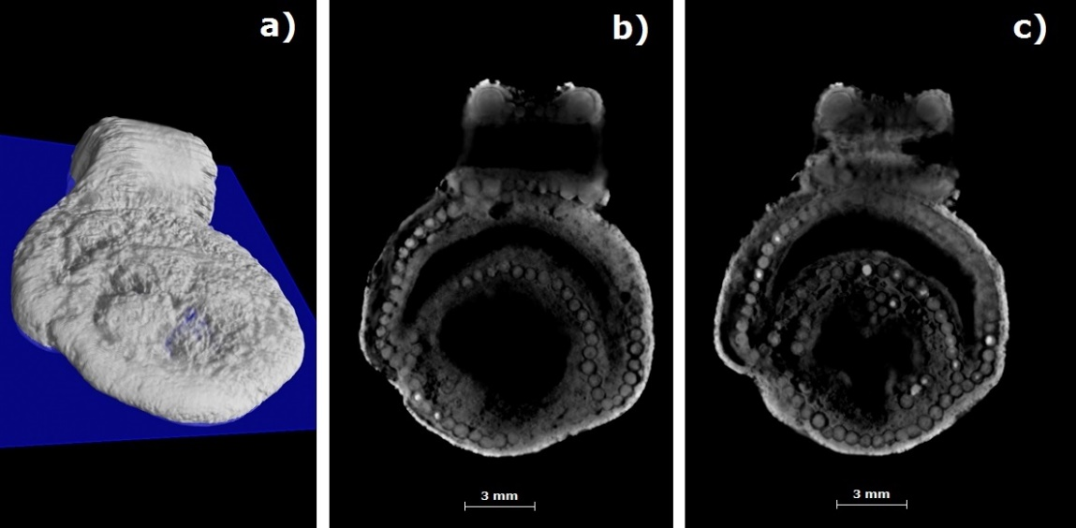
Micro-CT analysis of silver jewelry (7th-6th century BCE)
X-ray CT images of a curved pendant:
a) 3D rendering;
b) internal section;
c) coronal slice, showing details of granulation and filigree decorations.
X-ray CT images of a circular pendant: a) coronal plane sectioning the 3D rendering;
b) crescent moon decoration;
c) star decoration.
PUNIC NECROPOLIS OF THARROS – CAPO SAN MARCO (SARDINIA, ITALY)

Slide 29
Examples of case-studies
Analysis of medium-size artefacts

Slide 30
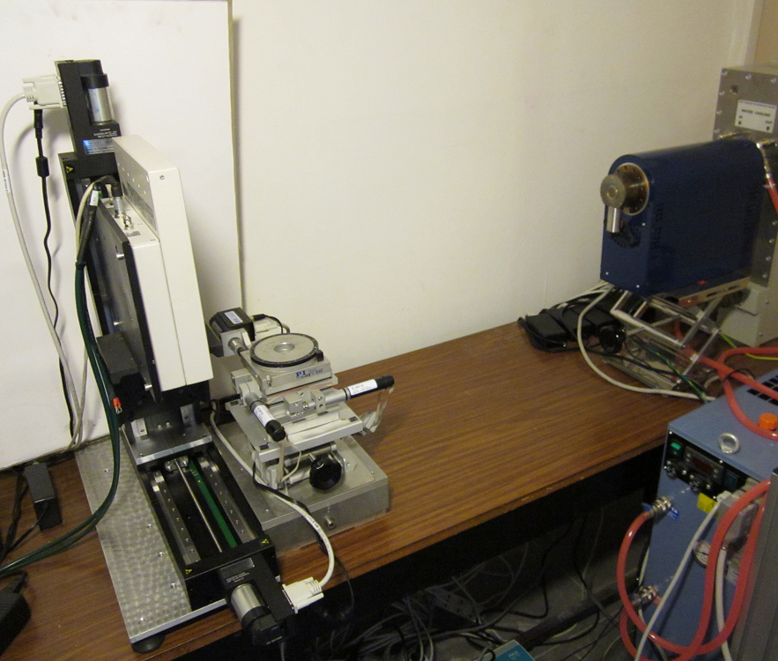
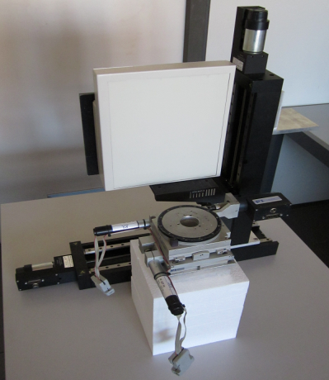
CT system for medium sized-object

Slide 31
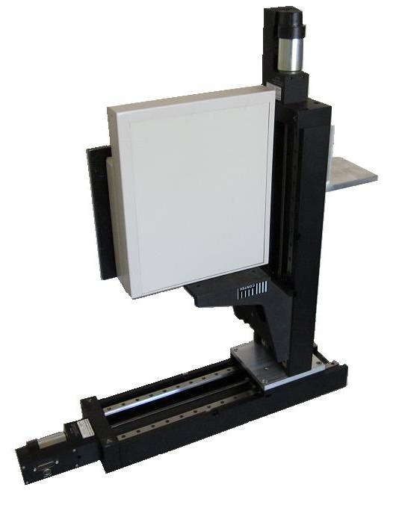
CT system for medium sized-object
Vertical axis
Physik Instrumente (PI)
Model: M413.3PD
Range: 30 cm
Step: 1/10 micron
Flat panel
Varian
Model: PS2520D
Pixel: 127 micron
Area: 25 cm x 20 cm
Vertical axis
Physik Instrumente (PI)
Model: M413.3PD

Slide 32
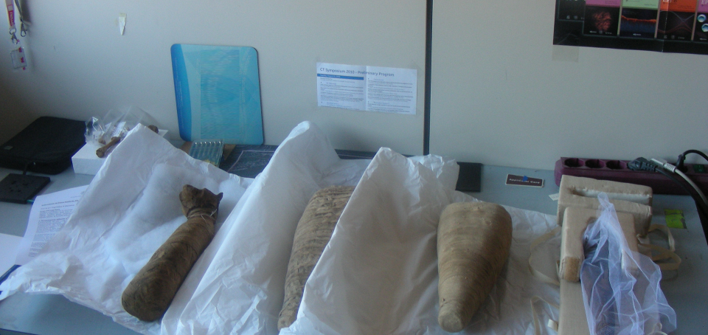
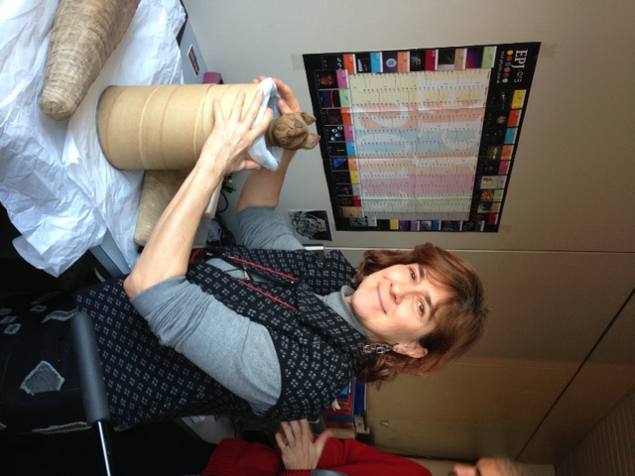
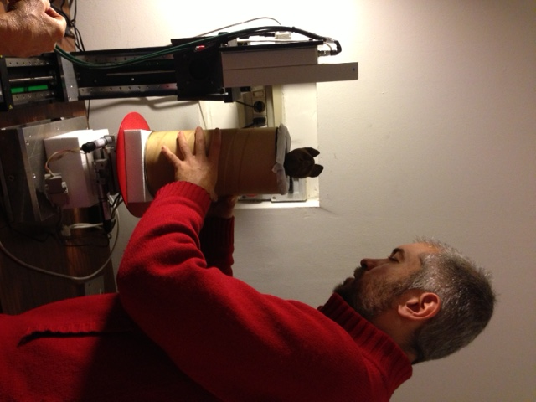
CT analysis of Egyptian animal mummies
CT analysis of 4 animal mummies from the Archaeological Museum of Bologna.

Slide 33
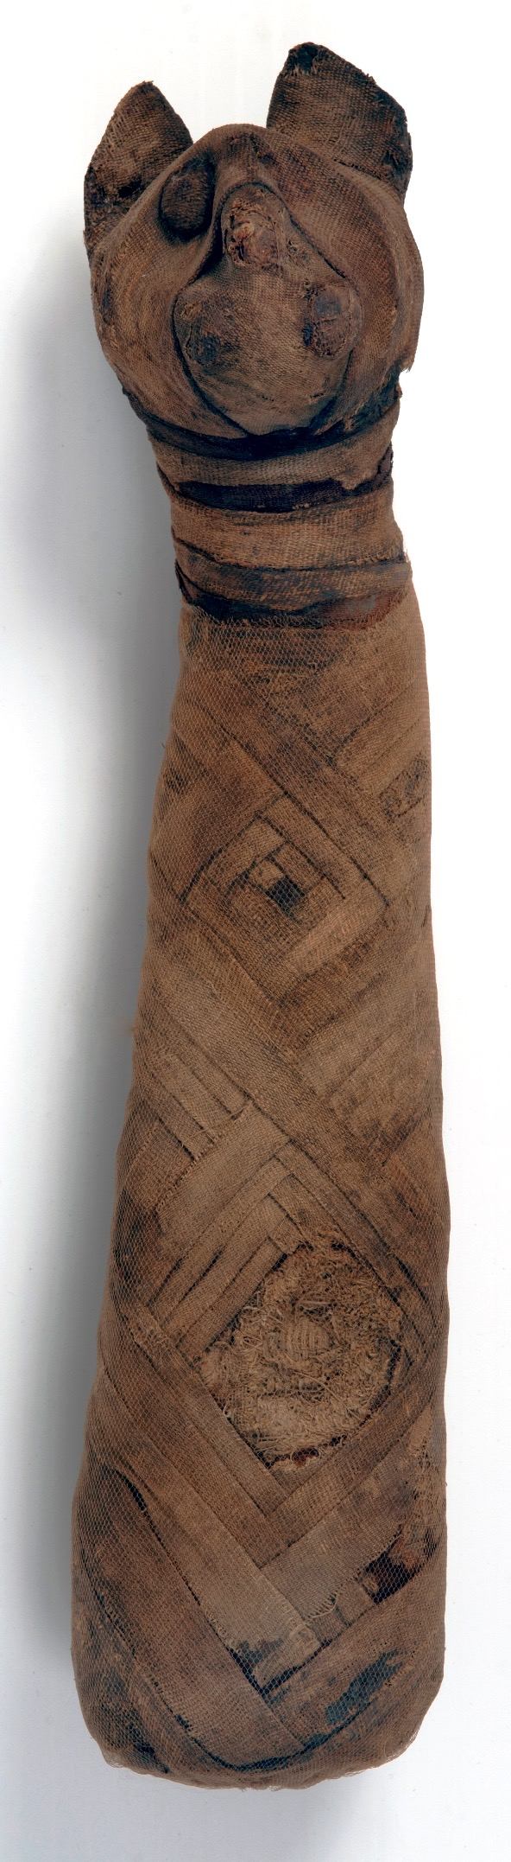
CT analysis of Egyptian animal mummies
Mummy of a cat
cm. 28
Unknown provenance
Ptolemaic - Roman period
Palagi Collection, EG 2039
Cat mummies represented a very common votive offering to Bastet, a goddess with a feline head.

Slide 34
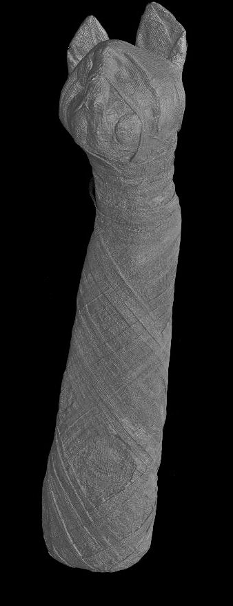
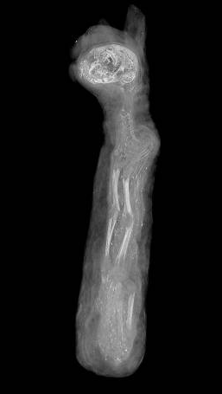
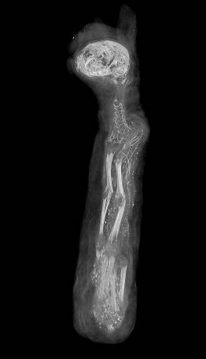

CT analysis of Egyptian animal mummies
Cat mummy (EG 2039)

Slide 35


CT analysis of animal mummies
Hawk mummy wrapped in linen bandages
cm. 28 x 6,5
Unknown provenance
Late Period-Ptolemaic Period
Palagi Collection, EG 2050
The falcon-like god Horus, closely related to the concept of royalty, is one of the most important deities for the ancient Egyptians.
This hawk mummy, covered only by a few layers of bandages that leave the head uncovered, appears intact.

Slide 36


CT analysis of Egyptian animal mummies

Slide 37



CT analysis of Egyptian animal mummies

Slide 38

CT analysis of Egyptian animal mummies
37 x 10 x 19.5 cm
Cat-shaped wooden coffin (Egyptian Collection of the Archaeological Museum of Bologna).

Slide 39

The Lilibeo Project
PARTNERS:
Centro Fermi
Bologna University & INFN
Tor Vergata University
Scuola Normale Superiore
University of Geneve
Trapani and Marsala Regional Pole for Cultural Sites
Regional Archaeological Museum «Lilibeo» (Marsala)
AIM OF THE PROJECT:
To study, through non-invasive methodologies, the characteristics of some finds preserved at the Lilybaeum Museum.

Slide 40

The Lilibeo Project
Roman Ship
Urban and Funerary wing
Punic Ship

Slide 41







CT analysis on-site
BABY-BOTTLES AND RATTLES
PLASTIC VASES
3th century B.C.

Slide 42



CT analysis on-site
Polychrome glass alabastron (23×24×87 mm), late 4th – 3rd century B.C.
Blown glass balsamarium (height: 90mm), 1st century A.D.
Black-glass aryballos (30×23×41 mm), late 4th – 3rd century B.C.

Slide 43





CT analysis on-site

Slide 44






CT analysis on-site
Axial slices

Slide 45



CT analysis on-site

Slide 46



CT analysis on-site
Polychrome glass alabastron

Slide 47
Examples of case-studies
CT analysis of large artefacts

Slide 48


The Coronelli’s celestial globe at Marciana Library
Vincenzo Coronelli
(1650-1718 )
Pair of terrestrial and celestial globes by Coronelli
Marciana National Library (Venice)

Slide 49



Transfer of the CT system on site
Marciana National Library in Venice

Slide 50



On-site experimental set-up
Energy
150 keV
Current
2 mA
Resolution
200 μm
Fast Acquisition 3min x CT
≈ 3.2 m
Flat Panel Detector
X-Ray Tube
C10900D – Hamamatsu –
Solid State Detector + CsI:TI scintillator
12 x 12 cm²
100 µm pixel
SMART EVO 200 D – Yxlon –
50-200 kV
0.5 – 6 mA
1 mm focal spot

Slide 51



CT analysis of the globe
Tile scanning
≈ 200 detector positions
3 minutes for each one
10 hours
180000 partial radiographs

Slide 52



Results of the CT analysis
- wooden polar axis
- 7 internal circles
7 groups of 4 perpendicular wooden boards
- Metal nails
- 2 polar pivots
North Pole
South Pole
Poles

Slide 53



Structural elements of the globe
Elements of the inner structure
Wooden elements on the surface

Slide 54


The African wooden statue at Pigorini Museum
African wooden statue kept at the Luigi Pigorini Museum of Prehistory and Ethnography in Rome.
It represents an anthropomorphic idol believed to have magical power.
It is carved from a single piece of wood and has a lot of metal nails in the torso for a votive function.
Height: 120 cm
Second half of the 19th century

Slide 55

The African wooden statue at Pigorini Museum
In 2014 the Metropolitan Museum of New York asked the Pigorini Museum for the loan of this statue for an exhibition on African Art.
Conservators at the Pigorini Museum were concerned about some parts of the statue they considered fragile and critical, thus potentially subject to fracture and detachment especially during trasport from Rome to New York.

Slide 56


Details of the beard and of the so-called power-pocket in the abdomen of the statue: it consists of a bolus supporting a large shell and hiding an inner cavity with magical objects (herbs, stones, shells, etc.).
They have been shaped with a moldable material consisting of an oleo-resin mixed with kaolin, quartz and vegetable matter.

Slide 57




A double line of metal pins deeply embedded into the wood offers firm support for the beard.

Slide 58


Axial section of the abdomen showing the inner cavity behind the bolus.

Slide 59

Four metal pins enclose the bolus of the so-called «power pocket».

Slide 60



A polygon mesh of the surface obtained from the 3D volume allowed the scientists at the Metropolitan Museum of Art to design and build a custom-made crate with a molded interior for the safe transportation of the statue.

Slide 61

The terrestrial globe by Egnazio Danti
X-ray Computed Tomography of the ancient globe by Egnazio Danti at Palazzo Vecchio – Florence (2004)
The Municipality of Florence decided to set up an important diagnostic campaign for this masterpiece. Besides the cleaning of the surface, which had become brown, the project also involved an exploration of the nature and condition of its inner structure. It was therefore decided to perform a CT scan.

Slide 62

The terrestrial globe by Egnazio Danti
The Map room (“Sala delle Carte geografiche”) within Palazzo Vecchio, with the ancient large globe created by Egnazio Danti around 1567, on assignment of Cosimo I de’ Medici, duke of Florence.

Slide 63

The experimental set-up
On the left: the X-ray tube;
in the middle: the globe on the turntable;
on the right: the detector and the translation axes (31000 radiographs).

Slide 64

The terrestrial globe by Egnazio Danti
Picture of the experimental set-up: the detector on the moving axes on the left, the globe on the rotating platform in the middle, and the tube on the vertical moving axis on the right.

Slide 65

The terrestrial globe by Egnazio Danti
Rendering of the 3D volume obtained by the CT reconstruction. It is clearly possible to see the entire inner structure, consisting of a central axis, 8 equatorial bars, 8 bars as 2 tetrahedrons and 30 meridians.

Slide 66


Slide 67



The terrestrial globe by Egnazio Danti
The globe is no more a perfect sphere; it collapsed about 10 cm
The globe is made mainly by iron
Calculated weight of iron:
TOTAL: ~608 Kg
INTERNAL: ~350 Kg
30 meridians,
each 12° far

Slide 68
Conclusions
CT is a versatile technique that can be applied to a variety of objects of different size and made of different materials.
The availability of mobile CT systems expands the number of case studies in which tomography can be applied.
Moreover, it gives us the possibility to work in close contact with restorers and conservators in the place where archaeological findings and works of art are located.

Slide 69
Thank you for your attention!
Maria Pia Morigi
Department of Physics and Astronomy «Augusto Righi»
University of Bologna & INFN CHNet
Viale Berti Pichat, 6/2
40127 – Bologna
Tel.: +39 051 2095085
mariapia.morigi@unibo.it

