Slide 1



Experimental
Nuclear Astrophysics
James deBoer
University of Notre Dame and the Joint institute for nuclear astrophysics
University of Bologna summer school, July 18, 2023

Slide 2
OUtline
What is Nuclear Astrophysics?
Nucleosynthesis
Facilities
Detectors
Measurement Limits
Underground Facilities
New Types of Facilities
Some Nice Example Projects

Slide 3
The question
How were the elements in the universe formed? (nucleosynthesis)
  Why do they exist in the amounts that they do? (abundance)

Slide 4
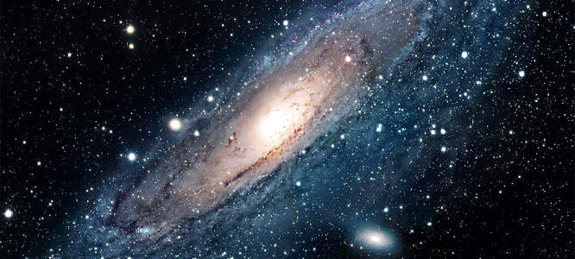
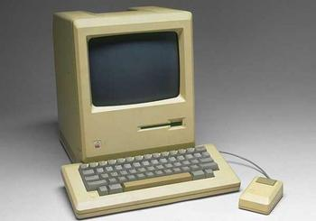
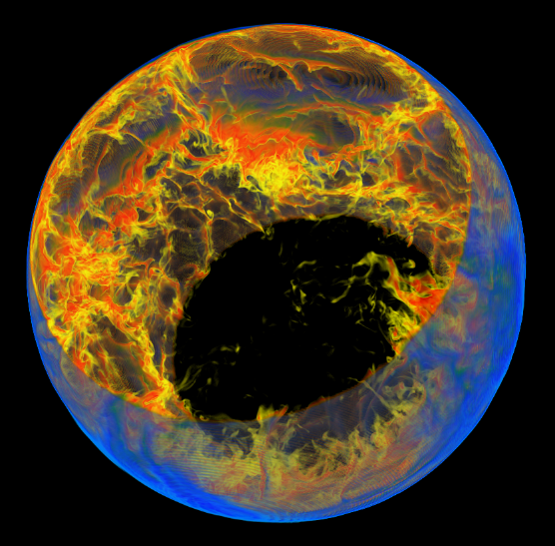
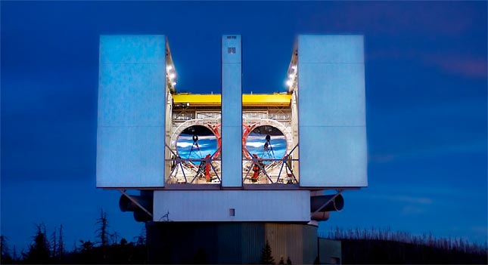
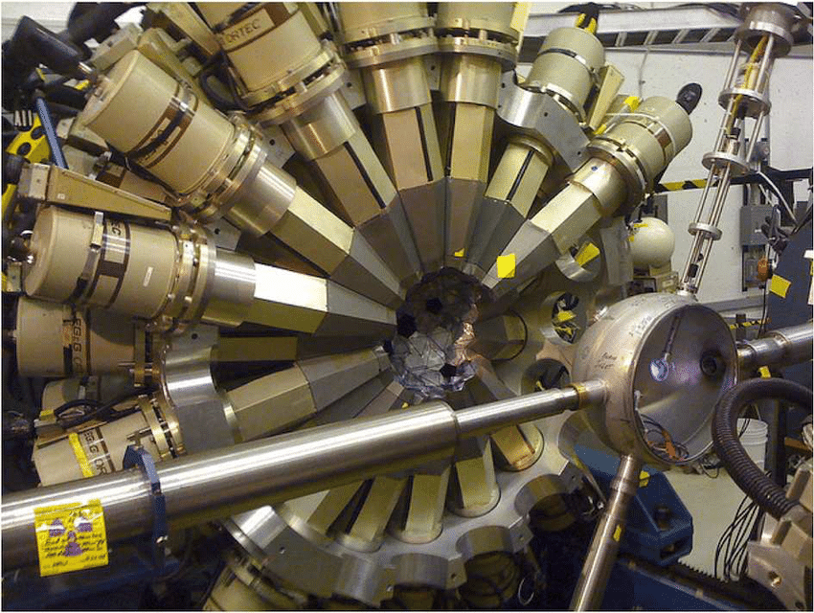
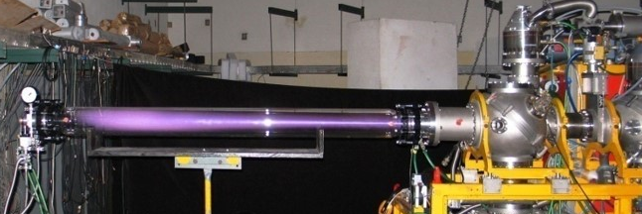
How is nuclear astrophysics a science?
Observational Astronomy and Astrophysics
Astrophysics
(Stellar Simulations)
Experimental and Theoretical Nuclear Physics

Slide 5
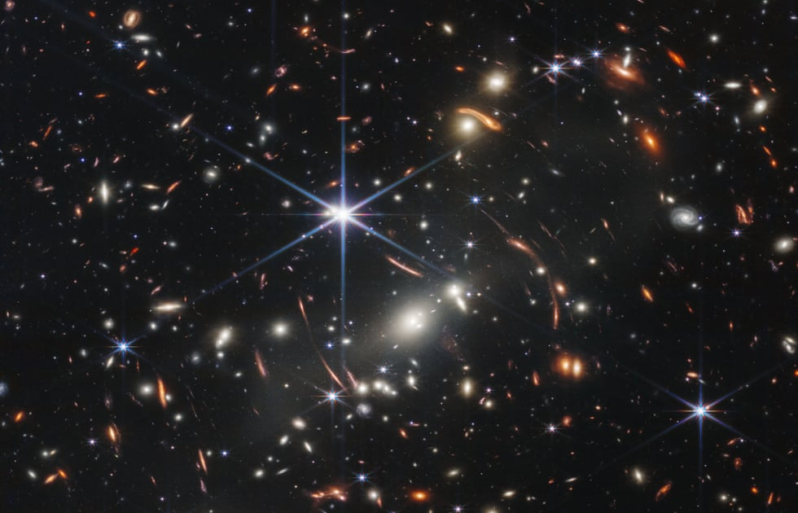
Spectra
Keller et al. Nature (doi:10.1038/nature12990)
Electromagnetic spectra observed from stars show features that are characteristic of atomic transitions of elements in the atmosphere of a star
The light from a star
γ-rays from a nuclear reaction
Electromagnetic spectra observed from nuclear reactions performed in the laboratory provide a key piece of information needed to model how the elements in stellar atmospheres got there.
Zhang et al. (2022)

Slide 6
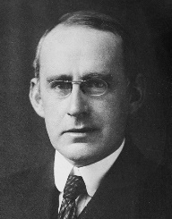
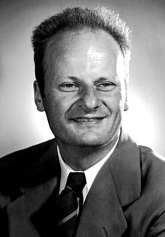
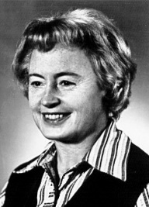
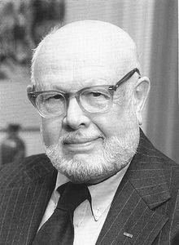
Birth of nuclear astrophysics
Eddington (1920)
  Conversion of four hydrogen nuclei into one helium nuclei can power the sun! Quantum Tunneling!
Hans Bethe (1939)
  Gives the first detailed description of how hydrogen burning works
Burbidge, Burbidge, Fowler, and Hoyle (1957)
  Set forth most of the processes that we now believe form the elements
4 X M_{hydrogen} > M_{helium}
E = mc²
Hydrogen burning, helium burning, carbon burning, etc.
r-process, s-process, etc.

Slide 7
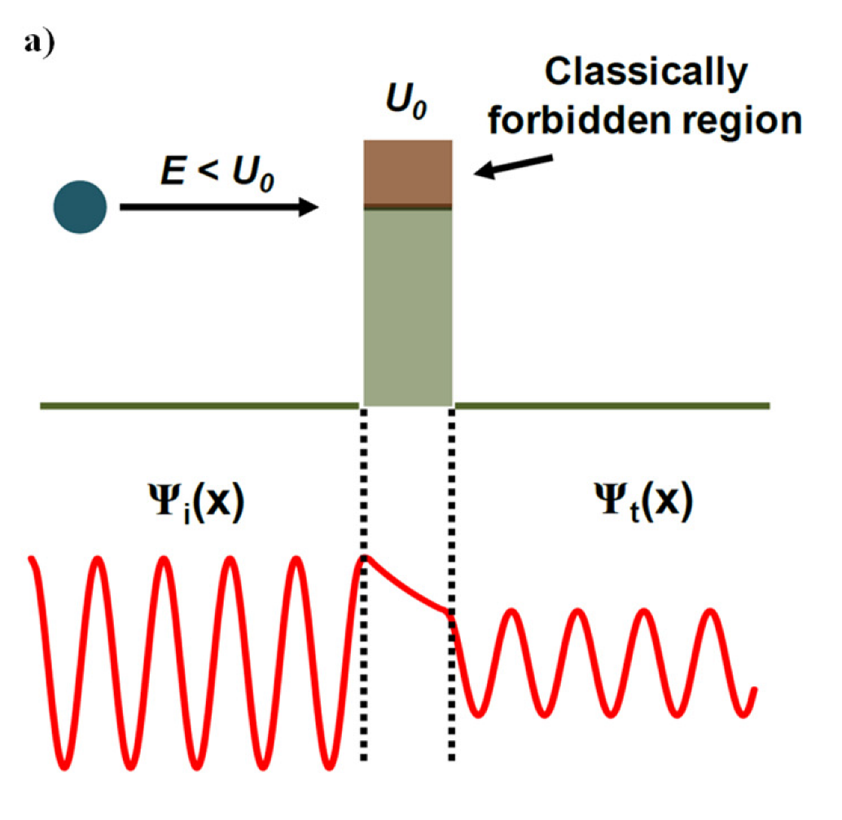
Physics concept: Quantum tunneling
Probability of a particle penetrating through a classically impassible barrier.
This barrier is the repulsion of two like charged particles and angular momentum
The idea that quantum particles exist as “probability packets” not localized particles.
Without quantum tunneling, our sun would not “burn”.
Cross Section = Tunneling Probability
Banerjee and Mastrangelo, Micro 2022 2(4) 679-698 (2022)

Slide 8
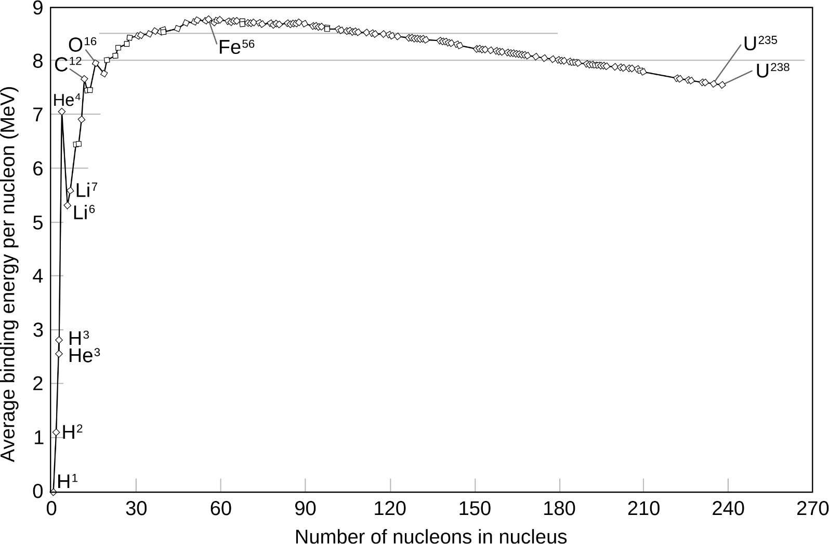
Physics concept: binding energy

Slide 9
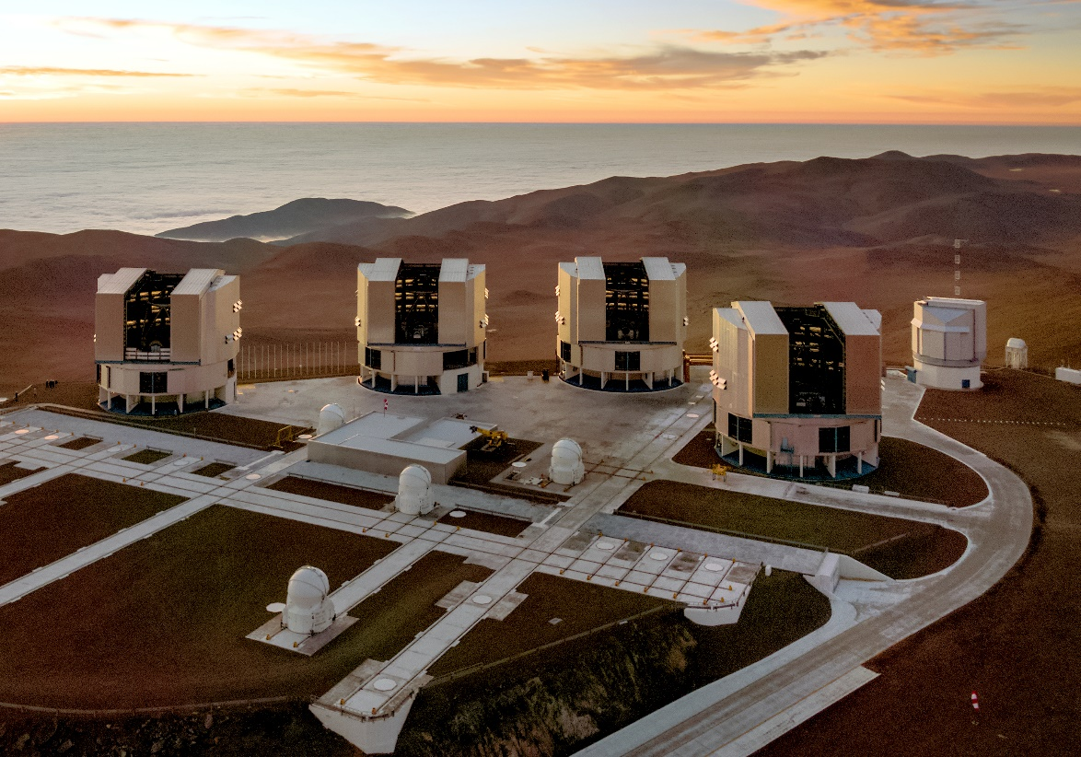
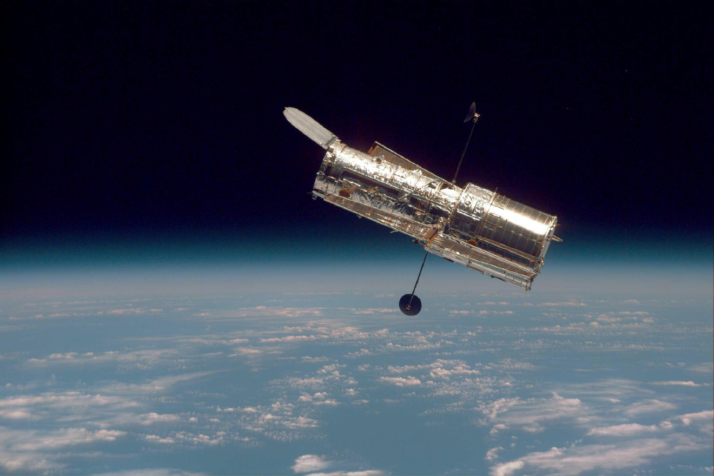
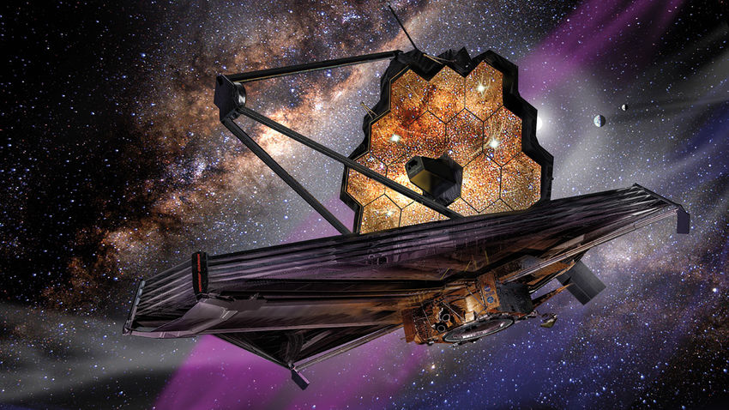
Modern observational astronomy
Very Large Telescope
Hubble
James Webb

Slide 10
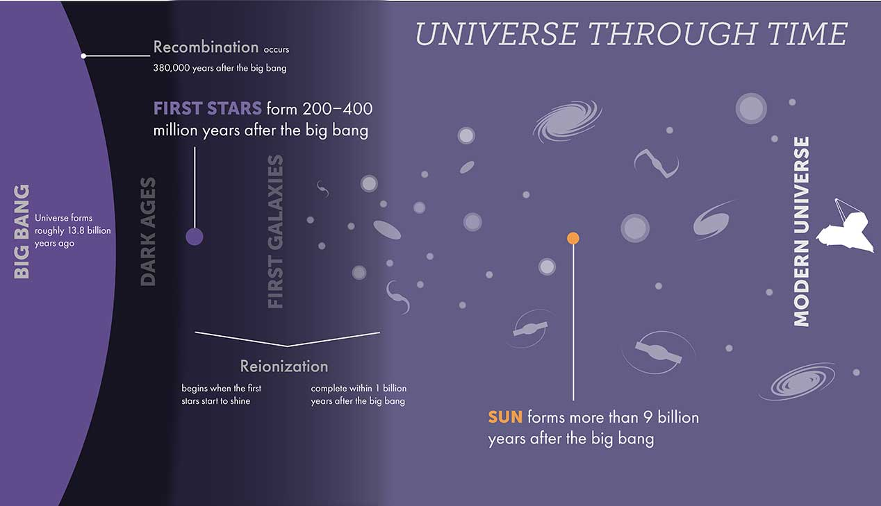
James Webb telescope website (Credit: STScl)

Slide 11
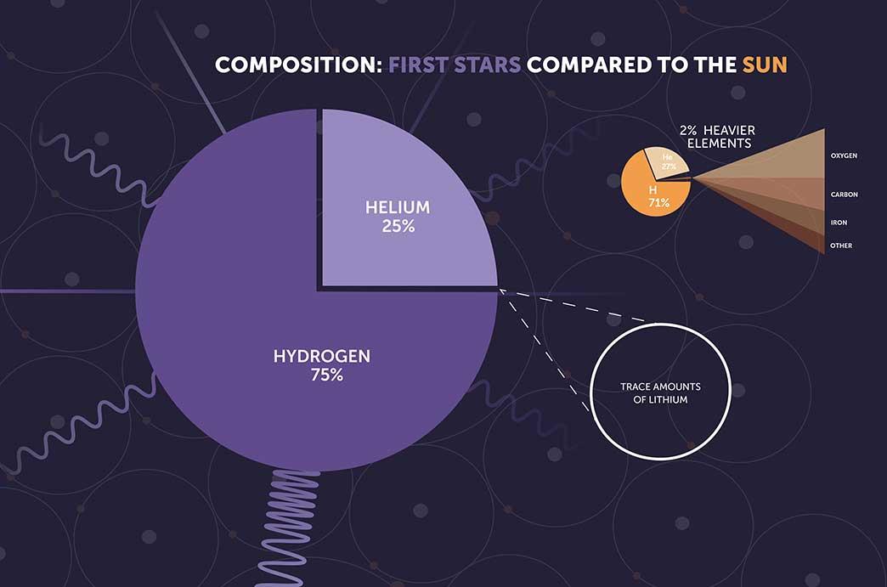
Big Bang Nucleosynthesis
James Webb telescope website (Credit: STScl)
Fields (2011)

Slide 12
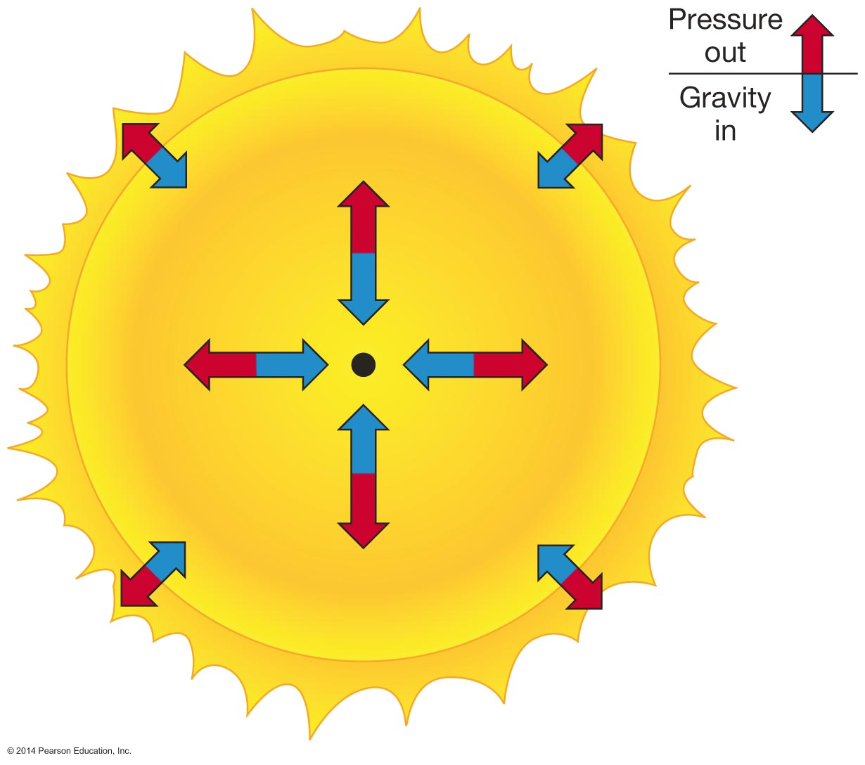
Physics Concept: Hydrostatic equilibrium
Gravity fights nuclear energy production
Stars burn hydrogen into helium for most of their lives
Some nuclear reactions contribute both to nucleosynthesis and energy production
Some only contribute to nucleosynthesis and happen “in the background” compared to energy production reactions

Slide 13
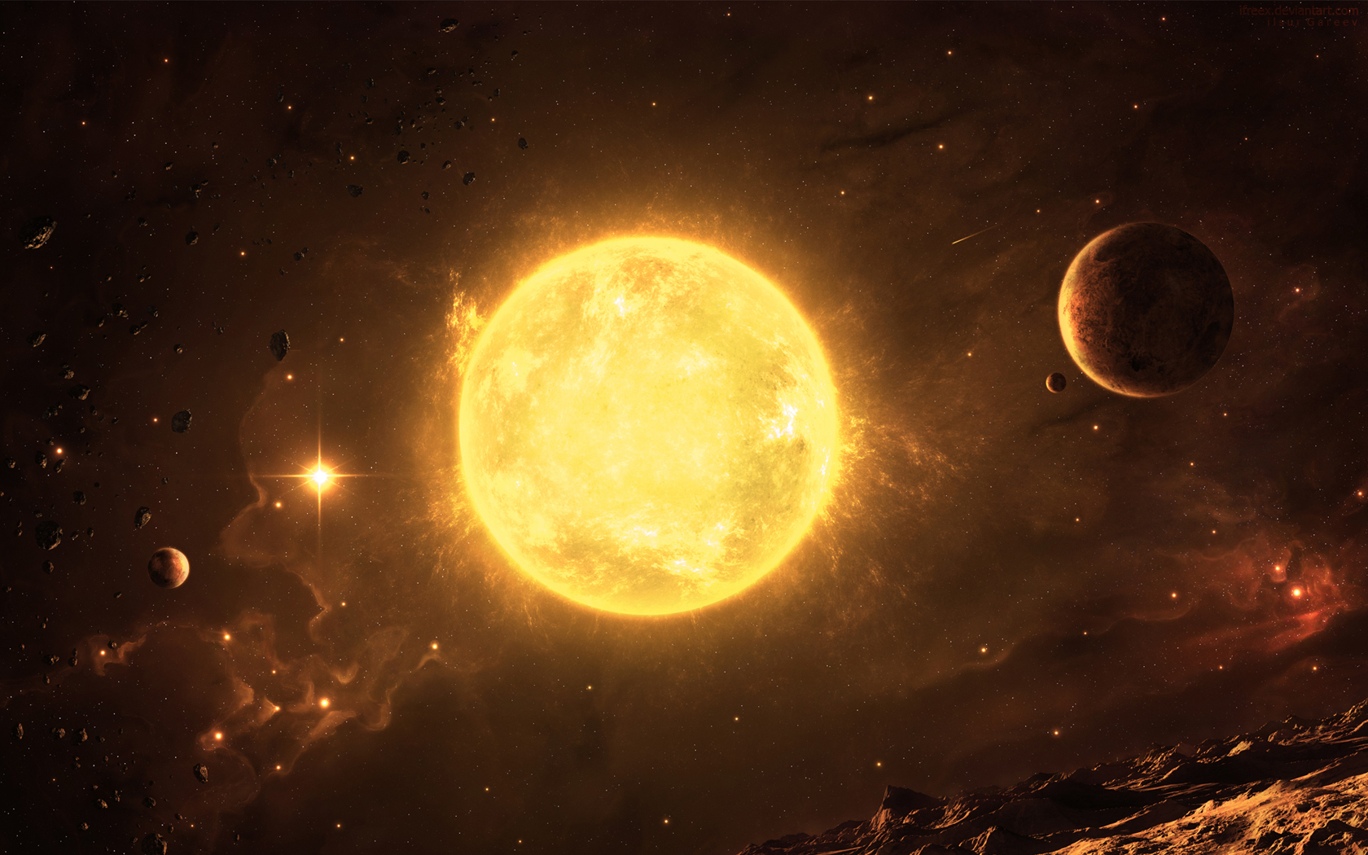
Sites of nucleosynthesis:
Stellar burning: Main Sequence
Hydrogen Burning
pp chains
4¹H → ⁴He + 2e⁺ + 2ν_{e} + 2 γ
(³He + ⁴He → ⁷Be* + γ → ⁷Li )
CNO cycle
¹²C+¹H → ¹³N + γ
¹³N → ¹³C+e⁺+ν_{e}
¹³C+¹H → ¹⁴N + γ
¹⁴N +¹H → ¹⁵O + γ
¹⁵O → ¹⁵N +e⁺+ν_{e}
¹⁵N + ¹H → ¹²C + ⁴He ↑

Slide 14
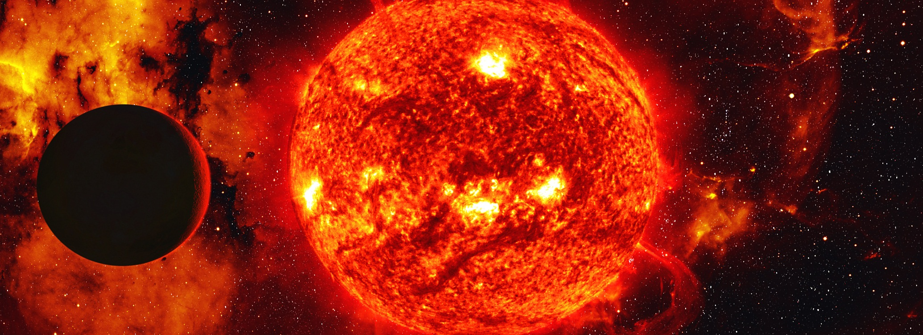
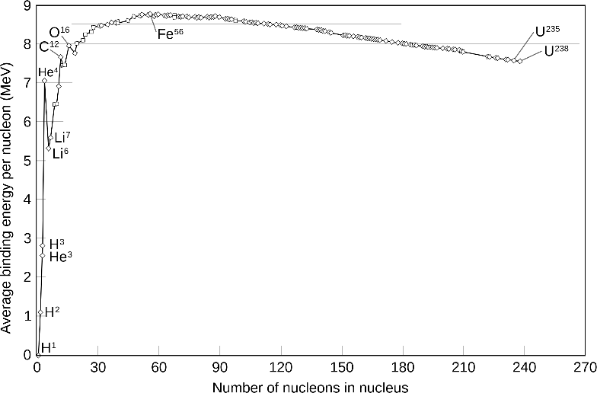
Sites of Nucleosynthesis:
Red Giant stars
Helium Burning
3 ⁴He → ¹²C + γ
¹²C + ⁴He → ¹⁶O + γ
¹⁶O + ⁴He → ²⁰Ne + γ
(¹³C + ⁴He → ¹⁶O + n)
(²²Ne + ⁴He → ²⁵Mg + n)
s process
(n + ⁺⁶⁰X
→ Heavy Nuclei)
Carbon Burning
¹²C + ¹²C → ²³Na + ¹H
→²⁰Ne + ⁴He
→²⁴Mg + γ
Messy Burning
Stuff → Iron Peak
“Iron peak”

Slide 15

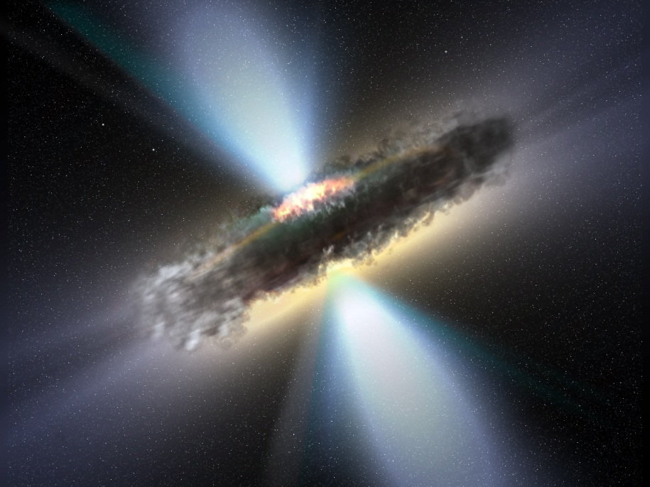
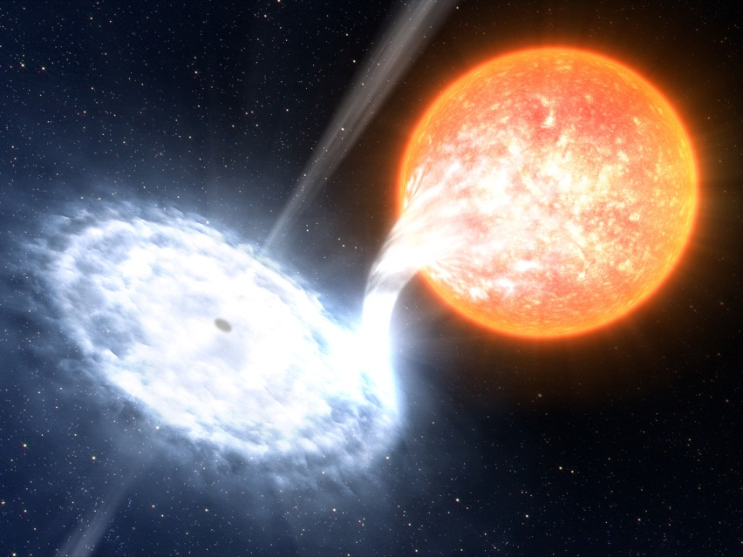
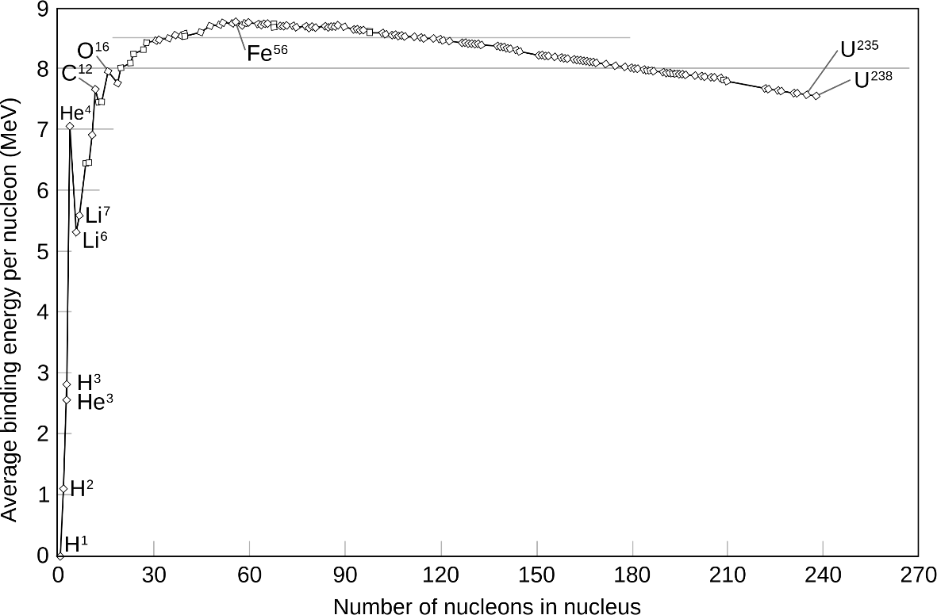
Sites of Nucleosynthesis:
More exotic locals
Hot CNO Cycle
r process
(n + ⁺⁶⁰X → Heavy Nuclei)
ν process
(ν + X → Y)
“Iron peak”
???? Process(es)

Slide 16
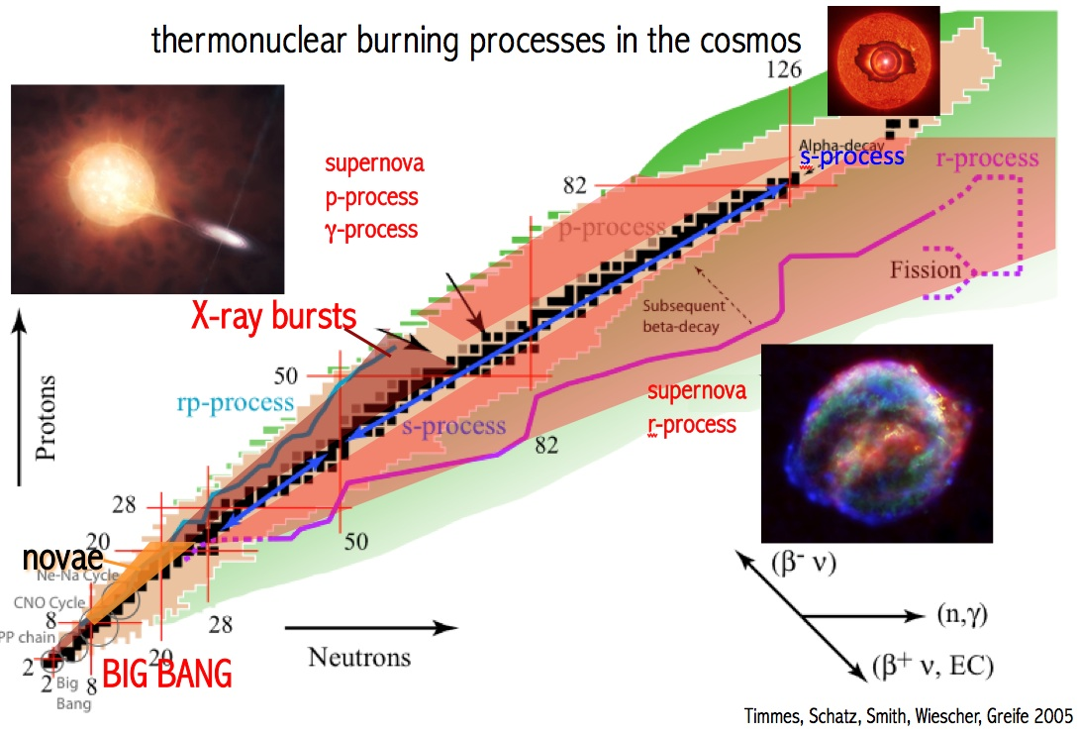

Slide 17
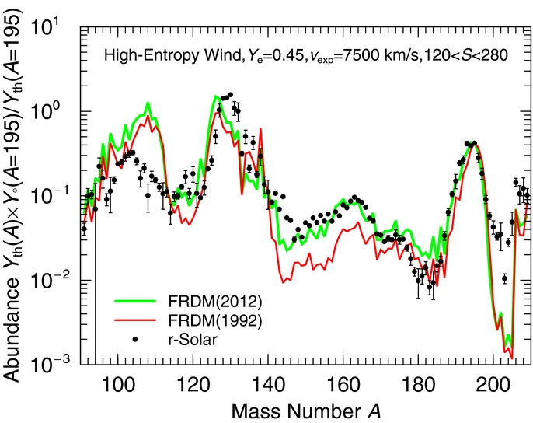
Abundance patterns (r-process)
Kratz et al. (2014)

Slide 18
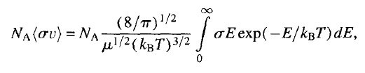
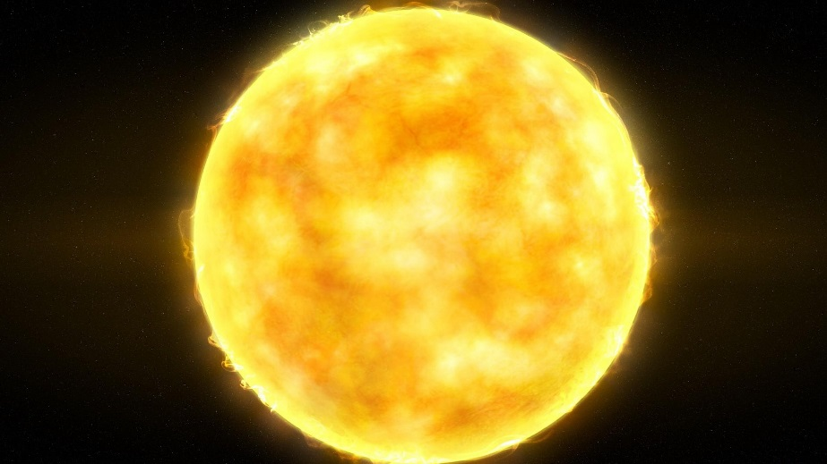
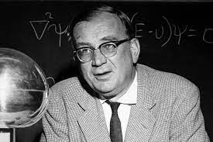
Reaction Rate
Maxwellian averaged reaction rate
¹²C(α,γ)¹⁶O at T = 0.2 GK
Number of particle available at some energy
goes as e^{-2πη} at low energy
where η = Z₁Z₂/E
Penetrability between two particles fusing
Ideal gas
Gamow peak
George Gamow

Slide 19

The temperature in stars corresponds to a low accelerator energy!
Energy of interest to nuclear astro:
10 to 500 keV.
Want 0.2 MeV!
??
Often can’t be measured:
Coulomb barrier,
background reactions
D. Schurmann et al. (2005)
=
??

Slide 20
Nuclear structure and reaction mechanisms
We don’t fully understand the mechanisms that govern these reactions because we don’t know how to fully describe the underlying nuclear forces
  A theory problem that nuclear physics has never been able to solve
We therefore try to understand the behavior of specific reactions by measuring over a wide energy range
If we can describe the cross section over a wide energy range with a phenomenological model (partial physics, partial free parameters), we can then try to extrapolate to very low energies

Slide 21
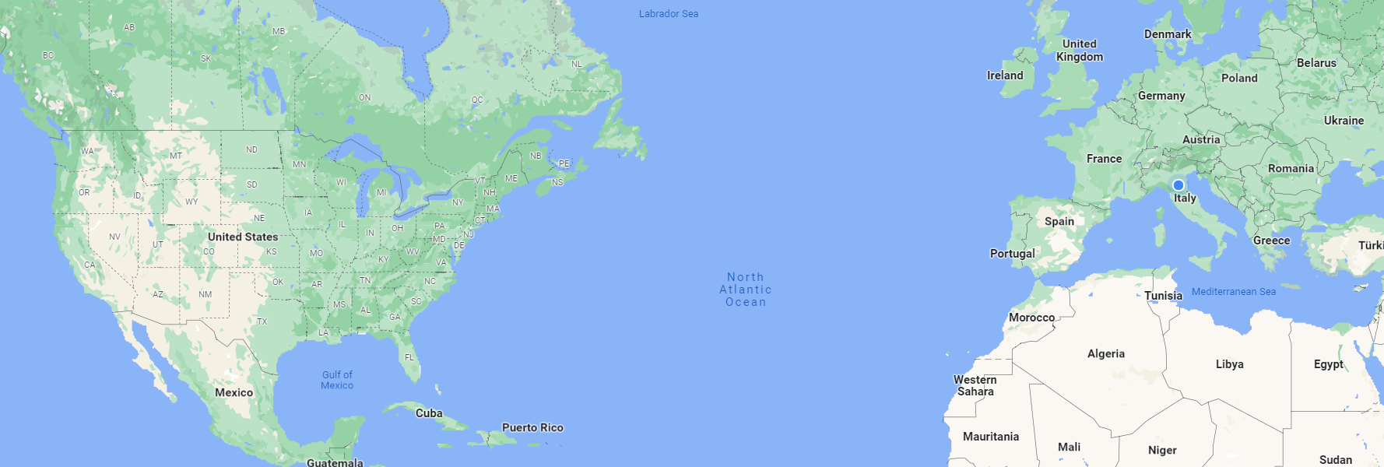
A few example facilities
University of Notre Dame
CERN
HIγS

Slide 22
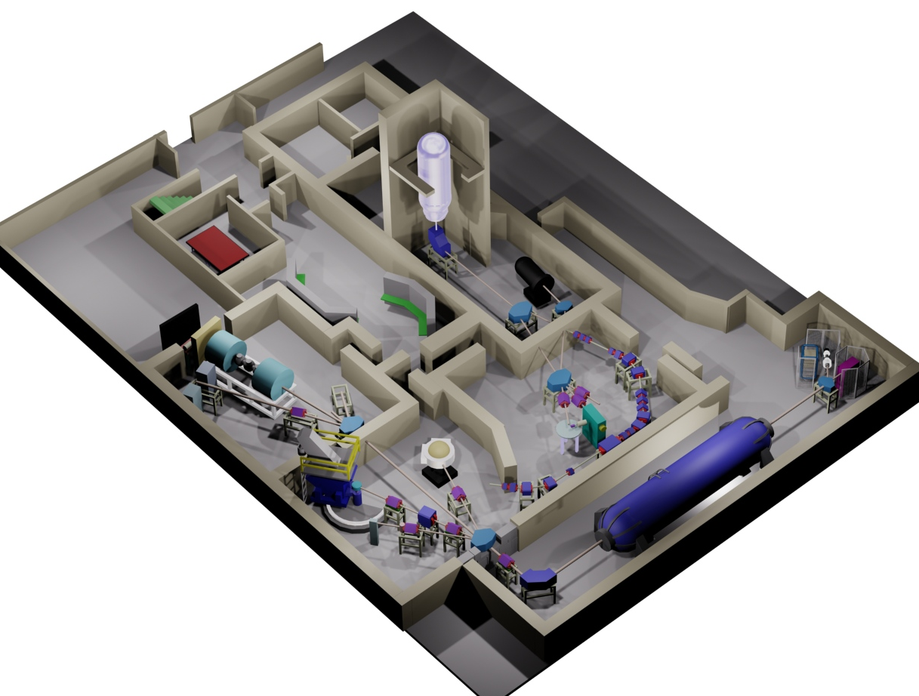
Example low energy nuclear physics lab for charged particle beams: the University of Notre Dame
“Twin-Sol” radioactive beam facility
Santa Ana Accelerator (5 MV)
St. George recoil
separator
Accelerator Mass Spectrometry
Spectrograph
FN Tandem
Accelerator
(11 MV)
“R2D2”
Scattering Chamber
physics.nd.edu

Slide 23
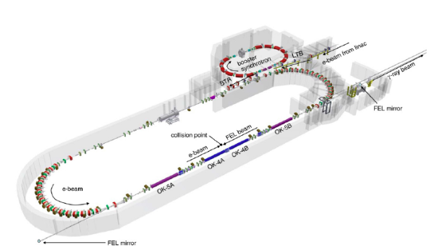
High Intensity γ-ray Source (HIγS)

Slide 24

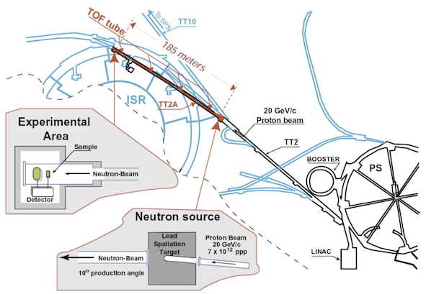
Neutron Time of Flight
Neutrons only have a half life of about 10 minutes
They are responsible for the creation of nearly all of the elements heavier than iron.

Slide 25
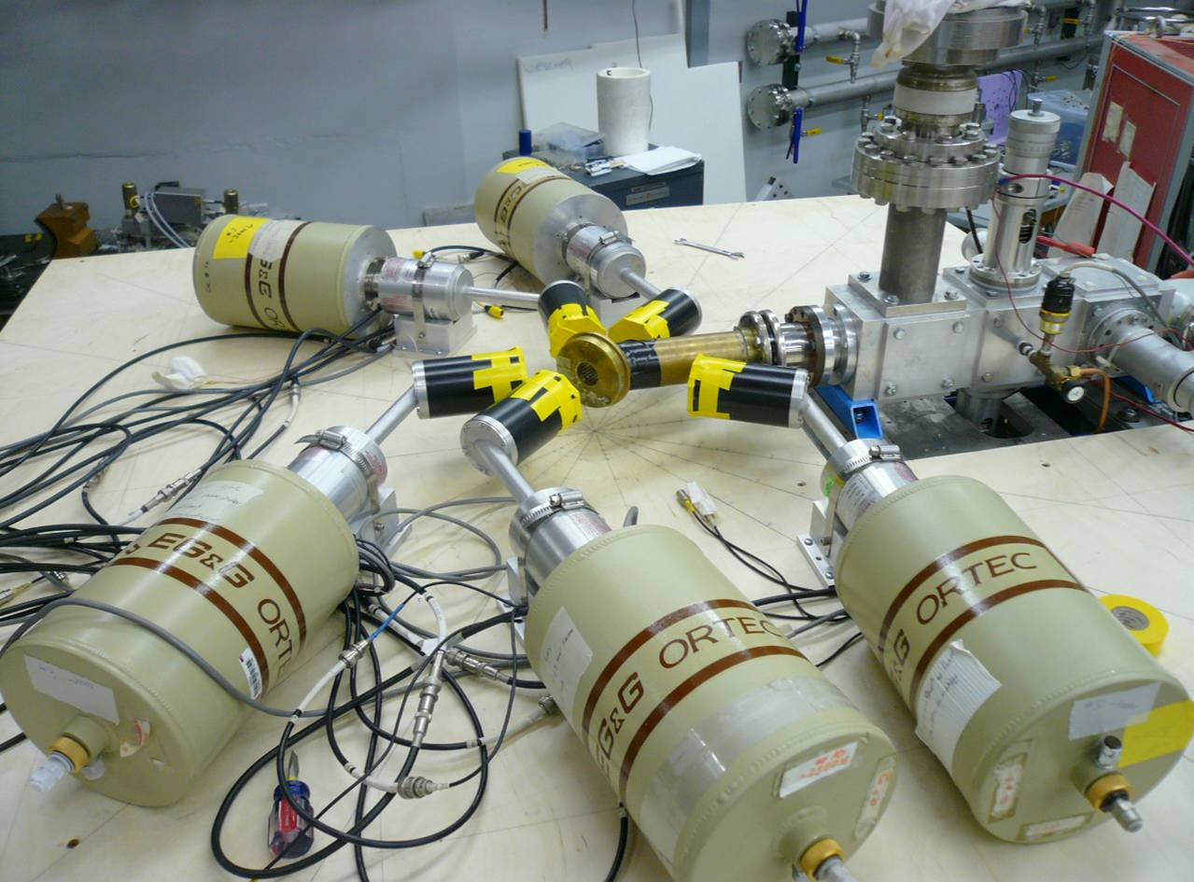
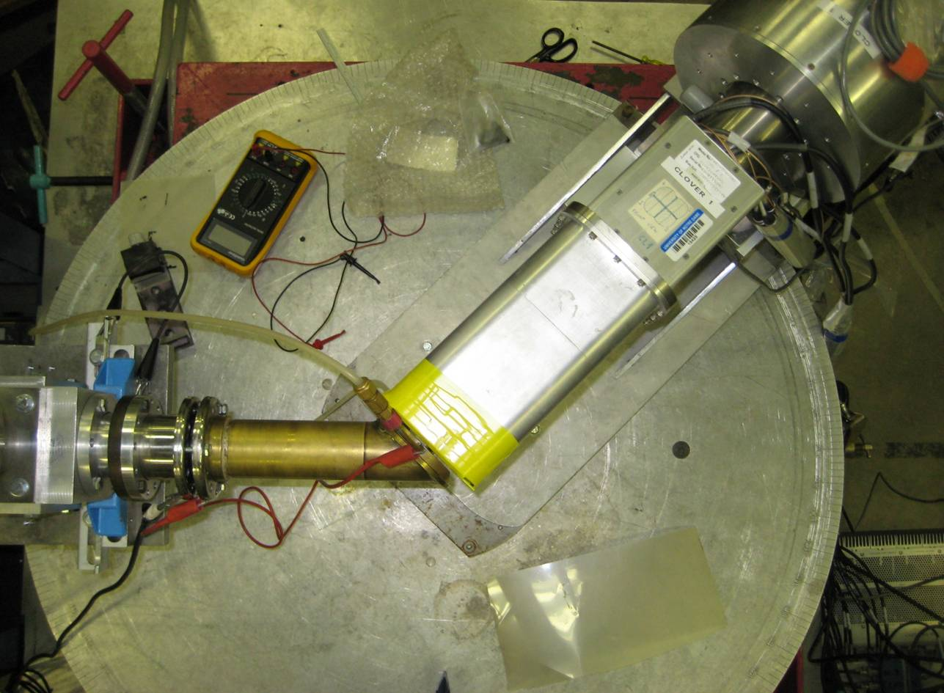
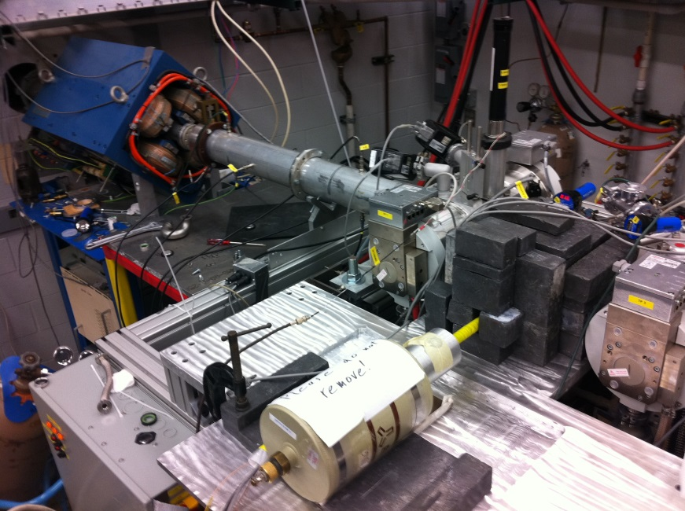
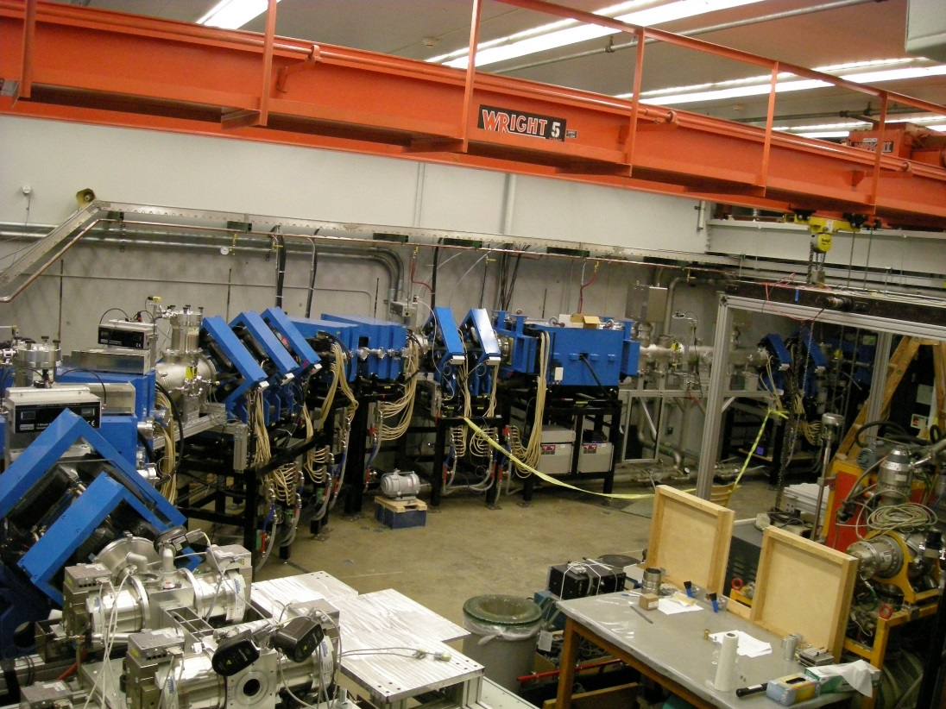
Gamma ray detection A(b,γ)C
¹⁴N(p,γ)¹⁵O
High Purity Germanium Detectors
³He(α,γ)⁷Be
St. George recoil separator

Slide 26
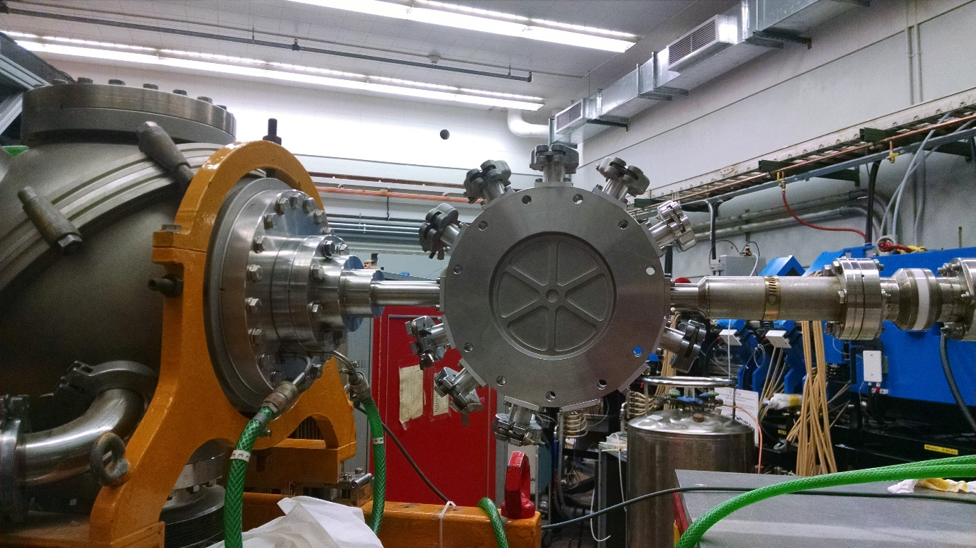
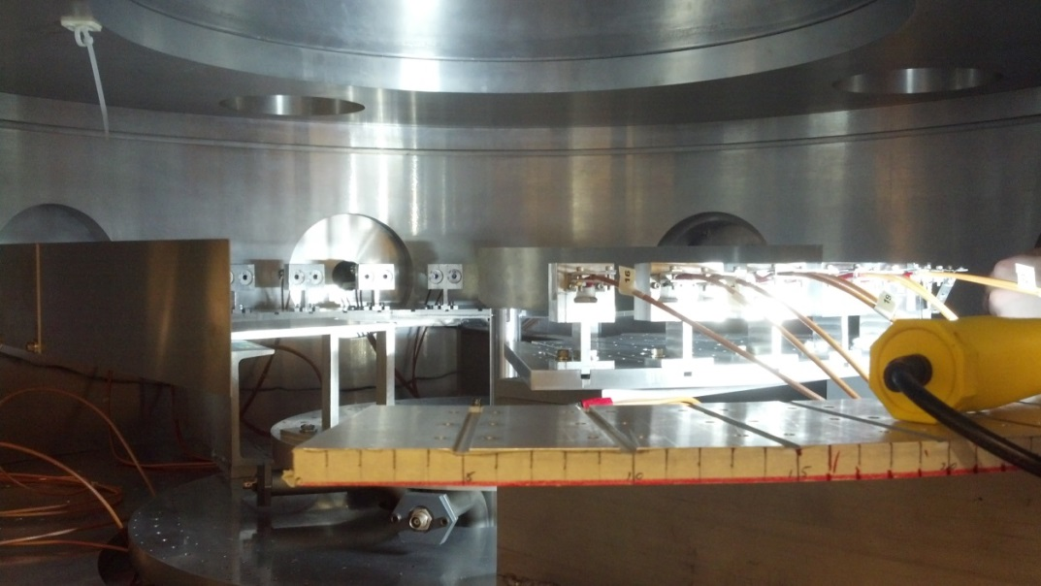
Scattering measurements at ND, charged particle detection
KN accelerator E_{p} = 1.0 to 3.0 MeV
FN accelerator E_{p} = 1.8 to 4.0 MeV
1.2 m
6 ruggedized silicon det., 30 to 160 degrees
30 photodiodes, 30 to 170 degrees
10 cm
beam
beam
¹⁵N gas target, about 3 ug/cm² (0.1 keV at 1 MeV)
Solid Adenine (C₅H₅N₅) target, about 20 ug/cm²
(3 keV at 2 MeV)

Slide 27
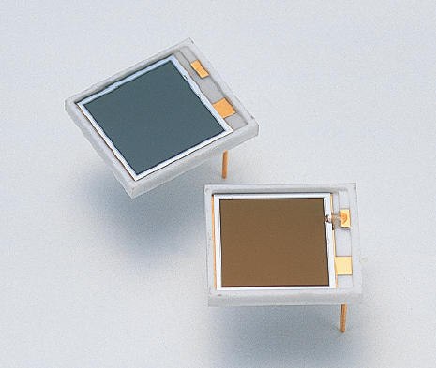
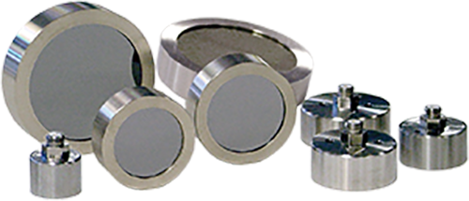
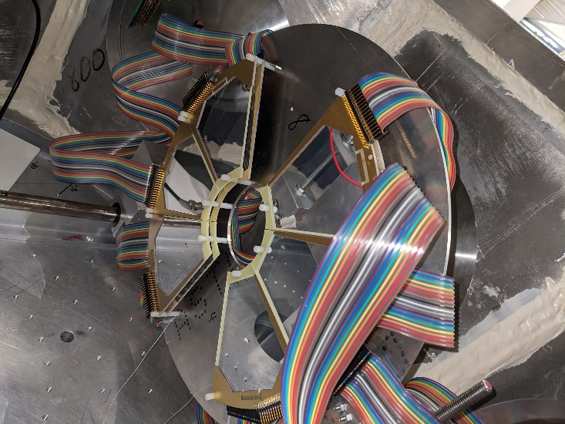
Some example charged particle detectors
Hammatsu photo pin diodes
Mirian technologies silicon detectors
“Lampshade” array

Slide 28
“4π” neutron moderator type detector
Macklin (1957)

Slide 29
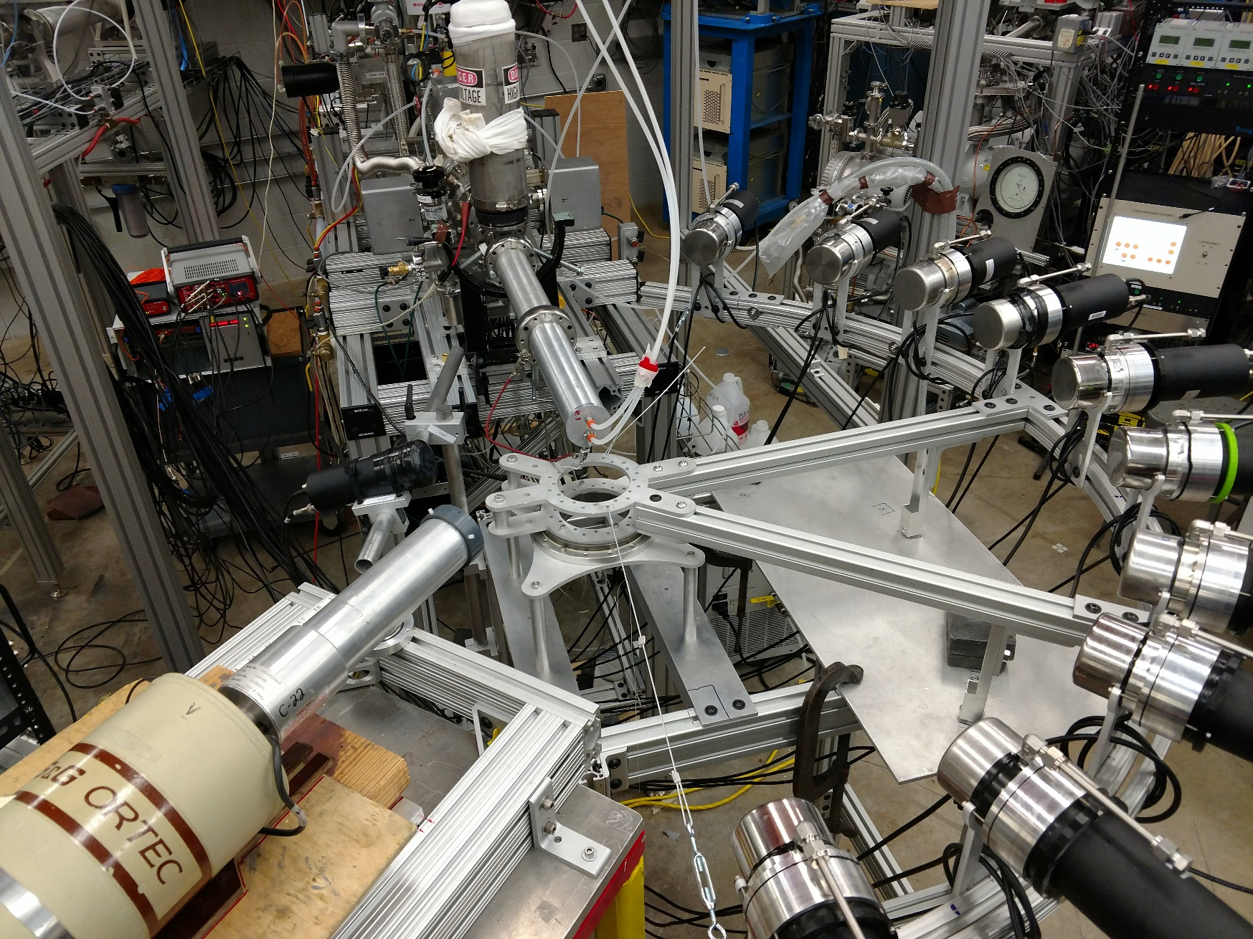
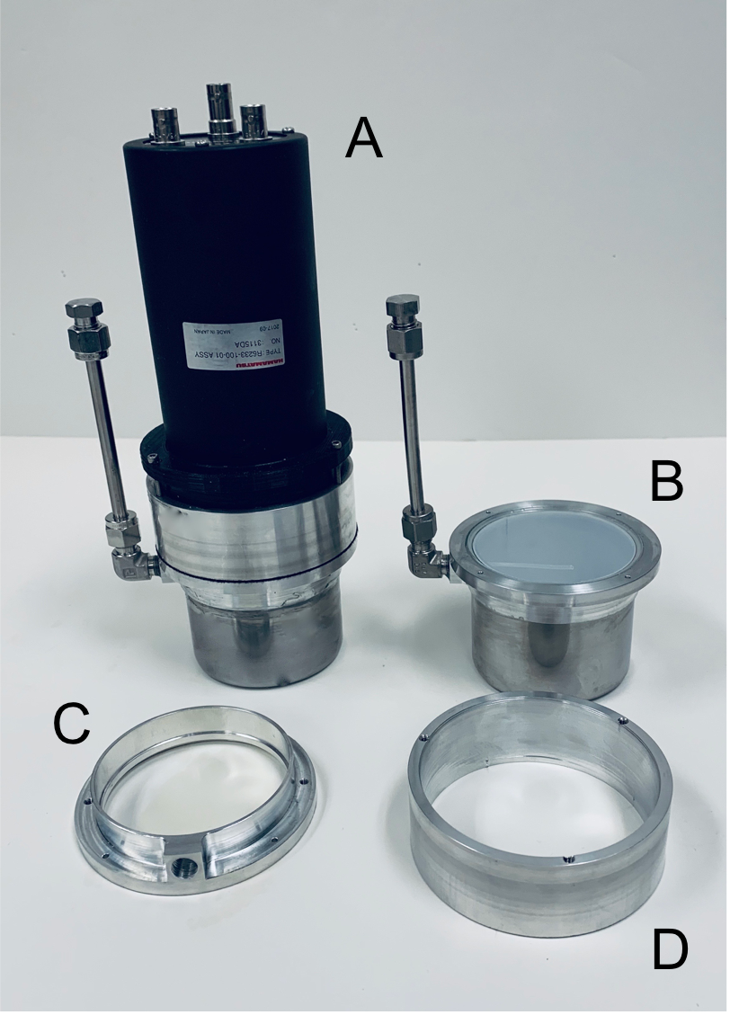
Liquid scintillators for neutron detection
ODeSA
ORNL
GEANIE
Febbraro et al. (2019)

Slide 30
What limits our measurements?
Beam intensity
  We can make a super intense particle beam, but then we melt our target!
Target thickness
  We can make a very thick target, but then we loose energy resolution, making the results harder to understand
Detectors
  Our detectors are limited by energy resolution and efficiency, but this is where there is the most development
Background
  Very often, the signals that we want to detect are very weak compared to other signals coming from unwanted reactions
  These can be the result of impurities in our target or particle beam
  They can just come from natural decaying radioactive nuclei in building material and detector material
  They can be from cosmic rays
Time
  Students want to graduate at some point

Slide 31
Cross Section measurements over a wide energy range
¹³C(α,n)¹⁶O

Slide 32
Data set comparison and uncertainty evaluation (Bayesian methods now becoming popular)

Slide 33
S-factor to reaction rate
We take the reaction rate with an improved determination and uncertainty and feed it back into the astrophysics simulations.

Slide 34
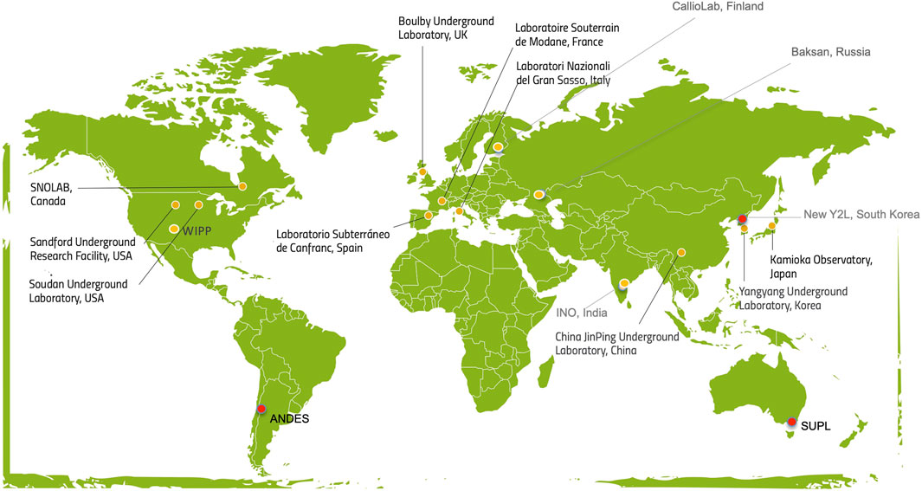
Forefront facilities: underground low background
Ianni, Front. Phys. 23 (2021)

Slide 35
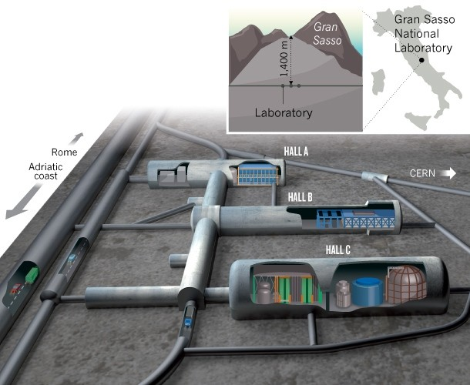
LUNA
One of the experimental facilities in Hall B
Two particle accelerators underground!

Slide 36
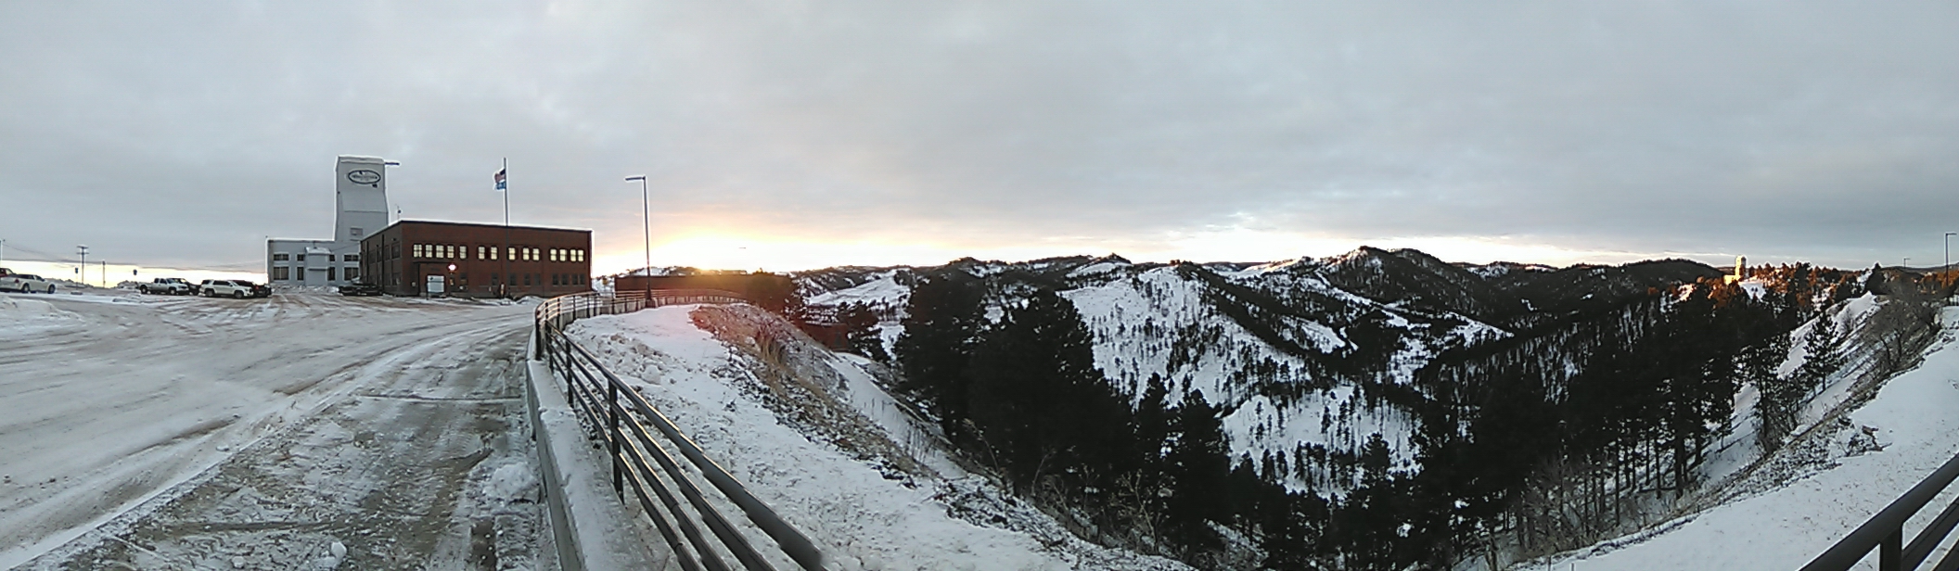
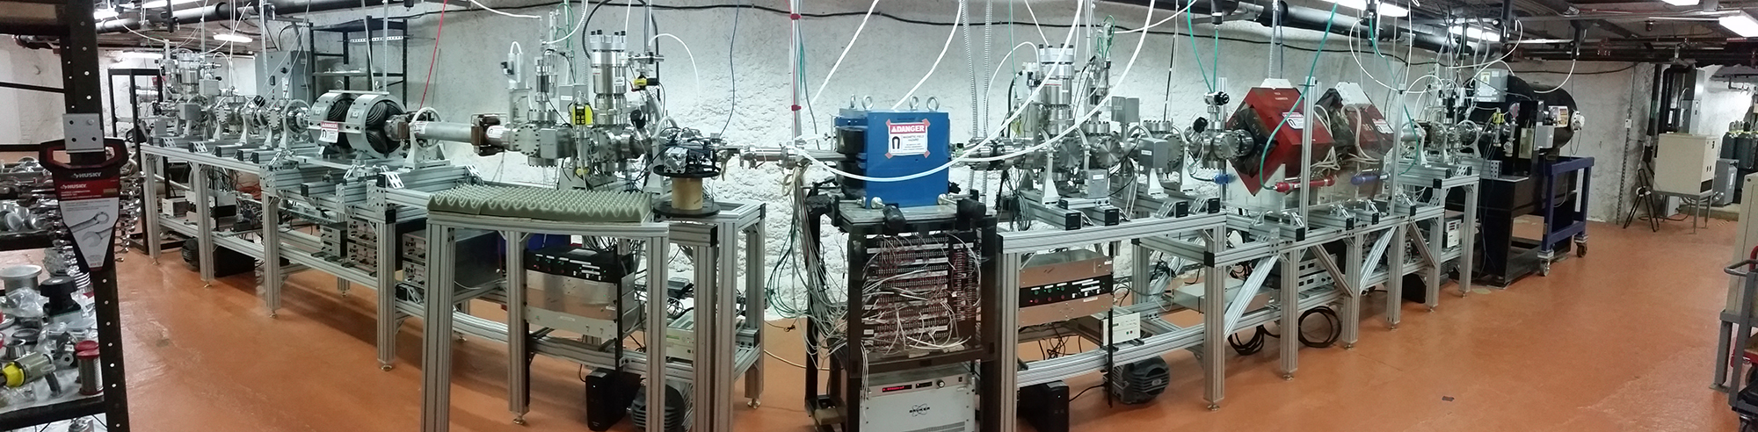
CASPAR
Homestake, South Dakota, USA
16oo meters

Slide 37
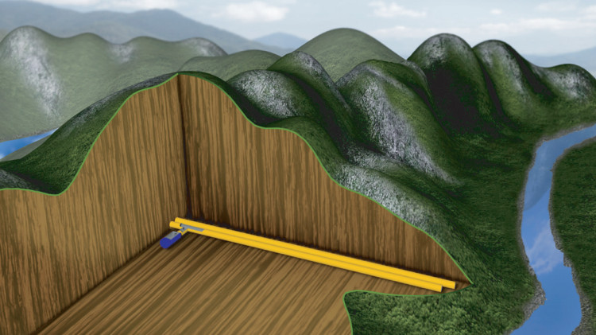

China JinPing Underground laboratory
2400 m

Slide 38


Spectrum background suppression from rock shielding
Figures from Andreas Best

Slide 39
A few example facilities
FRIB
NIF

Slide 40



Radioactive beam facilities
Facility for Rare Isotope Beams (FRIB)
Michigan State University

Slide 41


National ignition facility (NIF)
Closely reproduce the temperature and density conditions of a stellar interior
But only for a few nanoseconds at a time
300 meters
11.24 mm

Slide 42

Some “ideal” research projects

Slide 43

Ca production in POP III stars
The Keller star is extremely metal poor, yet it has a measurable abundance of Ca
What was the method for this Ca production?
Hot CNO breakout is suggested
Yet simulations by Ondrea Clarkson and Falk Herwig, Mon. Not. R. Astron. Soc. 500, 2685 (2020) say it can’t work, unless the reaction rate of ¹⁹F(p,γ)²⁰Ne / ¹⁹F(p,α)¹⁶O is 10 times higher than predicted
The Keller star (SMSS0313-6708)
A very Ca poor star
Image: NASA/STScl
Keller et al. (2014)

Slide 44

What’s the hot CNO cycle?
Ca
Breakout!

Slide 45
¹⁹F(p,αγ)¹⁶O at JUNA
Zhang et al. (2021)
¹⁹F(p,α)¹⁶O = ¹⁹F(p,α₀)¹⁶O + ¹⁹F(p,αγ)¹⁶O
New JUNA data extend down to 72.4 keV!
Measurement extends into the Gamow energy window for the first time!
First statistically significant indication of the near threshold resonance!
More measurements to come!

Slide 46
¹⁹F(p,γ)²⁰Ne at JUNA

Slide 47

Motivation
Together with the 3α process, the ¹²C(α,γ)¹⁶O reaction determines the ¹²C/¹⁶O ratio in the universe.
For stellar evolution, the ¹²C/¹⁶O ratio determines the evolution of massive stars, which in turn effects all later stages of nucleosynthesis.
EOS / S. Steinhöfel

Slide 48

LIGO aerial photo

Slide 49

Motivation Highlight: Black Hole Mass Gap

Slide 50
Lowest energy data is at about 1 MeV
Region of astrophysical interest
σ (300 keV) ≈ 2 × 10⁻¹⁷ barn!
We need to extrapolate

Slide 51
Many experimental studies help determine this reaction rate
Total capture cross sections (recoils)
Avila et al. (2015)
Low energy ¹²C(α,γ)¹⁶O data
Bound state ANCs
Reaction rate
¹⁶N(βα)¹²C spectrum
Multichannel R-matrix
¹²C(α,α)¹²C data
Azuma et al. (1994)
Tang et al. (2010)
Tischhauser et al. (2009)

Slide 52
Simple Monte Carlo
Created thousands of “synthetic” data sets by assuming that the error bars on the data represented an underlying Gaussian (probably should have used lognormal) Probability Density Function.
Refit
Histogrammed S-factor calculated at many energies to get uncertainty.
Calculated many different variations on assumptions about the R-matrix fit and included those as well.
Even more computationally expensive
Monte Carlo of experimental data
Model uncertainties

Slide 53
Obtain a well defined reaction rate uncertainty

Slide 54
Feeding cross section data back into the model
Mehta et al. (2022)

Slide 55
Comparing with LIGO observations of gravitational waves from black hole mergers:
A new frontier for nuclear astrophysics
Mehta et al. (2022)

Slide 56

Thank you!

