Slide 1


Environmental
Thermography
Lecturers: Dr. Francesco Barbano, Dr. Erika Brattich
Tutor: Luigi Brogno
Atmospheric Physics group, Department of Physics and Astronomy "Augusto Righi", University of Bologna

Slide 2
Thermography
Definition: the infrared thermography deals with the acquisition and analysis of the thermal information coming from physical bodies and acquired with remote sensing devices (without contact)
The infrared camera is the remote sensing device that reads the emitted radiation from the surface of a physical body (input) and converts it into a radiative temperature (output)

Slide 3
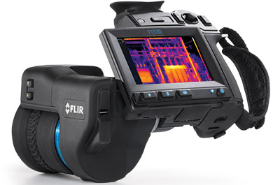
Thermography
No-contact sensing
  Do not modify the object status
  Do not perturb the measurement
Bi-dimensional
  The acquired image can be further modified and analyzed within certain limits
Real time
  Snapshot of stationary thermal schemes
  Snapshots of transitory stages

Slide 4
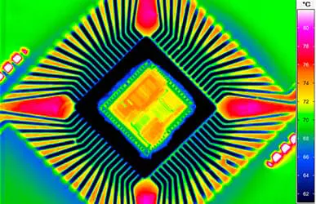
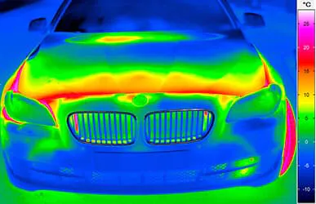
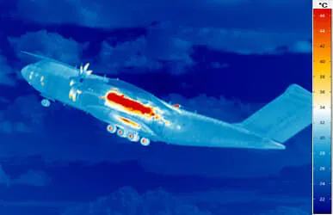
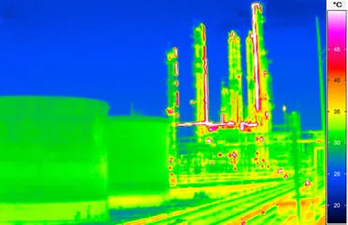
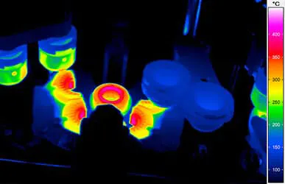
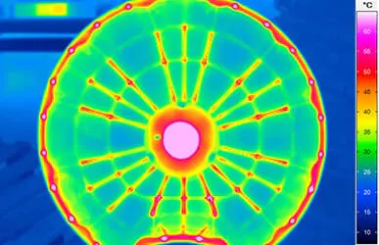
Example of Thermography Applications
Industry: Car, Metallurgical, Chemical, Aerospace, Industrial, Plastic, Glass, Electrotechnical

Slide 5
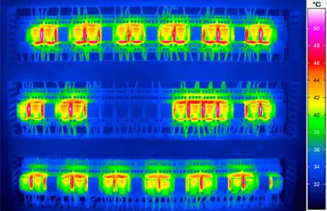
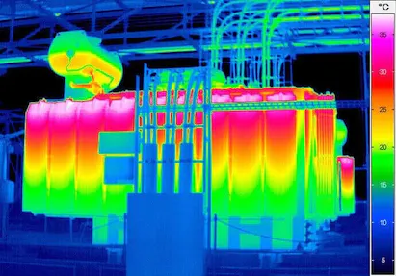
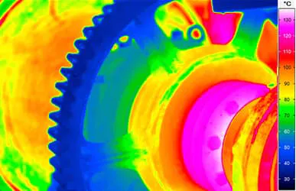
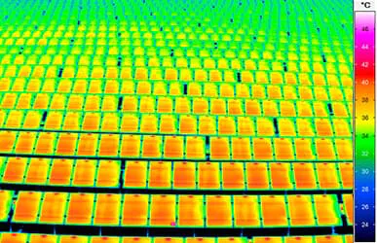
Example of Thermography Applications
Energy sector: mostly used for the identification of malfunctions, troubleshooting, and optimization

Slide 6
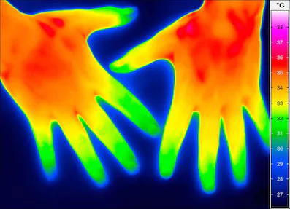
Example of Thermography Applications
Medicine: identification of anomalies in the human body and diagnosis of different pathologies

Slide 7
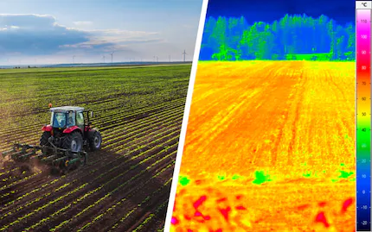
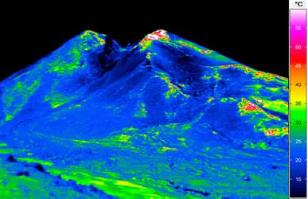
Example of Thermography Applications
Agriculture
Thermography to assess the health condition of agricultural fields, cultivations and livestock. Support production and problem individuation.
Biology and Geology
Analysis of surface heterogeneities, daily cycles of surface heating, natural and anthropogenic heat sources.

Slide 8
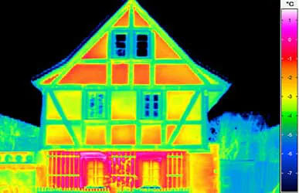
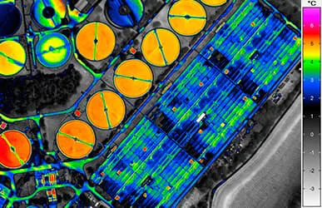
Example of Thermography Applications
Construction Industry
Façade and rooftop integrities, heat and water leaks. Thermal forcing of the building on the environment
Areal Thermography
Geological evaluation, environmental damage evaluation, surface heat island effect computation.

Slide 9
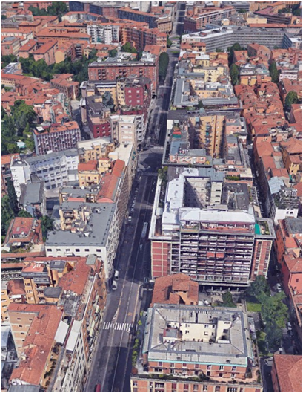
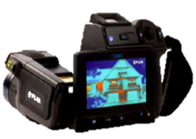

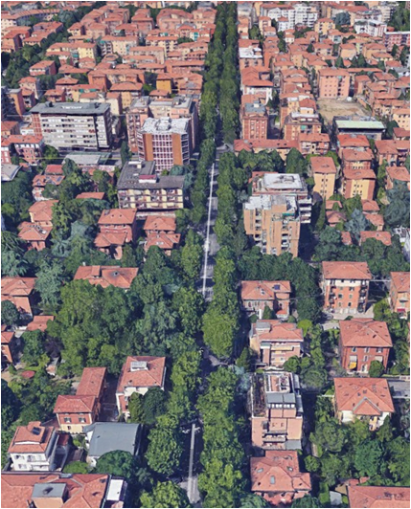
Application in Bologna: SUHI estimation
Via Marconi
H = 33m, W = 20m H/W = 1.65
Downtown, 4 lanes
No trees
ZTL, autobus, pedestrian
Densely built-up area
Thermographic campaign
Scope: Measure the surface temperature of building facades and street pavements within two urban canyons
Setup: 2 man-handled thermal cameras working simultaneously
Measure: 24-hour experiment with measurements of 10 selected buildings (plus the street) once every two hours
FLIR T620
Via Laura Bassi
H = 17m, W = 25m H/W = 0.7
Residential area, 2 lanes
Trees
No ZTL, private cars, pedestrian, cycle
Single houses or buildings, gardens

Slide 10
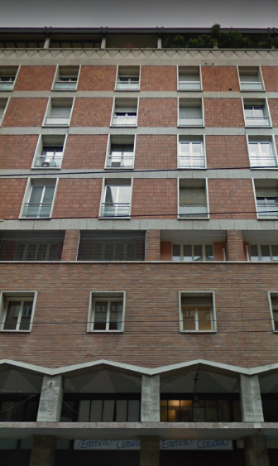
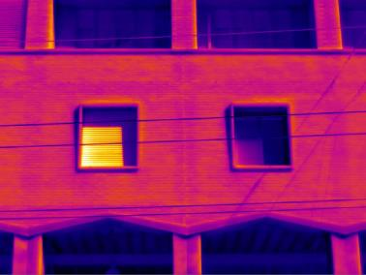
Position 1: Via Marconi, 31 - facing west (Marconi P1W)
04:00 pm - 22/08/2017

Slide 11
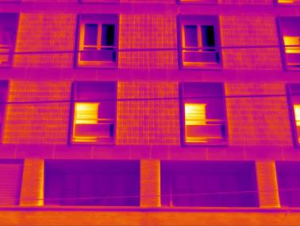
Position 1: Via Marconi, 31 - facing west (Marconi P1W)
04:00 pm - 22/08/2017

Slide 12
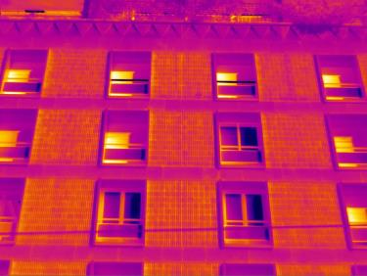
Position 1: Via Marconi, 31 - facing west (Marconi P1W)
04:00 pm - 22/08/2017

Slide 13
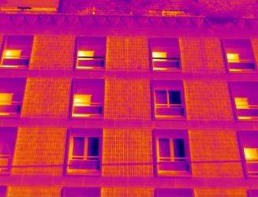


Position 1: Via Marconi, 31 - facing west (Marconi P1W)
04:00 pm - 22/08/2017

Slide 14
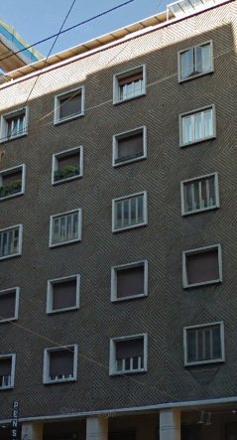
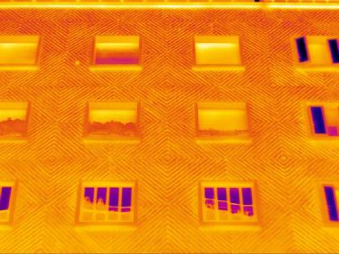
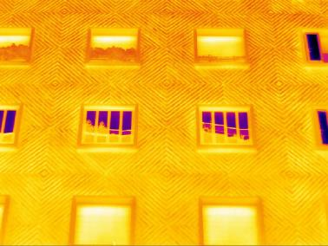
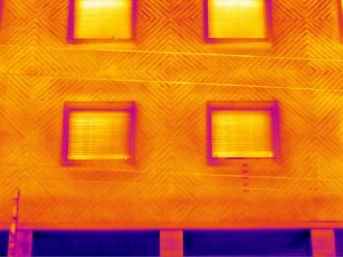
Position 5: Via Marconi, 24 - facing east (Marconi P5E)
04:00 pm - 22/08/2017

Slide 15
Marconi P1W
Marconi P5E
12:00 pm - 22/08/2017

Slide 16
Marconi P1W
Marconi P5E
02:00 pm - 22/08/2017

Slide 17
Marconi P1W
Marconi P5E
04:00 pm - 22/08/2017

Slide 18
Marconi P1W
Marconi P5E
06:00 pm - 22/08/2017

Slide 19
Marconi P1W
Marconi P5E
08:00 pm - 22/08/2017

Slide 20
Marconi P1W
Marconi P5E
10:00 pm - 22/08/2017

Slide 21
Marconi P1W
Marconi P5E
12:00 am - 22/08/2017

Slide 22
Marconi P1W
Marconi P5E
02:00 am - 22/08/2017

Slide 23
Marconi P1W
Marconi P5E
04:00 am - 22/08/2017

Slide 24
Marconi P1W
Marconi P5E
06:00 am - 22/08/2017

Slide 25
Marconi P1W
Marconi P5E
08:00 am - 22/08/2017

Slide 26
Marconi P1W
Marconi P5E
10:00 am - 22/08/2017

Slide 27
Marconi P1W
Marconi P5E
12:00 am - 22/08/2017

Slide 28
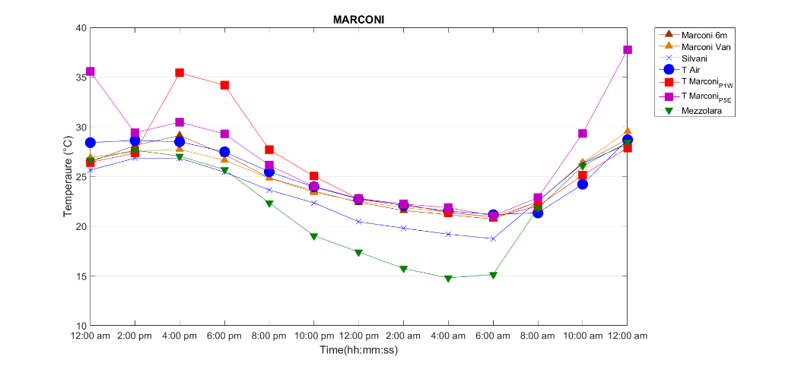
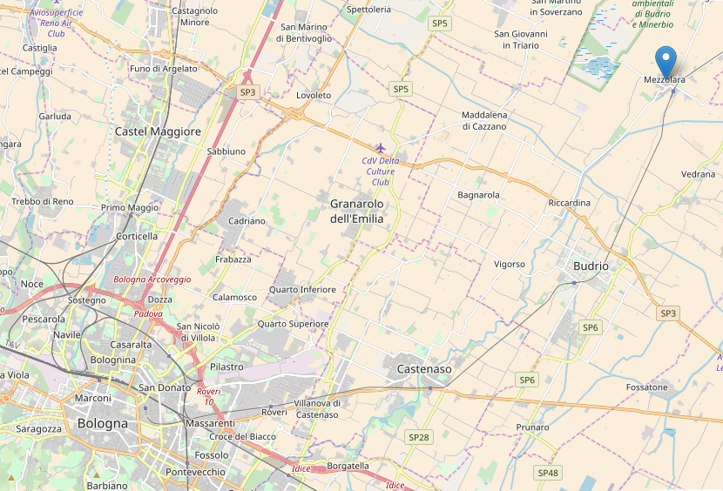
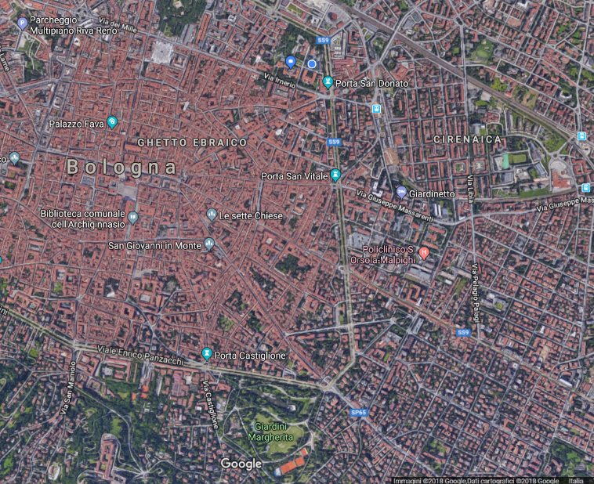
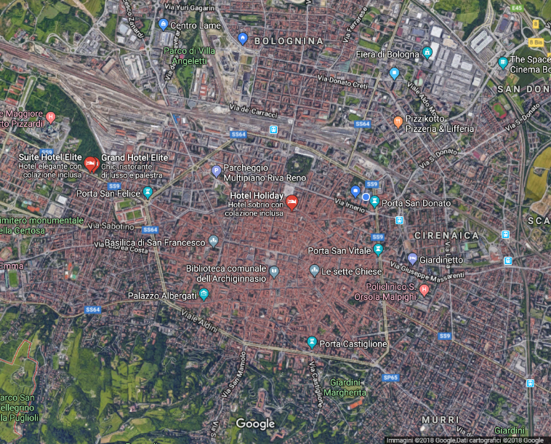
Mezzolara
Di Sabatino et al., 2020
∼ 7 °C
∼ 20km
No Trees
Bologna
Trees
Fig. (Top) Temperature evolution at different locations within Marconi St., city and rural references. (Bottom) Temperature evolution at different locations within Laura Bassi St., city and rural references
∼ 5 °C
Via Marconi
∼ 3km
Via Laura Bassi

Slide 29
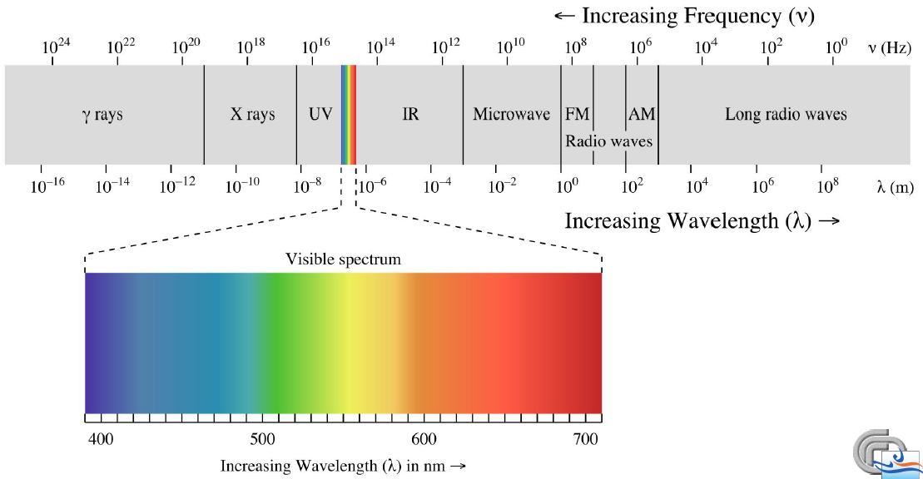

Solar Radiation
Solar radiation is the major energy source of the Earth and Climate System
For thermography, the most impactful portion of the solar radiation spectrum ranges at the infrared wavelength, where everyday bodies emit
Solar radiation has dominant frequencies in the shortwave ($λ<4 μm$) while terrestrial radiation is centered in the longwave ($λ>4 μm$)
Notes:
Energy, power and irradiance are scalar quantities, each a function of position and time. Calling S the
generic scalar quantity we can write S = S(x,t) , where x is the position vector.
Radiance at each point x, can vary with direction: L = L(x,omega (solid angle), t) = L(x,θ ,ϕ , t) .
We can say that radiance is a vector quantity,

Slide 30
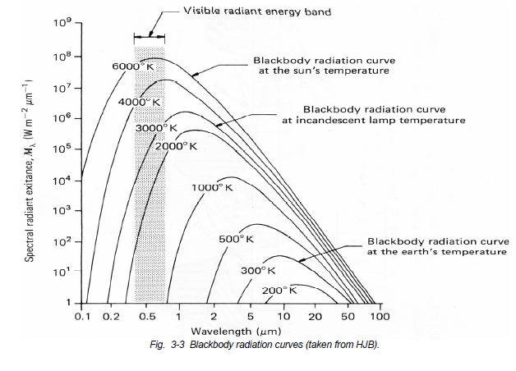

Blackbody Radiation
A blackbody is a body that is characterized by:
Complete absorption of all incident radiation
Maximum possible emission in all wavelength in all directions
The monochromatic radiance emitted from a black body is determined by the sole temperature of the black body as defined by the Planck Law (Planck function):
$$B_{λ}\left(T\right)=\frac{2hc^{2}}{λ^{5}(e^{hc/kλT}−1)}$$
$h=6.626 x {10}^{−34} Js$ (Planck constant)
$c=2.998 x {10}^{8} ms^{−1}$ (light speed)
$k=1.381 x {10}^{−23}JK^{−1}$ (Boltzman constant)
Notes:
A black body is a perfect absorber and emitter of all radiation

Slide 31




Basic laws of radiative transfer
The incident radiation (i.e., the total radiation coming from multiple sources and impacting the object) is partitioned into absorbed, reflected and transmitted components when impacting an object

Slide 32


Basic laws of radiative transfer
The radiation measured by the camera is the sum of all the components coming from all the possible sources in the ambient. If we can isolate (with reasonable assumptions) the body of our investigation, we have
Our cameras operate in the far infrared (LW=long wavelength), between 7.5 and 14 micrometres

Slide 33
How radiation interact with bodies
Absorption (α): capacity of a body to capture and contain radiation changing its internal properties
Emission (ε): capacity of a body to emit the radiation
Reflection (ρ): capacity of a body to irradiate the incident radiation without absorption at the same angle of incidence (reflection or symmetrical scattering + in all directions diffusive scattering)
Transmittance (τ): capacity of a body to be passed by radiation

Slide 34





Transmission
Transmission is the capacity of a body to be passed by radiation without interacting with it.
The capacity of the body to transmit radiation is quantified by the transmission coefficient (or transmittance) $τ_{λ}∈\left[0,1\right]$:
A perfect window has $τ_{λ}=1$
An opaque body has $τ_{λ}=$ 0
The transmitted fraction of incident radiation is $W_{τ,λ}=τ_{λ}W_{I,λ}$
$$W_{α}$$
$$W_{I}$$
$$W_{τ}$$
$$W_{ρ}$$
Notes:
Le proprietà di trasmissione dell’atmosfera sono date dalla sua composizione, dalla natura degli aerosol presenti e dalla presenza di nubi e dalle loro caratteristiche.

Slide 35





Absorption
Absorption is the capacity of a body to capture the photons of the incident radiation and convert their energy in internal energy or heat.
Absorption occurs only if the energy of the photon corresponds to the energy required to the molecule to reach a state of excitation. If absorption is not possible, reflection or transmission will occur.
$$W_{α}$$
$$W_{I}$$
$$W_{τ}$$
$$W_{ρ}$$
The capacity of the body to absorb radiation is quantified by the absorption coefficient (or absorbance) $α_{λ}∈\left[0,1\right]$:
A blackbody has $α_{λ}=1$
A perfect window has $α_{λ}=$ 0
The transmitted fraction of incident radiation is $W_{α,λ}=α_{λ}W_{I,λ}$
Notes:
I livelli energetici di un oscillatore atomico o molecolare sono limitati ad un set discreto di valori che soddisfano a ...) E=nhv.
La transizione da un livello all’altro corrisponde all’assorbimento o al rilascio di una quantità di energia multipla di hv (fotoni).
La composizione dell’atmosfera è tale da assorbire ed emettere efficacemente radiazione IR. Questo, associato alla sua relativa trasparenza alla radiazione solare, fa sì che la superficie sia più calda di quanto sarebbe senza atmosfera.
L’assorbimento di radiazione IR in atmosfera avviene da parte di molecole che costituiscono una piccola frazione della massa dell’atmosfera stessa.
La dipendenza del clima dall’abbondanza di questi costituenti minoritari rende il sistema molto sensibile ai cambiamenti (naturali o antropici) della composizione dell’atmosfera.
Cambiamenti relativamente piccoli della composizione possono influenzare il flusso di energia attraverso il sistema clima e produrre importanti cambiamenti climatici.
Per comprendere come il clima dipende dalla composizione dell’atmosfera è necessario capire i processi fisici attraverso i quali la radiazione elettromagnetica interagisce con i gas e le particelle che la compongono.

Slide 36





Scattering (reflection)
Incident waves from some source excite secondary waves from the scatterer (a parcel of matter) and the superposition of all these waves is what is observed.
The capacity of the body to reflect radiation is quantified by the reflection coefficient (or reflectance) $ρ_{λ}∈\left[0,1\right]$:
A perfect mirror has $ρ_{λ}=1$
A black body has $ρ_{λ}=$ 0
The reflected fraction of incident radiation is $W_{ρ,λ}=ρ_{λ}W_{I,λ}$
$$W_{α}$$
$$W_{I}$$
$$W_{τ}$$
$$W_{ρ}$$
Scattering
Absorption

Slide 37

Emission
The radiance emitted by a body is
$$W_{λ}=ε_{λ}B(T)$$
where $B\left(T\right)$ is the Planck function and $ε_{λ}∈\left[0,1\right]$ is the emissivity (or emittance). In a stationary equilibrium case, the source function is equal to the energy absorbed by the body.
Emissivity is defined as the ratio of the emitted radiance and that of a blackbody (through the Planck function) at the same wavelength:
$$ε_{λ}=\frac{W_{λ}}{B_{λ}(T)}=\frac{W_{λ}}{σT^{4}}$$
Keep in mind that the energy absorbed by a body depends on the energy of the incident radiation and on the body absorbance. The energy emitted depends on the emissivity (and so the material) of the body and its temperature.
Kirckhoff law: $α_{λ}=ε_{λ}$

Slide 38

Radiation Balance
If $α_{λ}$, $ρ_{λ}$, and $τ_{λ}$ represent the fractional absorption, reflectance, and transmittance, respectively, then conservation of energy says
$$α_{λ}+ρ_{λ}+τ_{λ}=1$$
A perfect mirror has $ρ_{λ}=1$, and $α_{λ}=τ_{λ}=0.$
A black body has $α_{λ}=$ 1, and $ρ_{λ}=τ_{λ}=0$.
An opaque body has $τ_{λ}=0$, so radiation is either absorbed or reflected $α_{λ}+ρ_{λ}=1$

Slide 39
Radiation extinction by the atmosphere
Solar radiation is extincted by the atmospheric gases, aerosols and clouds.
The transmitted portion of the solar radiation arrives at the Earth surface and it is mostly absorbed by the hydrosphere, lithosphere, cryosphere and biosphere, and in minimal part reflected.
Notes:
Equation 3-56 allows to compute the radiance at any height and direction at any wavenumber,
provided we know how the mass absorption coefficient, as well as density of the radiatively active
gas vary along the path (or along the vertical). As already mentioned it is possible to use same
equation to compute the radiance (or irradiance, assuming that the Sun is a point source) spectrum for the spectral interval of interest (say, from 0.2 to 5 microns corresponding to 50000 to 2000 cm-1) provided we account for all the gaseous species that interact with incoming Suns radiance.

Slide 40

Emission
We consider a grey body, i.e. an opaque body (transmittance equals zero) that absorbs with the same efficacy at each wavelength, and a black body, in the form of infinite plates exchanging radiation only. Consider the plates in thermal equilibrium, i.e. plates absorb and emit the same amount of energy (this can be reached by introducing a medium between the plates).
The single plate balance will be
$$blackbody: ε_{g}σT^{4}α_{b}+ε_{b}σT^{4}ρ_{g}α_{b}=ε_{b}σT^{4}$$
$$greybody: ε_{b}σT^{4}α_{g}=ε_{g}σT^{4}$$
Considering that $ε_{b}=α_{b}=1$ and resolving the equation system we get
$$α_{g}σT^{4}+ρ_{g}σT^{4}=σT^{4}$$
$$α_{g}σT^{4}=ε_{g}σT^{4}$$
The first equation is an identity since $α_{g}+ρ_{g}=1$.
The second is the Kirckhoff law that can be generalized as: $α=ε$
Kirckhoff law holds also if we consider two opaque grey bodies
Notes:
Kirckhoff law holds at each wavelength so that alpha_lambda=epsilon_lambda

Slide 41





Basic laws of radiative transfer
Simple laws govern the ability of each body to interact with the radiation
A black body has
Real (opaque) bodies have
and

Slide 42
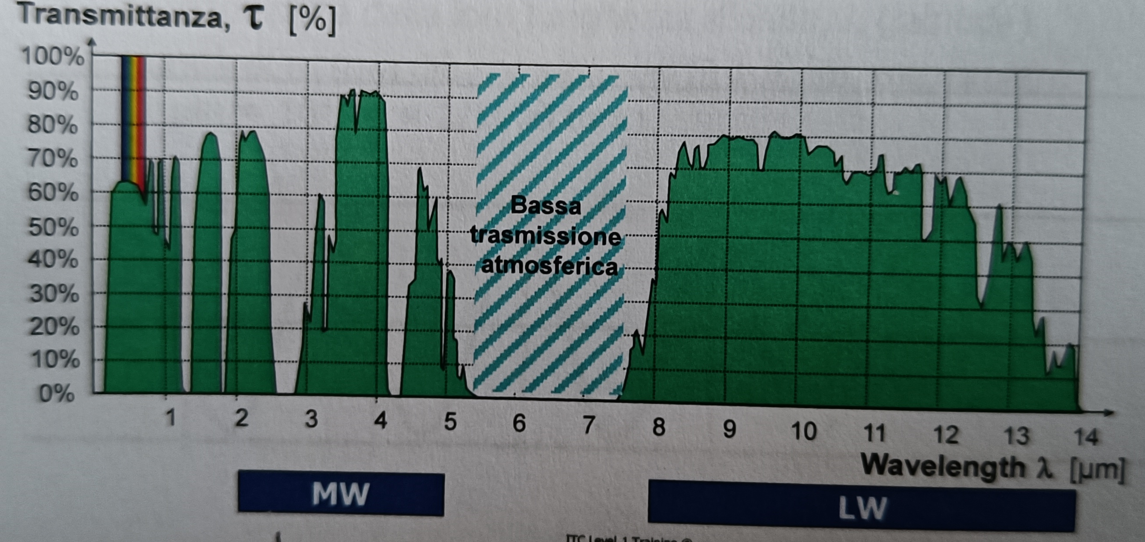
Operational range of the IR camera
The percentage of transmitted radiation by the atmosphere and operational ranges of the thermal cameras
Our cameras operate in the far infrared (LW=long wavelength), between 7.5 and 14 micrometers

Slide 43
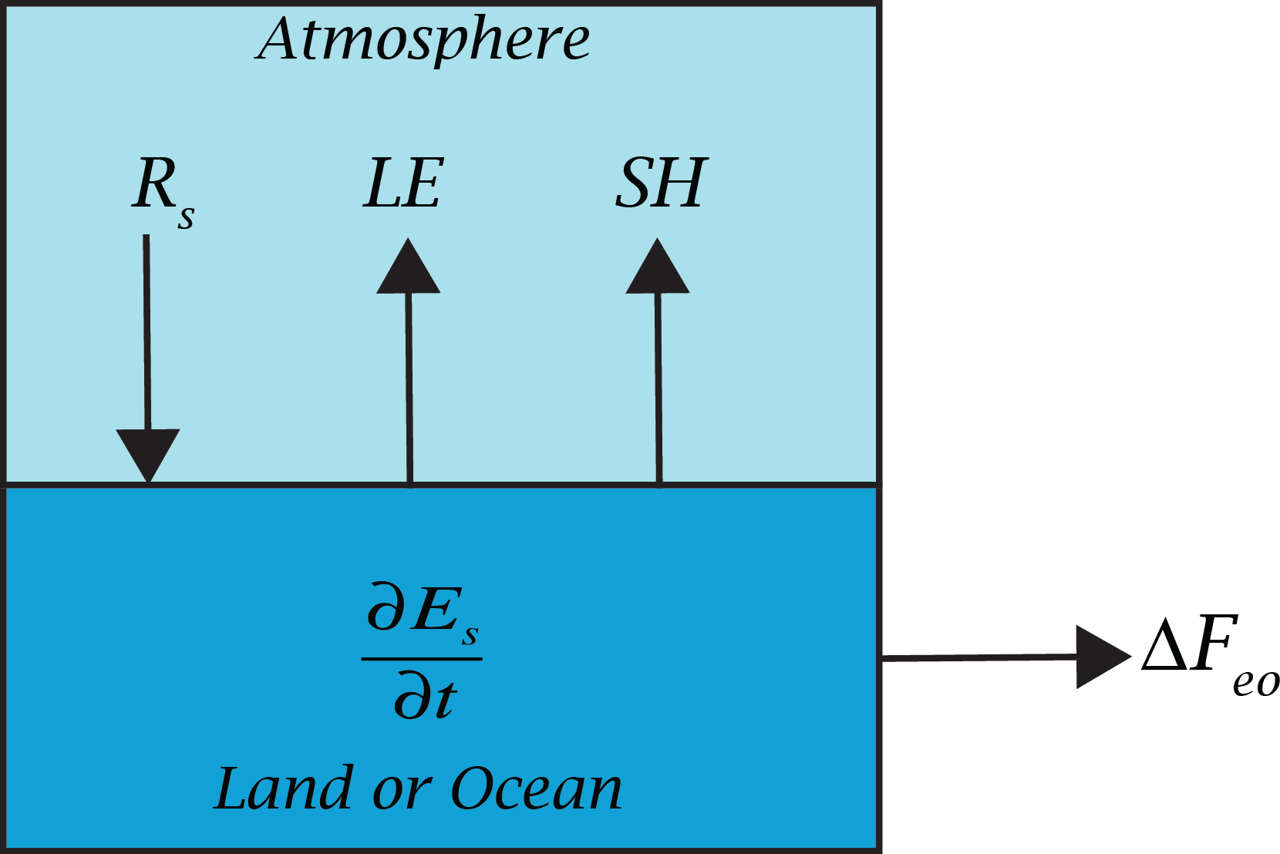


Surface Energy Balance
The processes that determine energy transfer between the surface and atmosphere include solar and infrared radiative transfer, fluxes of energy associated with fluid motions of the atmosphere and ocean, and movement of energy through the soil.
In the most general form, the surface energy balance can be written as
$$\frac{∂E_{S}}{∂t}=R_{S}−LE−SH−ΔF_{eo}$$
where $∂E_{S}/∂t$ is the storage of energy in the soil and water, $R_{S}$ is the net radiative flux of energy at the surface, $LE$ is the latent heat flux from the surface to the atmosphere, $SH$ is the sensible heat flux from the surface to the atmosphere and $ΔF_{eo}$ is the horizontal flux out of the column of land–ocean below the surface.
Notes:
Under most conditions, radiation heats the surface and latent and sensible heat fluxes cool it, so that the radiative, latent, and sensible heat flux terms in (4.1) and (4.2) are most often positive.
The physical meaning of (4.1) is that the storage of energy below the surface is equal to the net radiative input minus the heat lost from the surface by evaporation, sensible heat flux, and horizontal heat transport to other latitudes or longitudes. In constructing (4.1) we have left out a multitude of other terms that can be important locally or for brief periods. These terms include the following:
The latent heat of fusion required for melting ice and snow in spring may require 10% of the radiative imbalance for limited periods.
Conversion of the kinetic energy of winds and waves to thermal energy is generally small.
Heat transfer by precipitation can occur if the precipitation is at a different temperature than the surface. This mechanism is particularly important during summer showers, because the precipitation can be much cooler than the surface, and the thermal capacity of water is large.
Some solar energy is not realized as heat, but is stored in the chemical bonds formed during photosynthesis. This is less than 1% globally, but can be ∼5% locally for limited periods of time.
Heat release by oxidation of biological substances, as in biological decay or forest fires, is the reverse of photosynthesis. Energy bound up in biological matter during photosynthesis is returned to the physical climate system through oxidation. This process takes place year round, but proceeds most rapidly when the surface is warm and moist.
Geothermal energy release in hot springs, earthquakes, and volcanoes is small in a global sense.
Heat released by fossil fuel burning or nuclear power generation can be important locally, but is not significant for the global energy balance.

Slide 44

Heat Storage
Energy storage in the surface is very important for the seasonal cycle of temperature over the oceans and the diurnal cycle over land and ocean. The amount of energy in the surface may be written as the product of an effective heat capacity for the earth–ocean system ${\overline{C}}_{eo}$ and a corresponding mean temperature $T_{eo}$
$$E_{S}={\overline{C}}_{eo}T_{eo}$$
The heat capacity (the amount of energy that is required to raise the temperature of the body by 1°C) is defined as the heat required to force a temperature variation
$$C=\frac{Q}{ΔT}=\frac{mc_{p}ΔT}{ΔT}=mc_{p}$$
where $c_{p}$ is the specific heat at constant pressure (the amount of energy that is required to raise the temperature of a unit mass of a body by 1°C keeping the pressure as constant).

Slide 45

Sensible and Latent Heat
Sensible heat flux $SH$ is the transfer of heat through conduction between the surface and the atmosphere that does not imply a variation in the state of the involved particles.
$$SH=c_{p}ρC_{DH}U_{r}(T_{S}−T_{a}(z_{r}))$$
Latent heat flux $LE$ is the emission or absorption of heat by water particles during a phase change.
$$LE=LρC_{DE}U_{r}(q_{S}−q_{a}(z_{r}))$$
where $ρ$ is the air density, $c_{p}$ is the specific heat at constant pressure, $L$ is the latent heat of vaporization and $C_{DH}$ and $C_{DE}$ are aerodynamic transfer coefficients for heat and moisture, respectively. Subscripts $S$ and $a$ indicate values for the surface and the air at the reference level, respectively.
Evaporation is the change of state in a substance from a liquid to a gas.
For evaporation to take place, energy is required. The energy can come from any source: the sun, the atmosphere, the earth, or bodies on the earth such as humans.
Evaporation cools the fluid/surface the liquid evaporates from as it uses its heat to complete the phase change. Evaporation does not change the temperature of the evaporated particle but that of the fluid/surface the particle evaporates from.

Slide 46
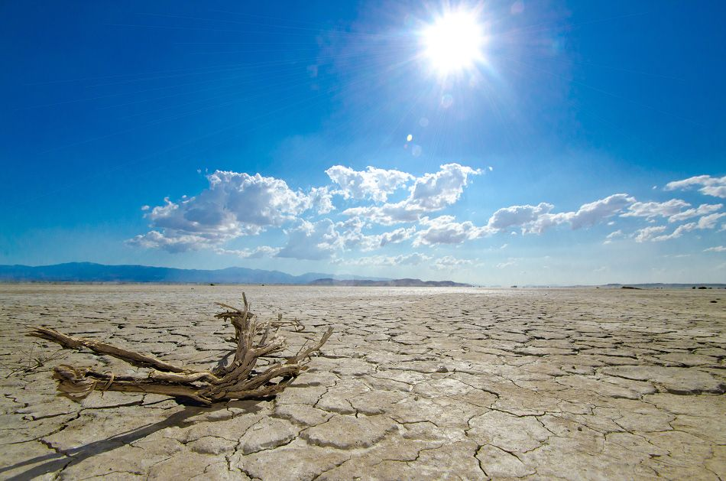
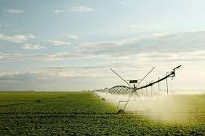
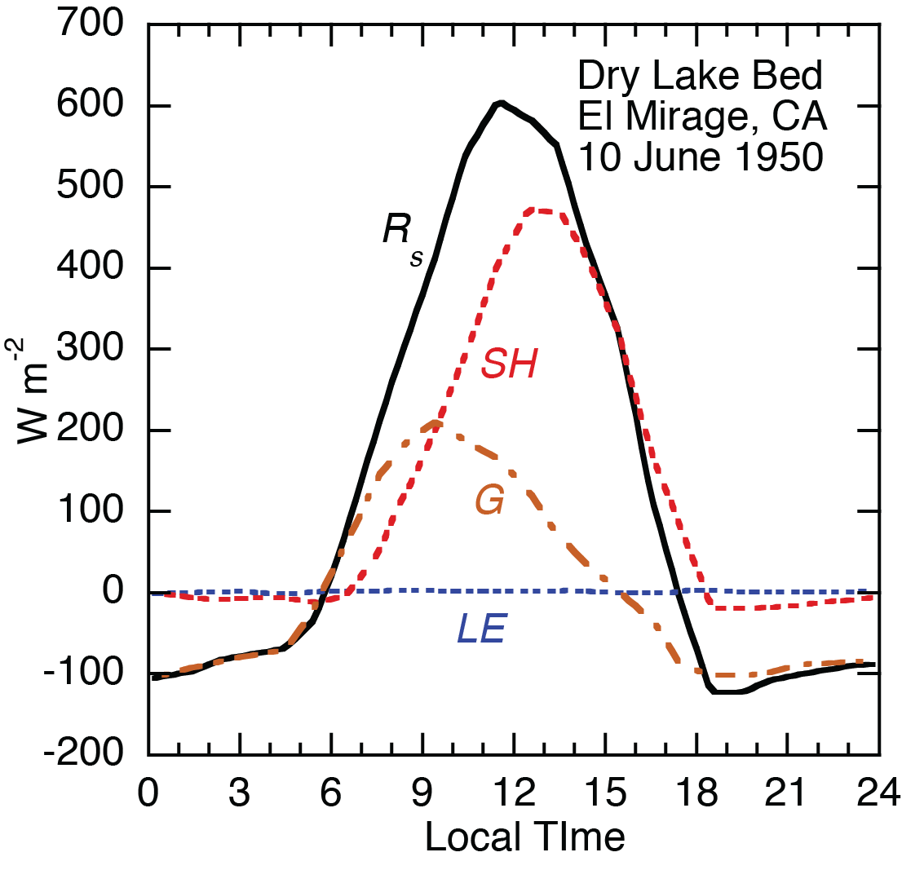
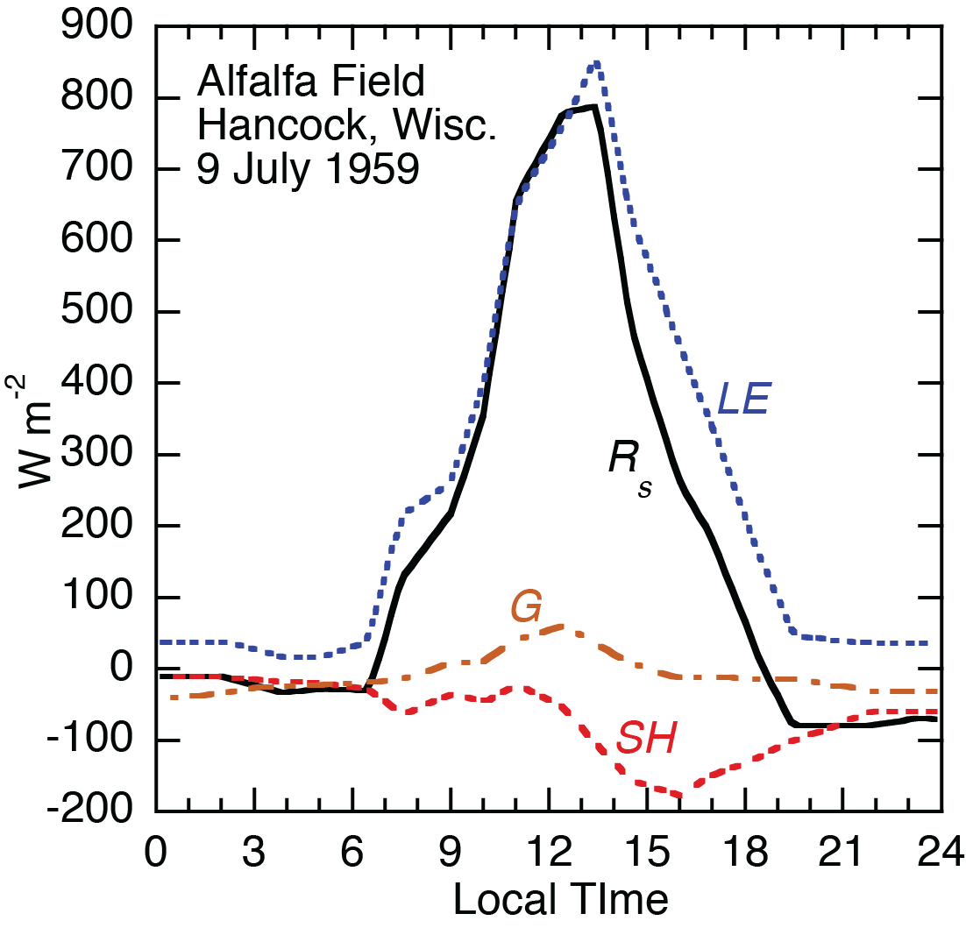
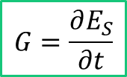
Surface Energy Balance
$$G=\frac{∂E_{S}}{∂t}$$
Notes:
Fig left: The diurnal cycle in surface energy balance components for a dry, barren lake bed is shown in Fig. 4.12. The surface soil moisture was measured at about 2% at the time the measurements were taken, so evaporation plays virtually no role in the energy balance. At night the net radiation balance is negative as the surface emits radiation into the dry desert air. The radiative cooling of the surface is balanced by energy lost from the soil as it cools through the night. Sensible heat flux is nearly zero at night because the winds are weak and the cold air near the surface is denser than the warmer air above. The high vertical stability associated with the nighttime temperature inversion suppresses the turbulent exchange of energy. Sunrise occurs at about 5 am and the surface cooling decreases rapidly. In the early morning, the net radiative heating is largely balanced by storage of heat in the ground. After mid-morning the strong daytime radiative heating is balanced primarily by upward sensible heat flux by atmospheric turbulence. The sensible heat flux peaks shortly after noon, and by mid-afternoon the surface has begun to cool because the sensible cooling exceeds the net radiation.
Fig middle: The heat budget for a mature cornfield during a clear day in late summer is shown in Fig. 4.13. Again the net radiation is weakly negative at night and goes through a strong positive maximum during the day. The nighttime radiation loss is balanced about equally by release of stored surface heat, downward sensible heat flux, and dewfall. Although the corn is nearly 3 m tall, a substantial amount of heat reaches the soil so that storage in the soil and corn stalks is an important part of the energy balance during the day. The surface soil is dry, but the corn roots have sufficient water. Sensible cooling is about half of the evaporative cooling, when averaged over the day. The peculiar change in the latent and sensible cooling near noon is thought to be related to the north–south orientation of the cornrows. When a surface is wet, or when growing vegetation has ample soil water for evapotranspiration, the net radiation may be almost entirely used for evaporation, with the soil storage and sensible heat fluxes being of minor importance.
Fig right: When warm and dry air moves over a surface with ample water, the evaporative cooling may actually exceed the net radiation. Figure 4.14 shows the energy balance on a day when winds carry warm dry air over a well-irrigated alfalfa field. Evapotranspiration equals or exceeds the net radiation at every hour of the day, and evaporation continues even through the night. The excess of the evaporative cooling over the net radiation is provided by downward sensible heat flux, with turbulent motions carrying heat downward to the evaporatively cooled surface. For small, irrigated plots in hot, arid regions, the sensible heating of evaporatively cooled surfaces can add to the water demand.

Slide 47
How to use the infrared camera

Slide 48
Settings
Before taking the photo (mandatory, unchangeable after):
  Adjust the focus of the camera
  Set the range of temperature (set by us)
  Determine the area of interest
Other settings adjustable after the image is acquired:
  Level and span
  Color table
  Object (Ambient) parameters

Slide 49
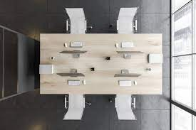
Focus
An image with an incorrect focus is useless!
To adjust the focus, point the camera on a surface with square geometry and large thermal contrast
A wooden table on a marble floor

Slide 50
Temperature range
Set the temperature range choosing between the option of your camera and depending on your image
The temperature range is meant to restrict all the pixels of your image within a known temperature, not to detail a certain portion of your image
If a pixel is outside the temperature range, the camera will let you know before taking the shot
Do not point the camera to the sun!!

Slide 51
Area of interest
It defines the area we want to capture with the shot
The subject of our investigation should be in the centre of the image
The cameraman should be at a convenient distance from the object and a convenient angle to avoid self reflection

Slide 52
Level and Span
The span is the range of the thermal scale (not the temperature range) on the screen (it is defined by the minimum and maximum temperature the camera is reading at each moment; it is based on what we look at).
The level is the central value of the span (located in the photographic area).

Slide 53
Color table
It defines how we are going to visualize the thermal image (remember the raw thermal image is in black and white)
It helps detailing certain aspects depending on the choice of color table
Rule of Thumb: use high-contrast color table for images with low span, low-contrast color table for images with high span

Slide 54
Ambient parameters
Parameters to be set to make our measurement realistic
To change the parameters means to change the temperature

Slide 55
Setup the ambient parameters
The ambient parameters are emissivity, reflective apparent temperature, air temperature, relative humidity and distance (plus transmittance compensation when a transmitting body is considered).
Setting these parameters allow to compensate for the object radiative properties and the filter of the atmosphere

Slide 56
Operate in "apparent temperature" mode
The apparent temperature is the temperature measured by the infrared camera if we assume that all the radiation comes from a black body near the camera
To setup the camera for the apparent temperature mode, you must set the emissivity to 1 and the distance to 0 m
The more the emissivity of a body approaches 1, the more the apparent temperature is the real temperature of the object

Slide 57
Reflective apparent temperature – an estimation of the ambient temperature
It is the apparent temperature of the objects which are reflected to the infrared camera by the object we want to analyze
It is not the atmospheric temperature!!

Slide 58
Reflective apparent temperature – an estimation of the ambient temperature
How to measure the reflective apparent temperature
Direct method: In apparent temperature mode, I select the angle between myself and the object and then search the main reflective source at 180° - the angle

Slide 59
Reflective apparent temperature – an estimation of the ambient temperature
How to measure the reflective apparent temperature
Official method: Apply an aluminum foil (high reflective matter) on the object and measure only the value on it

Slide 60


Reflective apparent temperature – an estimation of the ambient temperature
Given the object emissivity and apparent reflective temperature, the infrared camera automatically computes the real reflectance
and removes the reflective radiation

Slide 61
Emissivity
Measure the emissivity of the object you are going to measure before taking the snapshot
Tabled emissivity for different materials are good approximation but do not consider impurities, dirtiness and roughness
We are going to produce our own emissivity table

Slide 62
High vs Low emissivity
In bodies with high emissivity (non-metal objects):
  Apparent and real body temperature are close
  The apparent temperature is already a good measurement
In bodies with low emissivity (non-oxidized metal objects):
  The apparent temperature is close to the ambient temperature
  The camera will see more reflected then emitted radiation
  Temperature estimation will not be reliable even compensating for the emissivity

Slide 63
Factors that modify the emissivity
Material: trivial
Surface: a roughness surface has an apparent larger emissivity than a smooth one
Geometry: cavities increases emissivity
Angle: you should always put yourself at an angle larger than 0° (to avoid self-reflection) and less than 50° to take the shot. A 10-15° angle is optimal

Slide 64
Factors that modify the emissivity
Wavelength: the emissivity on my camera can be different from another if the range of measured wavelength is different
Temperature: high/low temperature may modify the state of the material
Impurities: dirty, oxidation, irregularities modify the emissivity

Slide 65
Measuring conditions
The object must have:
Zero/Negligible transmittance (opaque)
A known emissivity
A known reflectivity (computed from emissivity)
A location on an ambient context we can evaluate and exclude

Slide 66
The Laboratory Experience

Slide 67
Scope
Evaluate the temperature transition of a surface associated with heat exchange with the atmosphere, with and without a heating source (e.g., the sun).
Evaluate the different temperature transitions of homogeneous dry, homogeneous wet and wet surfaces with impurities hit by the same heating.
Quantify the impact of heat storage and evaporation.

Slide 68

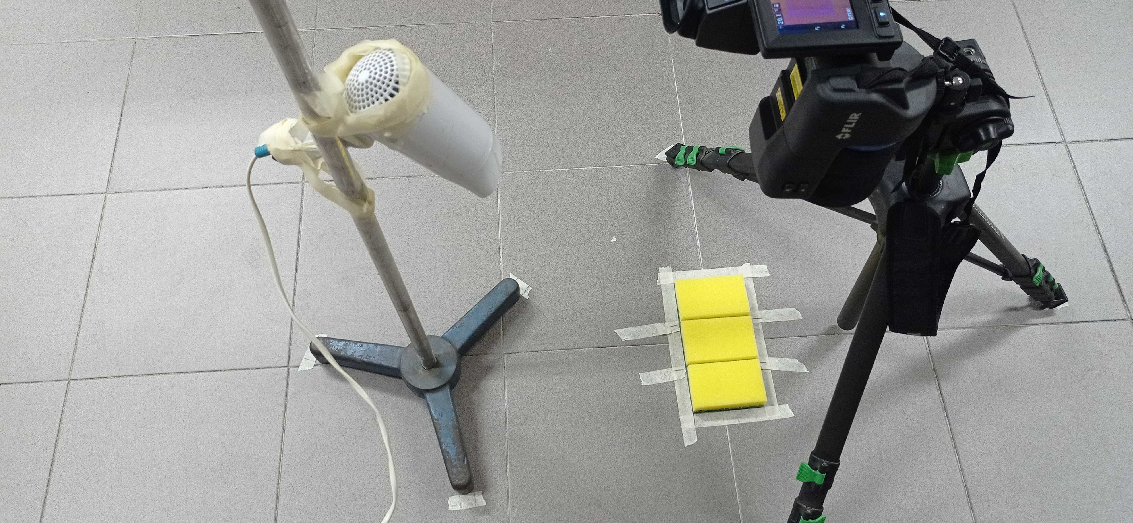
Environmental vs Lab setup
Surface under examination
Heat Source

Slide 69
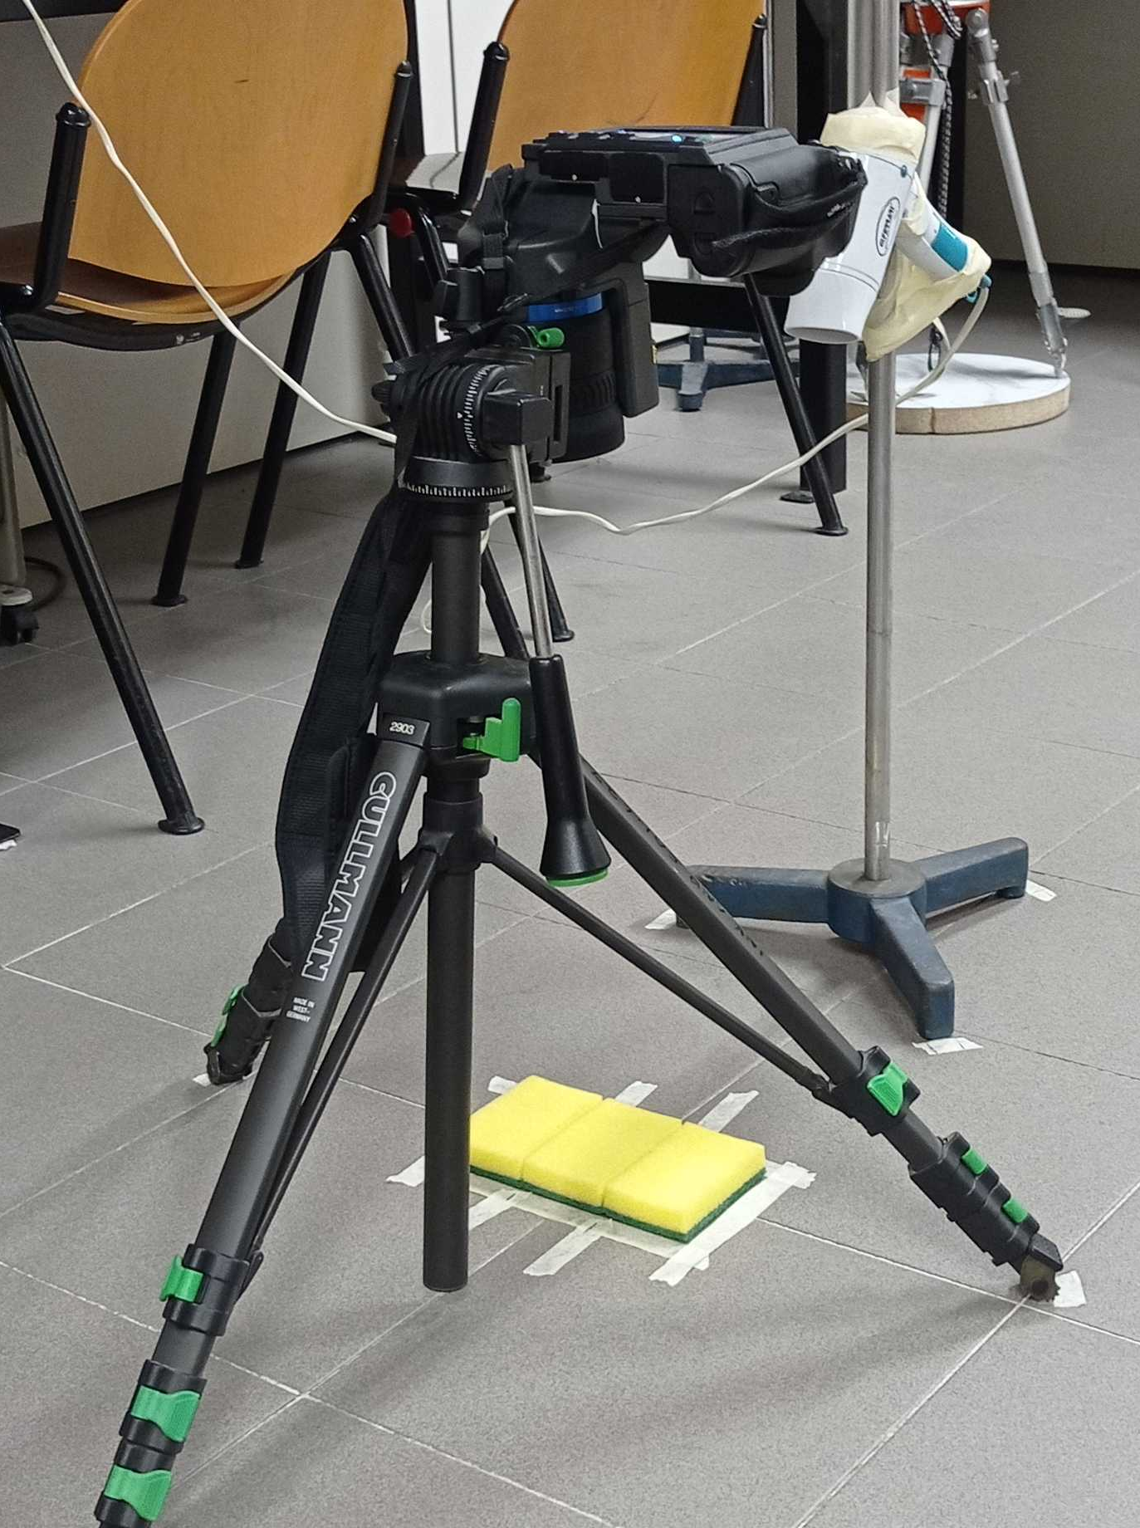
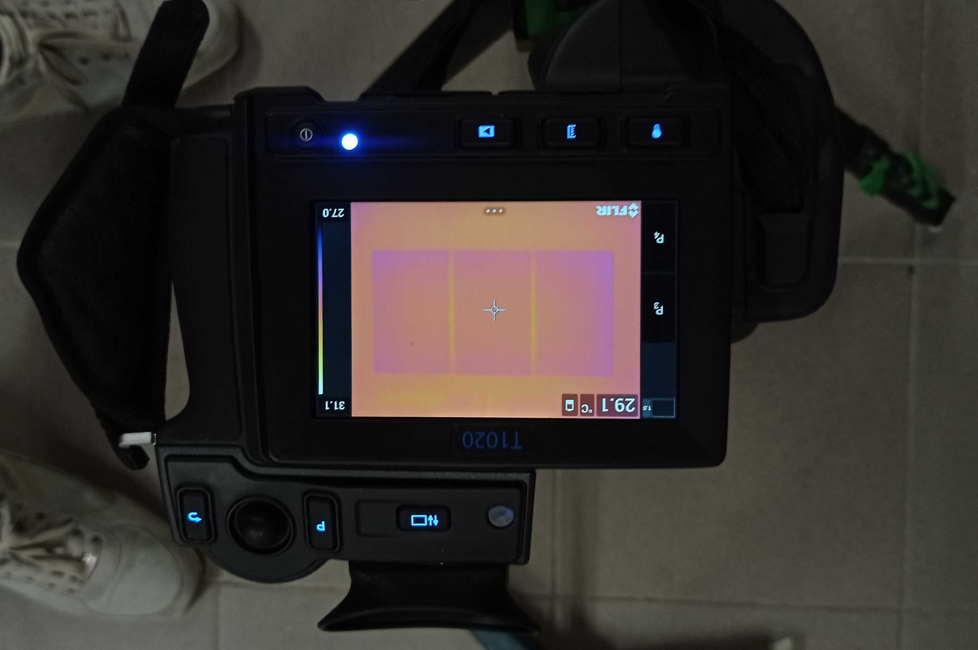
Lab setup
Dry sponge
C_{p} = 1.28 J/g°C
The Domain
Heat Source
Wet sponge
C_{p} = 4.186 J/g°C
Wet-salty sponge
C_{s} = 35 g/Kg
C_{p} = 3.901 J/g°C
Surface under examination
M_{sponge} = 10 g
M_{wet sponge} = 50 g

Slide 70
The experience
The exercise will consist of four phases of constant monitoring to “force” the heat storage and evaporation effects of the sponge:
Heat storage: evaluate the effect of warming and cooling of the sponges’ surface when evaporation is prevented
Evaporation: evaluate the effect of warming and cooling of the sponges’ surface when evaporation is permitted (Latent heat of evaporation, L_{wet sponge} = 2272 J/g, L_{salty sponge} = 2360 J/g)

Slide 71
Research Questions
What is the role of heat capacity in the surface temperature transitory?
What is the role of evaporation on the surface temperature transitory?
How do impurities impact the transitory?
What is the heat exchanged with the atmosphere during the different phases?
How do the surfaces exchange heat?
Is there parallelism with an outdoor environment?

Slide 72
Supporting material
At the end of the experience, the group will be provided with:
The collected sequence of thermal images measured with the IR camera, both in .jpg and .mat
A code in MATLAB to retrieve and save the surface temperature from the images in a text file
  Tune the input/output
  Manual identification of the pixel of temperature retrieval

Slide 73
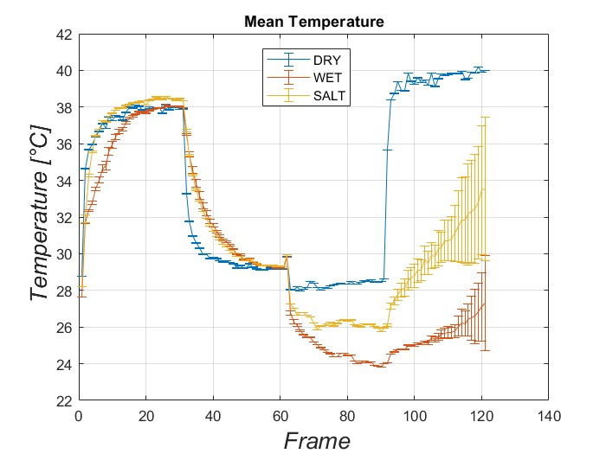
Fasi dell'esperimento
4 fasi da almeno 15 minuti circa ognuna:
1a) Fon acceso con pellicola
2a) Fon spento con pellicola
3a) Fon spento senza pellicola
4a) Fon acceso senza pellicola
In fase 1 e 2 domina l'effetto del calore specifico,
in fase 3 l'evaporazione,
in fase 4 entrambe.
4
1
2
3

Slide 74
Fase 1 (Fon acceso con pellicola)
Il riscaldamento delle spugne è regolato dal diverso calore specifico c_{p}:
- 1.28 J/(g°C) per l'asciutta;
- 3.67 J/(g°C) per la salata;
- 3.92 J/(g°C) per la bagnata.
Più è basso il calore specifico più la spugna si riscalderà prima, fino a raggiungere tutte la stessa temperatura d'equilibrio.
4
1
2
3

Slide 75
Fase 2 (Fon spento con pellicola)
Il raffreddamento delle spugne è regolato dal diverso calore specifico c_{p}:
- 1.28 J/(g°C) per l'asciutta;
- 3.67 J/(g°C) per la salata;
- 3.92 J/(g°C) per la bagnata.
Più è basso il calore specifico più la spugna si raffredderà prima, fino a raggiungere tutte la stessa temperatura d'equilibrio.
4
1
2
3

Slide 76
Fase 3 (Fon spento senza pellicola)
L'ulteriore raffreddamento delle spugne bagnata e salata è dovuto all'evaporazione.
La spugna bagnata si raffredda più velocemente perché parte del calore in quella salata serve a rompere I legami tra acqua e sale. Se le due spugne fossero egualmente umide, esse raggiungerebbero la stessa temperatura di equilibrio.
4
1
2
3

Slide 77
Fase 4 (Fon acceso con pellicola)
Il riscaldamento è dovuto al diverso calore specifico tra le spugne, a cui si sottrae il contributo evaporativo accentuando le differenze tra le spugne rispetto alla fase 1.
La spugna asciutta risulta più calda perché abbiamo tolto la pellicola, la quale è un isolante.
Nelle spugne bagnata e salata il contributo evaporativo cresce all'aumentare della temperatura. La superficie porosa della spugna fa sì che si creino delle disomogeneità di umidità sulla superficie della spugna, che influiscono poi su quanto le spugne si riscaldano localmente. Il sale rende la superficie ancora più disomogenea.
Lasciando andare l'esperimento per molto tempo, le spugne si asciugherebbero decretando la fine dell'evaporazione. Tutte le spugne raggiungerebbero la stessa temperatura d'equilibrio.
4
1
2
3

