Slide 1

Characterization of optical (and IR) solid state detectors
SUMMER SCHOOL on
PHYSICAL SENSING & PROCESSING – V EDITION
Department of Physics & Astronomy – University of Bologna
July 17-21, 2023

Slide 2
Atomic Silicon

Slide 3
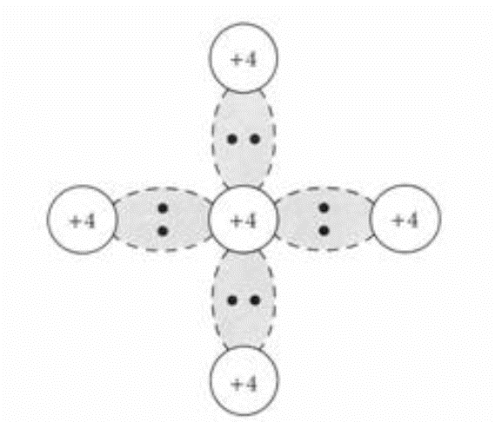
INFINITE crystal lattice of PURE Si

Slide 4
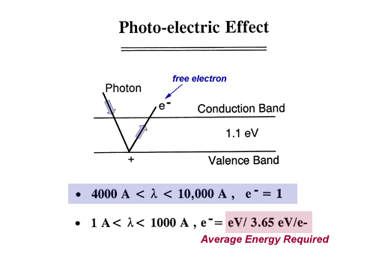
Photoelectric effect
In the infrared the most used material for astrophysical imaging is the compound HgCdTe.
By varying the percentage of Hg to Cd the width of the forbidden energy gap is adjusted → cut-off wavelength is moved
Hg_{1-x}Cd_{x}Te
x=0.196 Eg=0.09Ev λ=14um
x=0.295 Eg=0.25Ev λ=5um
x=0.55 Eg=0.73Ev λ=1.7um

Slide 5
Quantum efficiency / depth of absorption
10 um
0,1 um

Slide 6
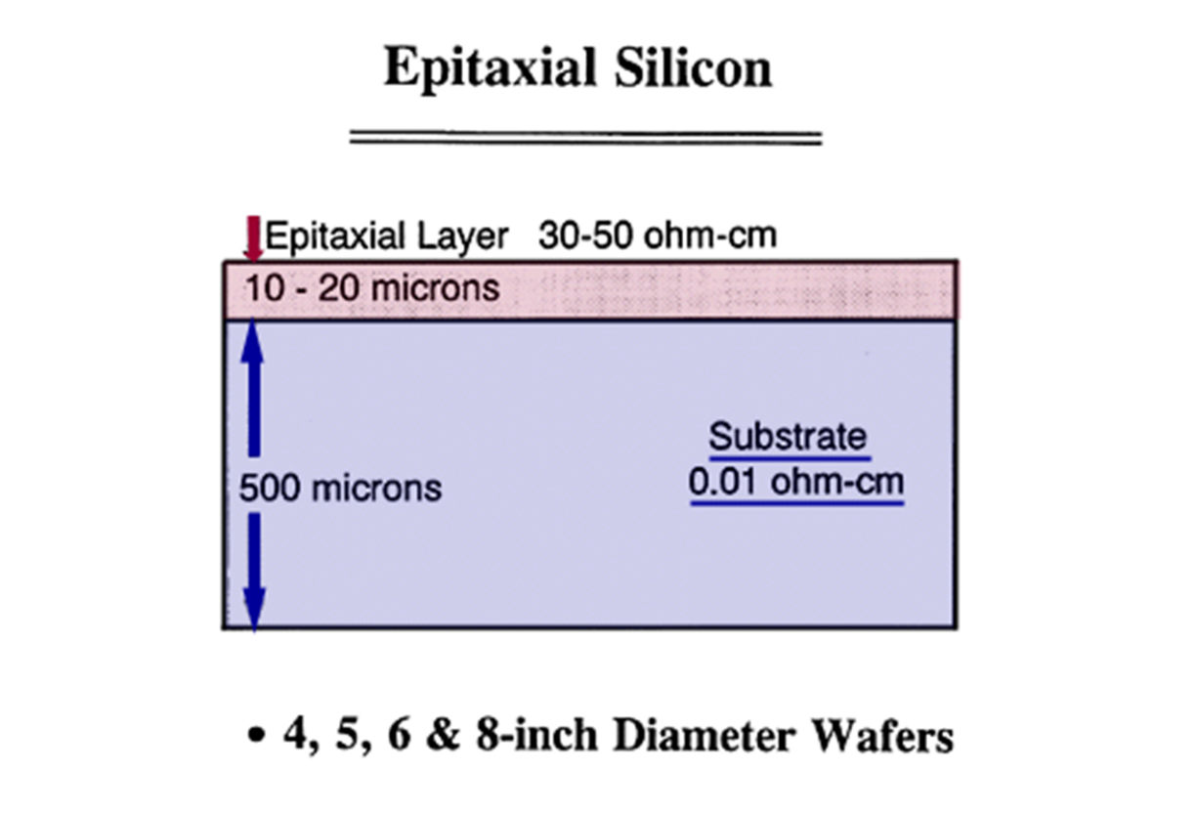
Physical dimensions
High quality epitaxial layer (high perfection of crystal lattice and absence of impurities – except dopant) is growth on top of a substrate. Detection takes place in this region.
Substrate (optically tick) provides mechanical support and electrical groud.

Slide 7
Charge collection 1: p-n junction depletion

Slide 8
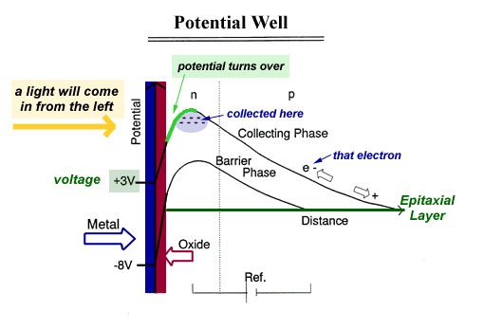
Charge collection 2

Slide 9
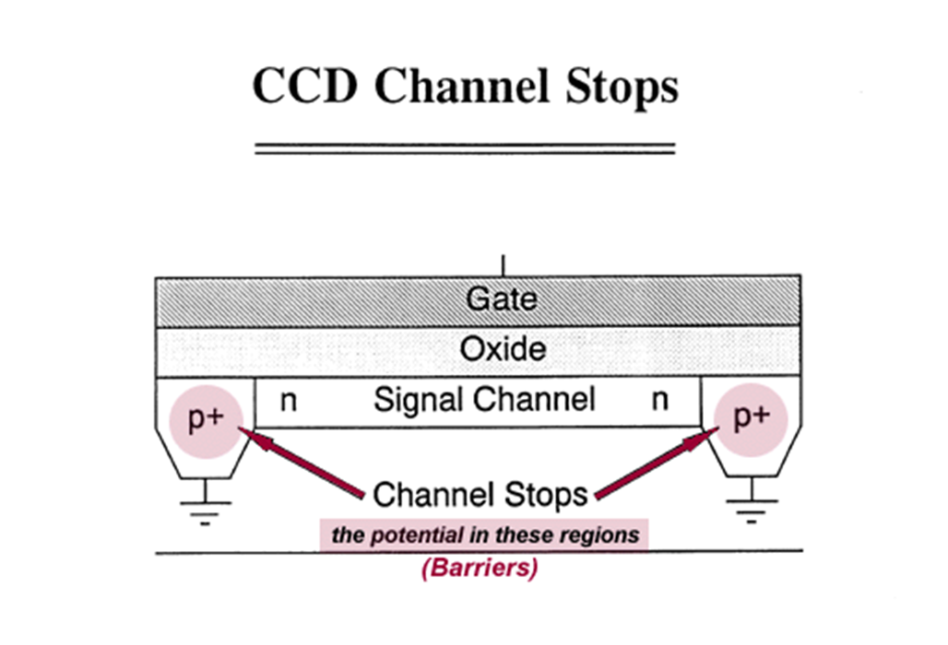
Pixels on CCD 1

Slide 10
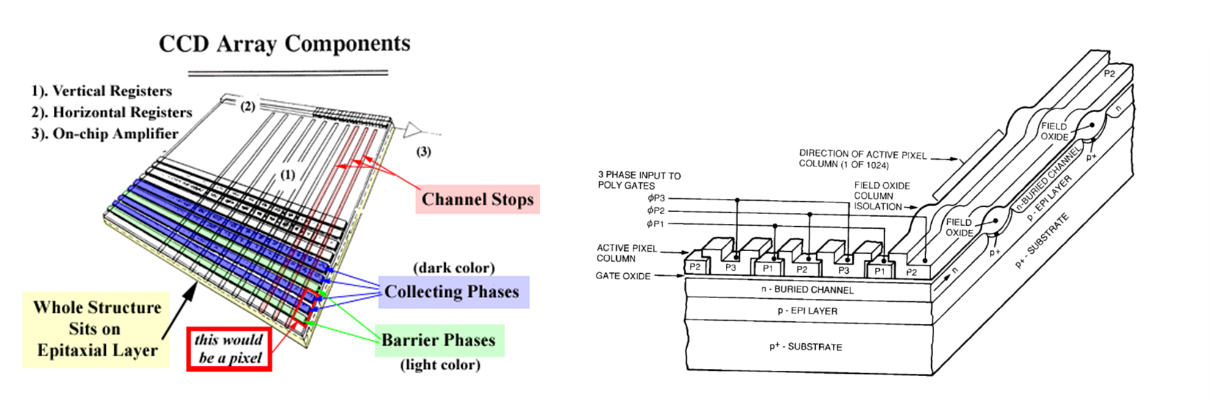
Pixels on CCD 2

Slide 11
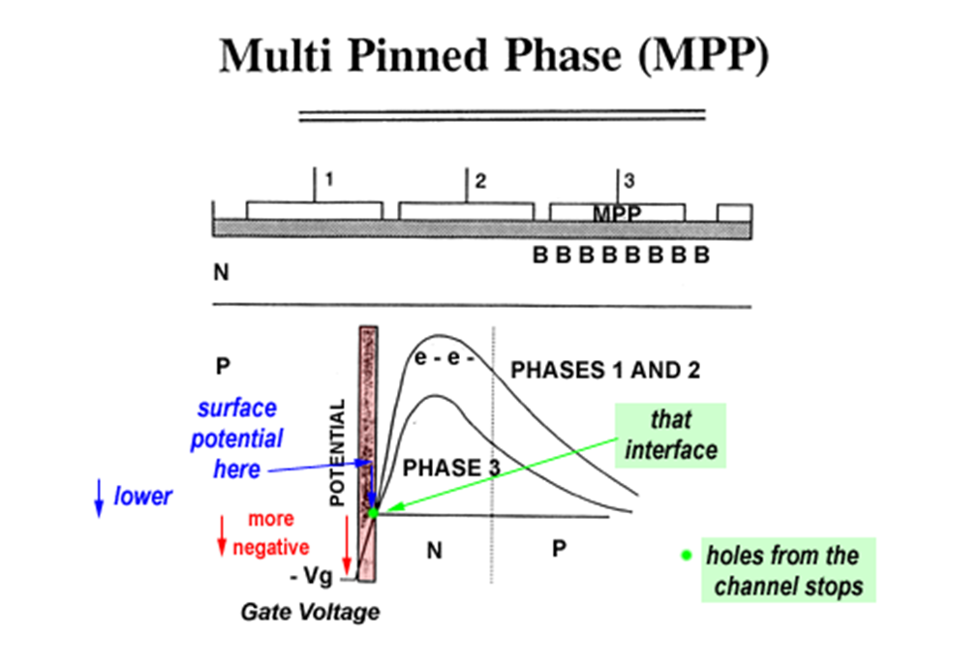
Multi Pinned Phase MPP

Slide 12
CMOS pixel architectures 1

Slide 13
CMOS pixel architectures 2

Slide 14
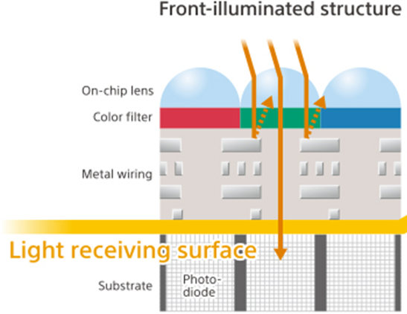
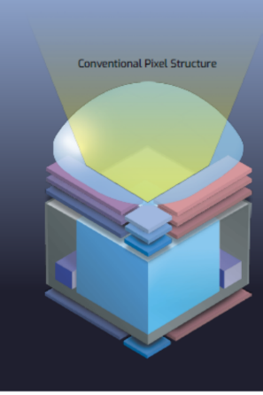
CMOS pixels arrangement 1
(front illumination)

Slide 15
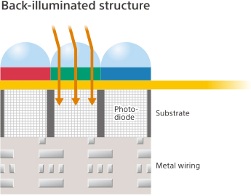
CMOS pixels arrangement 2
(backside illumination)

Slide 16
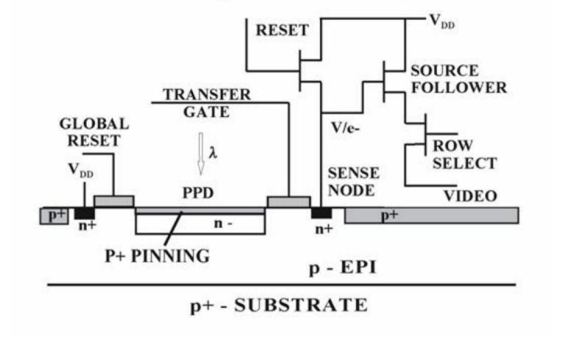
Charge measurement

Slide 17
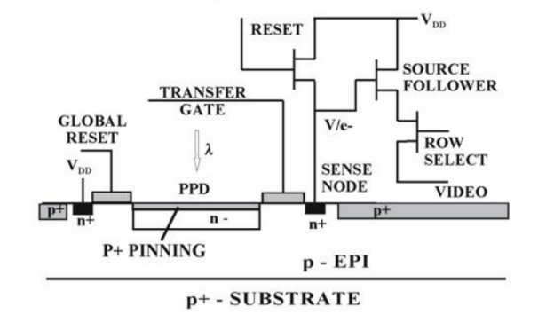
Correlated Double Sampling CDS

Slide 18
Charge measurement architecture 1

Slide 19
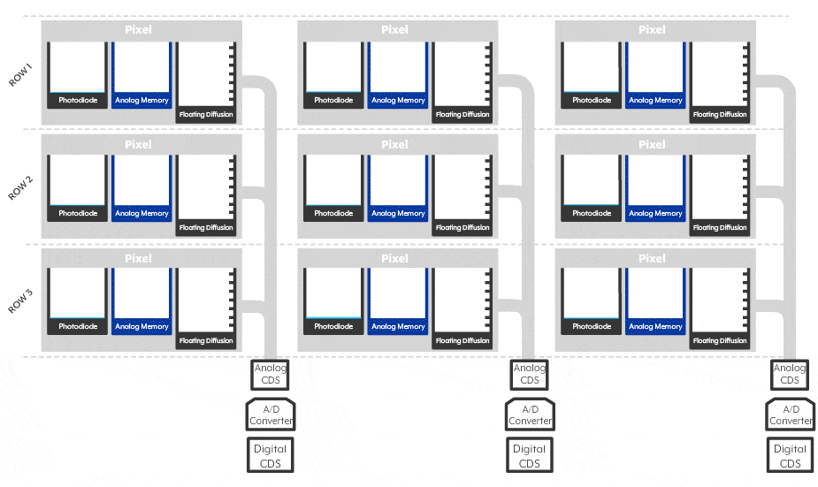
Charge measurement architecture 2

Slide 20
Transfer function
Camera gain constant
(e⁻/DN)

Slide 21

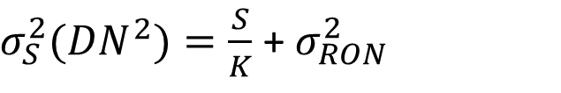
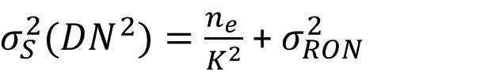
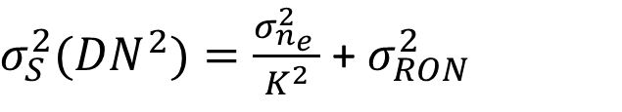
Photon Transfer function
Camera gain constant
(e⁻/DN)
$$S\left(DN\right)=\frac{n_{e }}{K}$$
Poisson statistic
1) Independent events
2) Time invariant probability distribution
3) Probability of an event proportional to the time small interval
4) Negligible probability of two event in the same small interval of time
$σ_{S}^{2}({DN}^{2})=\frac{σ_{n_{e }}^{2}}{K^{2}}$ + $σ_{RON}^{2}$
$σ_{S}^{2}({DN}^{2})=\frac{n_{e }}{K^{2}}$ + $σ_{RON}^{2}$
$σ_{S}^{2}({DN}^{2})=\frac{S}{K}$ + $σ_{RON}^{2}$

Slide 22
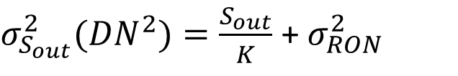
Photon Transfer: linear fit
$σ_{S_{out}}^{2}({DN}^{2})=\frac{S_{out}}{K}$ + $σ_{RON}^{2}$

Slide 23
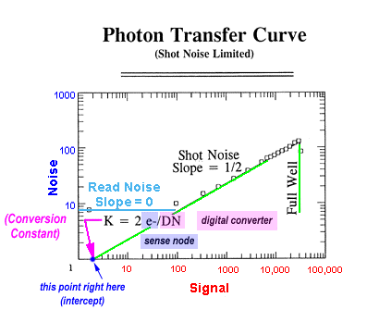
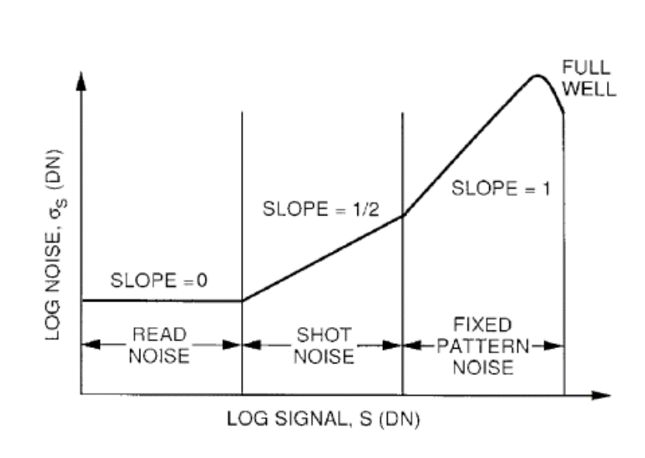
Transfer function: log fit
$$Log(σ_{S})\left(DN\right)=\frac{1}{2}\log\left(\frac{S}{K}\text{ + }σ_{RON}^{2}\right)$$

Slide 24

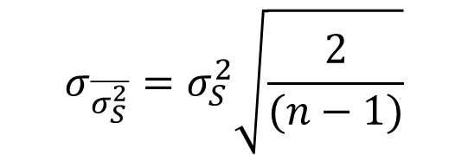



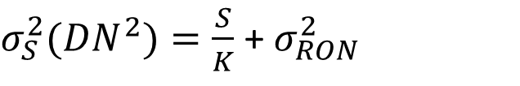
Estimators and estimators errors
$σ_{S}^{2}({DN}^{2})=\frac{S}{K}$ + $σ_{RON}^{2}$
$\overline{S}(DN)=\frac{\sum_{n}{S_{n}}}{n}$
$σ_{\overline{S}}=\frac{σ_{S}}{\sqrt{n}}$
$n=number of samples$
$$σ_{\overline{σ_{S}^{2}}}=σ_{S}^{2}\sqrt{\frac{2}{(n−1)}}$$
$\overline{σ_{S}^{2}}(DN)=\frac{\sum_{n}{(S_{n}−\overline{S})}}{n−1}$

Slide 25
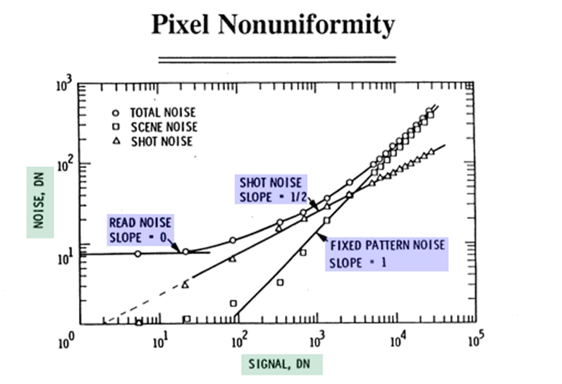
Fixed pattern noise

Slide 26
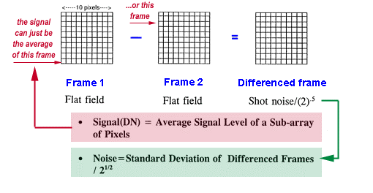
Pixels data analysis strategies
Flat fielding
Two images subtraction:

Slide 27
Pixels data analysis strategies
Pixel by pixel statistics on multiple images:
  Advantages:
      Characterisation of each pixel measuring chain
      No need for matrix pre- analysis (hot or cold spots identification) or data normalization (flat fielding)
      Cumulative statistics (many pixel)
      Identification of matrix defect
  Disadvantages: multiple images acquisition (100 - 1000)

Slide 28
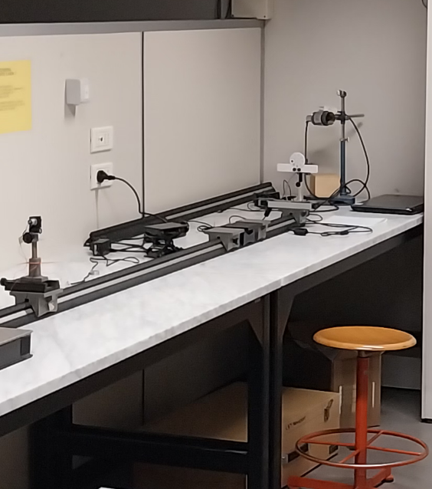
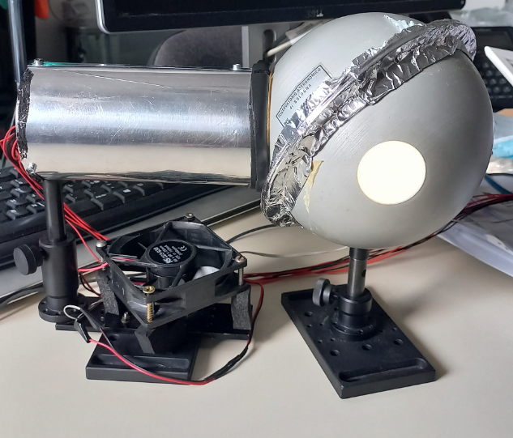
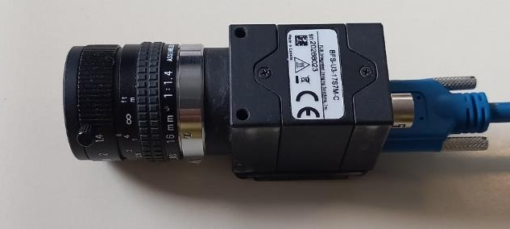
In the lab
SONY IMX425
Monochrome 12 bit camera
~125 Hz max frame rate
~ 1,3MB/image
DON’T TOUCH THE CAMERA: IT COULD BE VERY HOT UP 70 °C

Slide 29
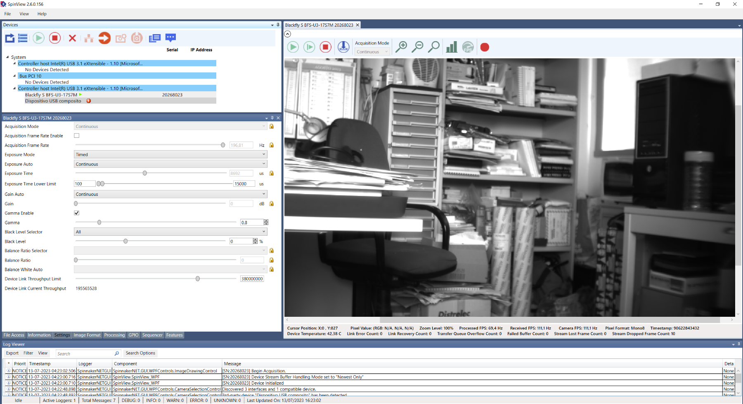
In the lab

