Slide 1

5th Physical Sensing and Processing Summer School, University of Bologna
Organic Semiconductors: New Frontiers in Radiation Detection
Dr Jessie Posar
Postdoctoral Fellow, University of Sydney
Honorary Research Fellow, University of Wollongong

Slide 2






Our Group and Location
University of Sydney
Gadigal people of the Eora Nation
University of Wollongong
Dharawal Country

Slide 3
Overview
Early Use of Ionizing Radiation and ‘Safety’
Introduction to Radiation Dosimetry
Basic Operation of Organic Semiconductors
New Frontiers in Radiation Detection with Organic Semiconductors

Slide 4
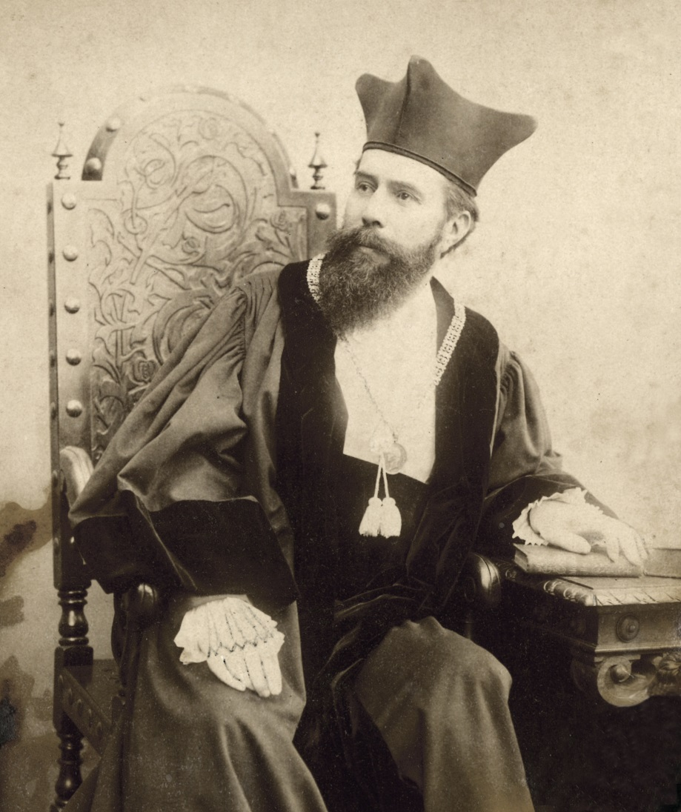
Early Use of Ionizing Radiation and ‘Safety’
How the discovery of x-rays revolutionised medical treatment
Wilhelm Röntgen
Born 1845 in Remscheid, Germany
PhD in Physics at University of Zurich

Slide 5

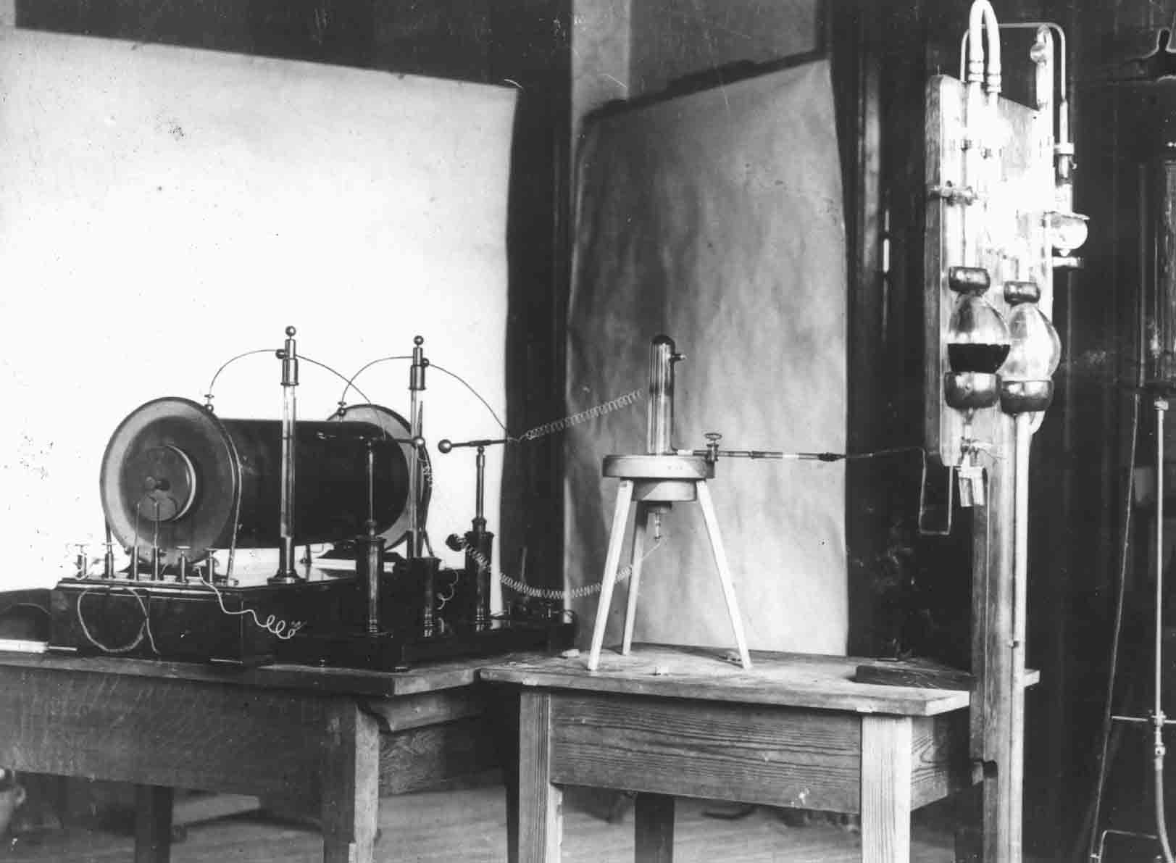
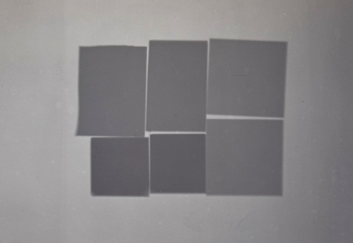
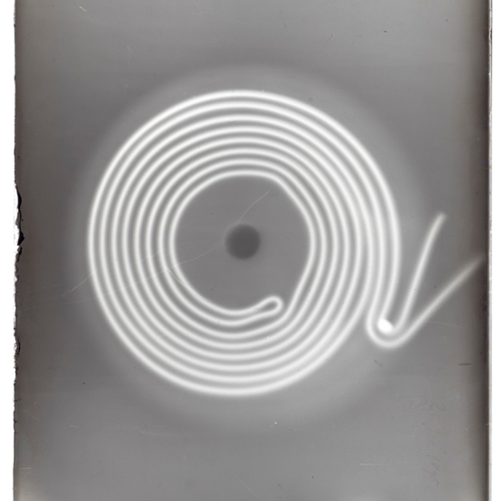
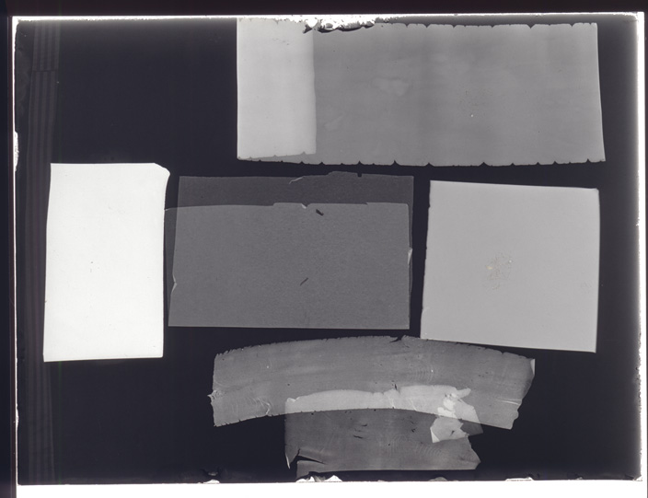
Discovery of X-Rays
Röntgen found that objects of different thickness and material (platinium, lead, zinc and aluminium foil) interposed in the path of the rays showed variable transparency to them when recorded on a photographic plate.
Wilhelm Röntgen’s Lab
Cathode Ray Tube
University of Würzburg, Germany
Notes:
Rontgen was not the first to generate and observe x-rays (Plucker 1801, Hittorf, Varley, Goldstein, Crookes, Hertz and Lenard)
But he was the first to clearly identify the new phenomenon and to describe its properties precisely in his research.

Slide 6
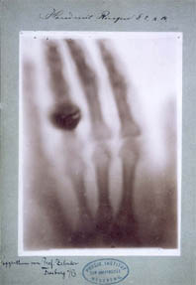
A Vision of Modern Diagnostics
Birth of Radiography on December 22nd, 1895
Radiograph of Rontgen’s Wife, Anna’s hand showing her wedding ring
Rontgen called them ‘X’-rays to underline the fact that the nature of them was unknown
Called Rontgen-rays in Europe

Slide 7
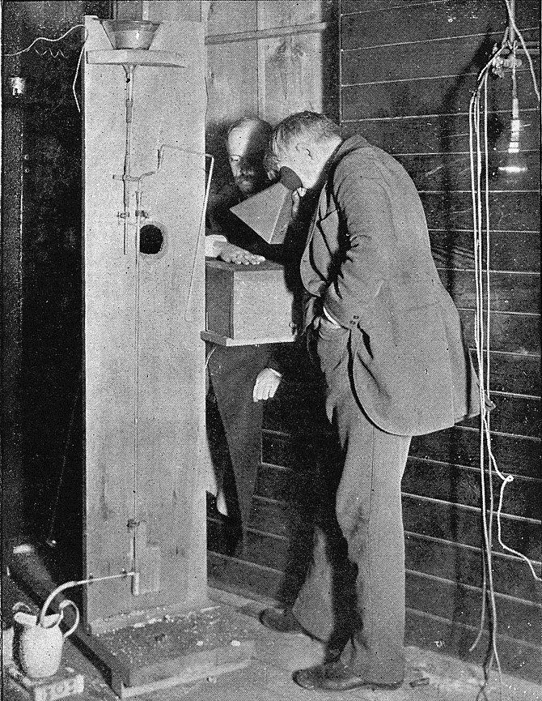
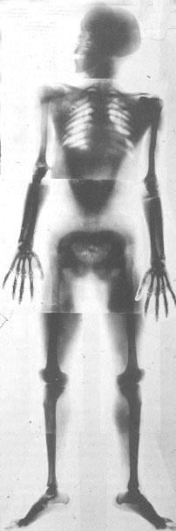
Science Phenomena to Surgical Tool
New York 1896
Public demonstration of x-rays
Thomas Edison examines Clarence Dally’s hand
Germany 1896
First whole-body radiograph
Exposure: up to 60 min for head/pelvis
Radiology was recognized as a medical speciality after end WW1

Slide 8
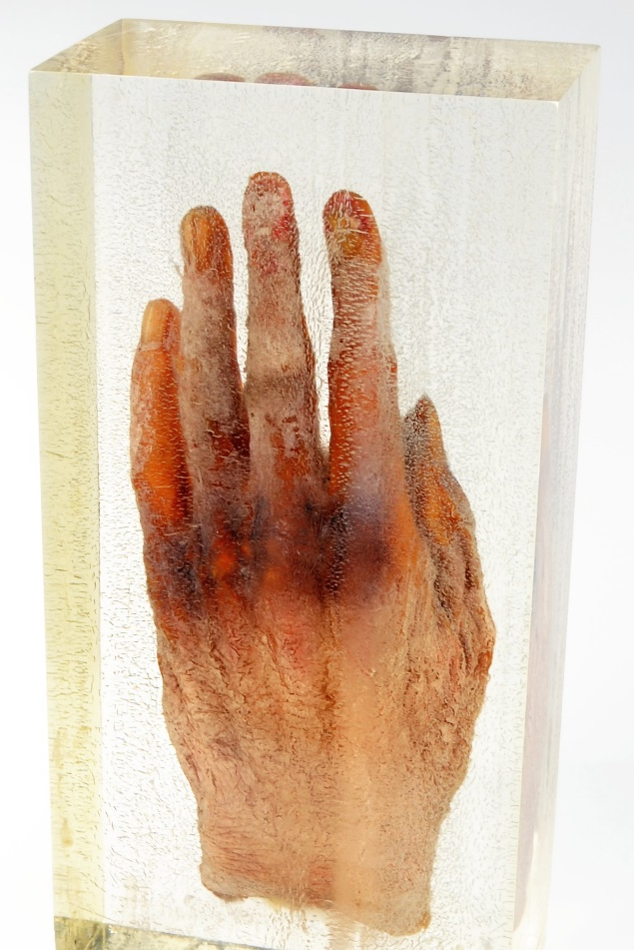
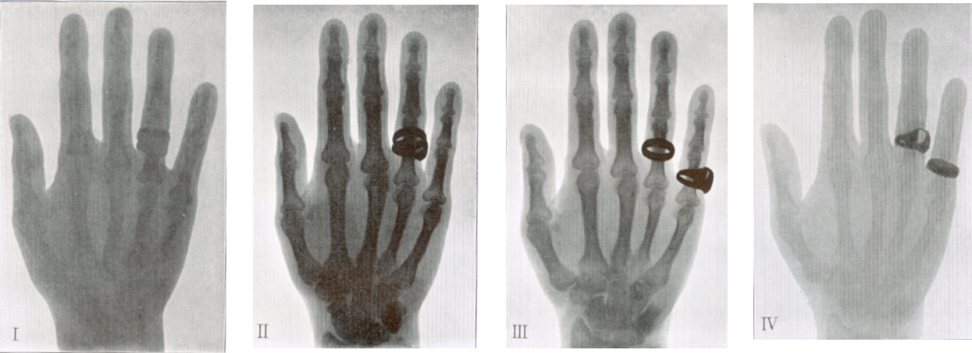
Dangers of Radiology
Effect of radiation exposure was not known and there was no way to monitor/measure exposure
Doctors would use their hand to optimize x-ray image settings
Treat superficial burns from x-rays like the sunburn from UV
Amputated and preserved Hand of Dr. Paul Krause

Slide 9
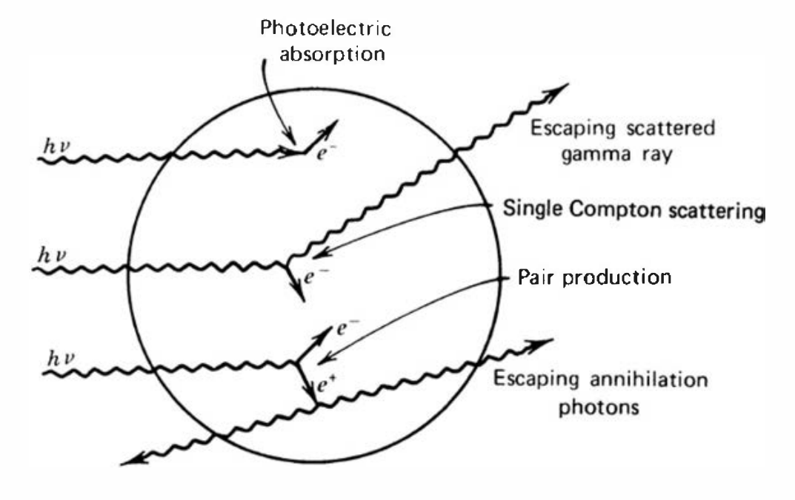
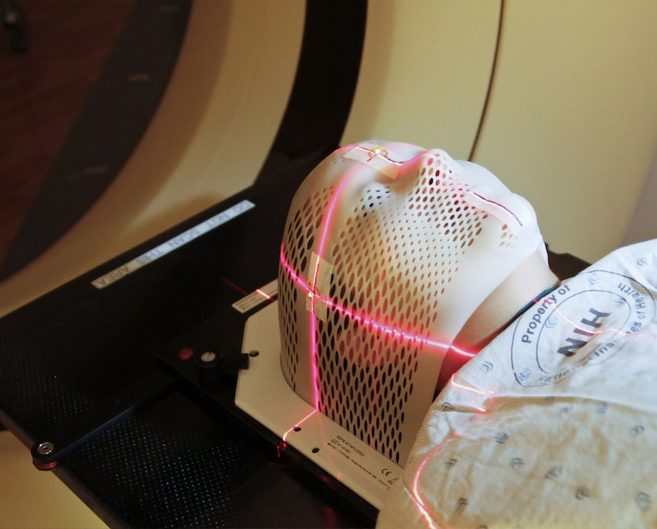
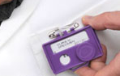
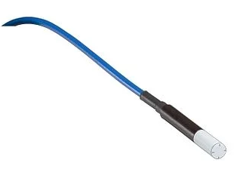
Introduction to Radiation Dosimetry
1. Interaction with x-rays
How we ensure the safe use of ionizing radiation in modern society
3. Medical Applications
2. Dosimeters

Slide 10


Units for Quantifying Ionizing Radiation
To ensure safe use of ionizing radiation we measure the amount of radiation a person is exposed to in units of radiation dose:
Gray (Gy)
Sievert (Sv)
Unit of absorbed dose (D)
Amount of energy deposited by radiation in a specific material* such as human tissue
Unit of equivalent dose (H)
Unit of effective dose (E)
Biological effect of absorbed dose by using a radiation weighting factor
H depends on the type of radiation incident on the body
E depends on the tissue sensitivity to certain organs
Tells you the potential harm caused by radiation
$$H=DQ$$

Slide 11
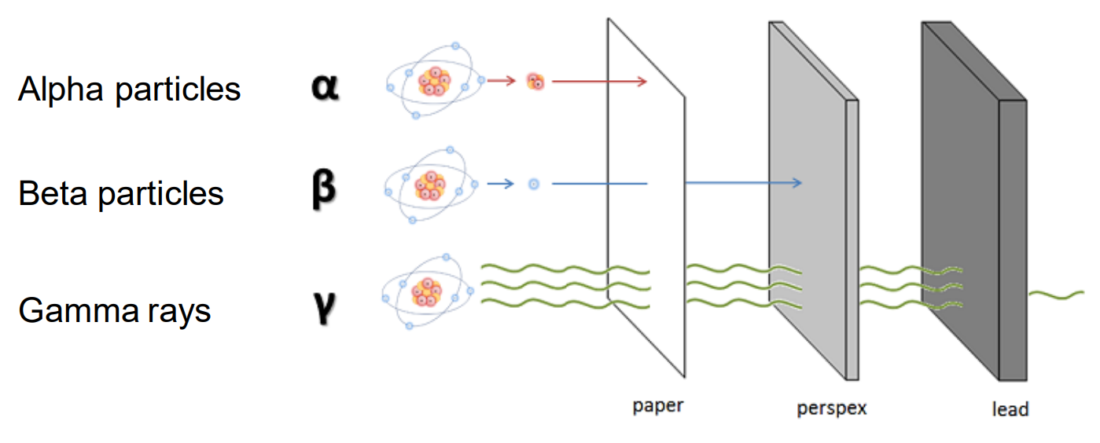
Types of Radiation

Slide 12
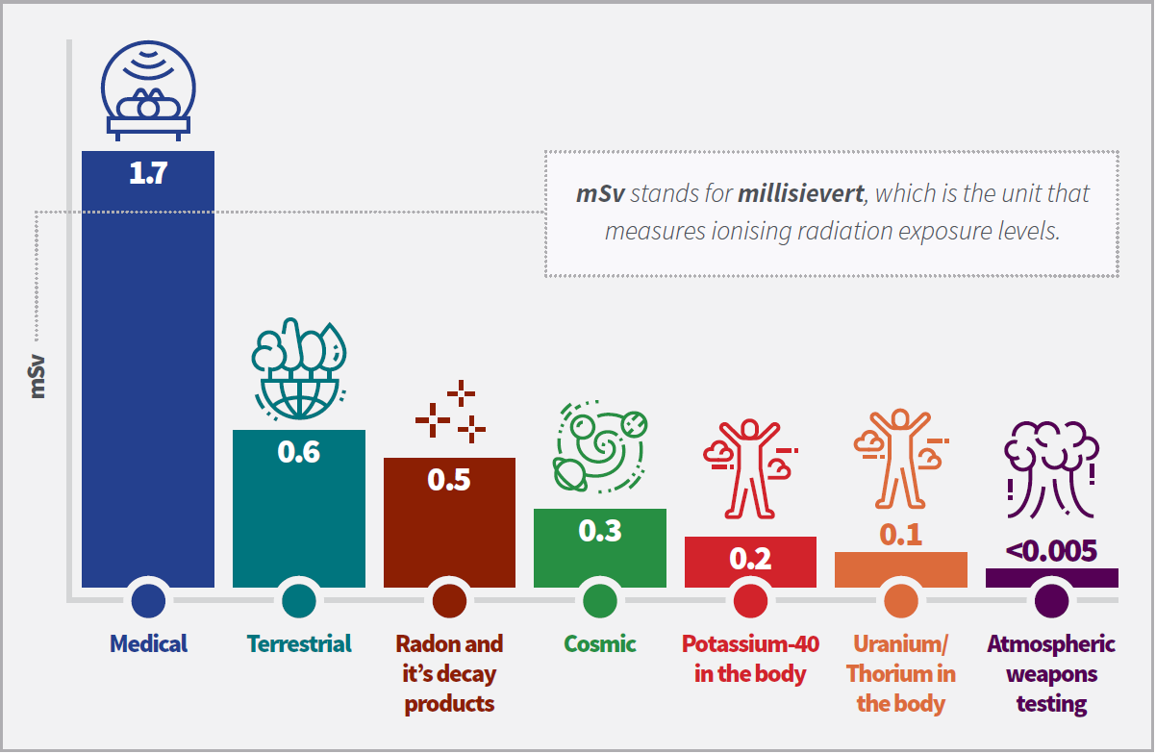
Sources of Exposure to Ionizing Radiation
Public exposure limit is ~1 mSv
Occupational exposure limit for radiation workers including medical workers, airline crew, nuclear workers and miners may be higher
Limit ~20 mSv per year, common recorded is 1-10 mSv per year

Slide 13
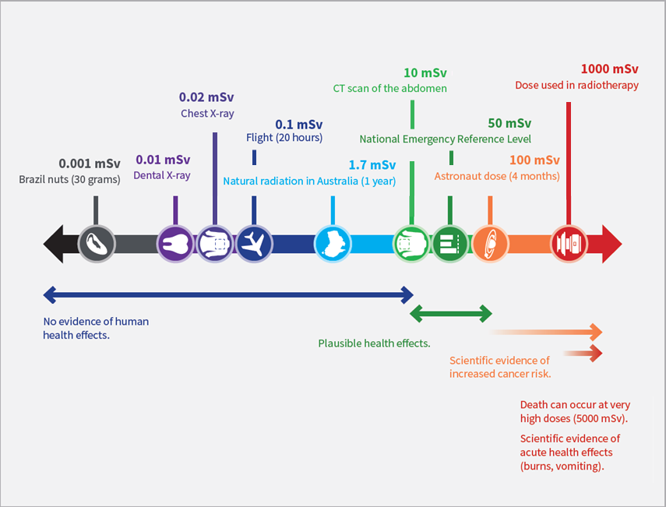
Highest Exposure to Ionizing Radiation

Slide 14
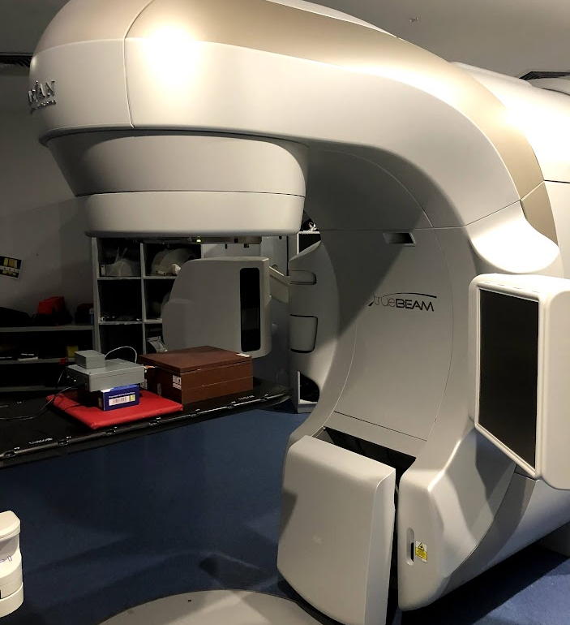
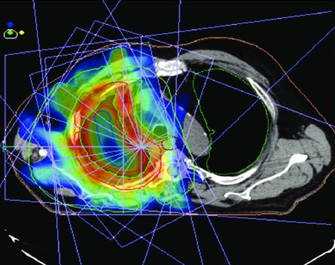
Radiation Therapy
20M cancer patients per year; 50% need Radiotherapy
Linear accelerator (LINAC) aims external beams of radiation from multiple directions to maximize dose to the tumor while minimizing dose to the normal cells/vital organs
Dosimeters (radiation detectors) calibrate the beam BEFORE the patient enters
Use lasers to align the patient
LINAC
Treatment Plan
Patient Alignment

Slide 15
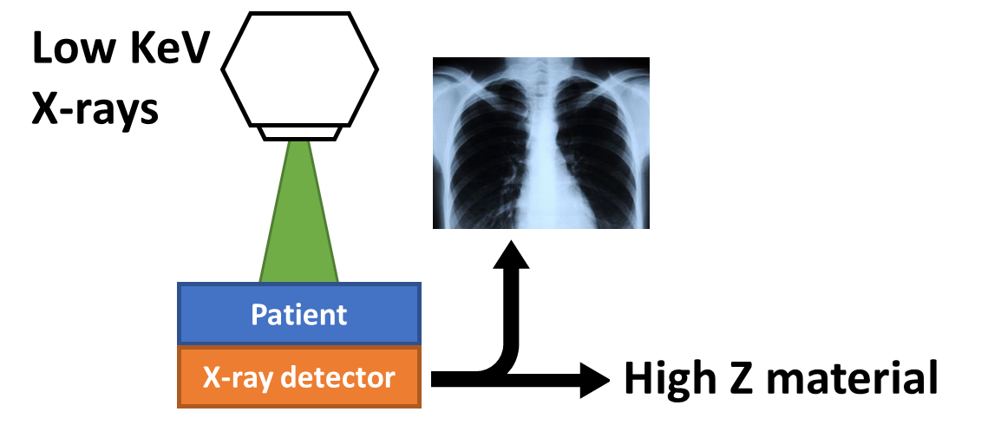
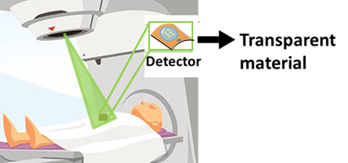
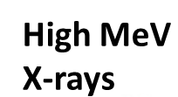
Medical Dosimetry
What is Dosimetry? | Measurement and assessment of radiation doses received by individuals or objects exposed to ionizing radiation
How is it achieved? | Passive dosimeters (film badges, TLDs) and Active dosimeters (silicon-based electronics)
Why in-vivo dosimetry? | Real-time feedback to instantaneously detect, evaluate, and correct for any deviations from the planned exposure; (ideally) without affecting the treatment plan.
Imaging vs in-vivo Dosimetry:

Slide 16
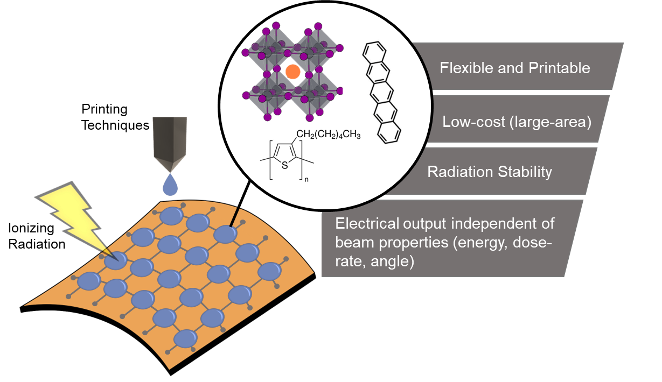
Need for Innovative X-ray Detectors
Material innovations needed:
Advantages of current dosimeters:
Well studied (and optimised for radiation detection)
High spatial and temporal resolution
High radiation stability
Commercially available
Limitation of current dosimeters:
Mechanically Rigid
Expensive (large-area)
Electrical output varies with beam properties

Slide 17
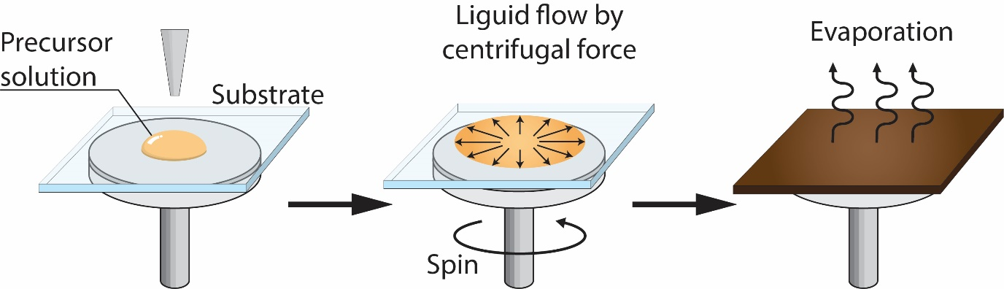
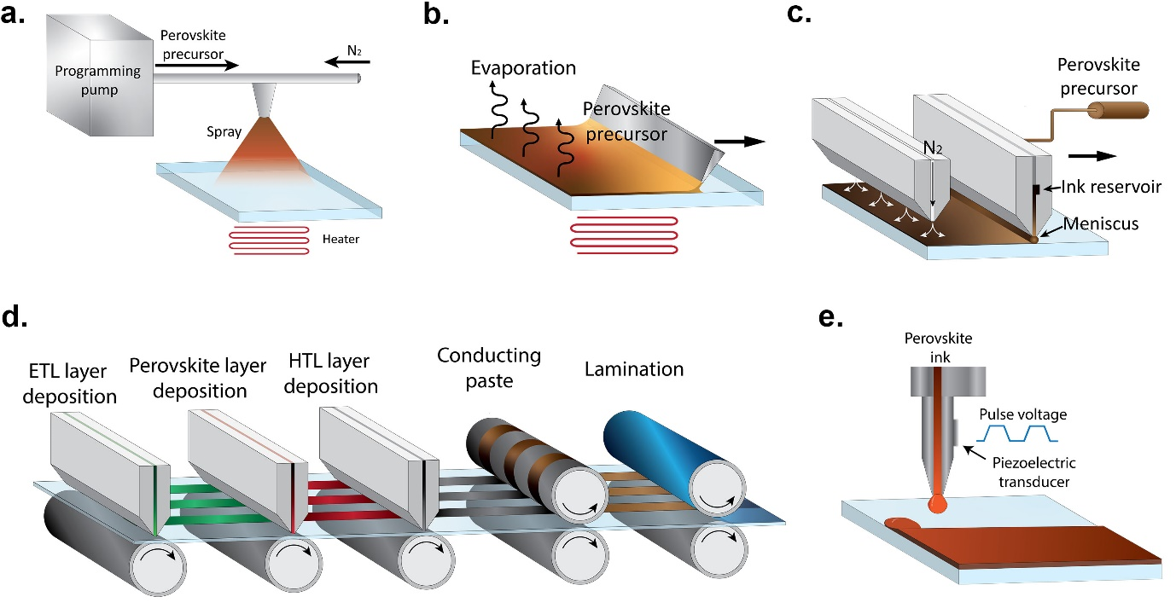
Next-Gen Materials for Radiation Detection
Solution processable electroactive inks can be printed onto flexible substrates with low-costs techniques: (a) spin-coating, (b) blading, (c) inkjet printing and (d) roll-to-roll printing
(a)
(b)
(c)
(d)
Active

Slide 18
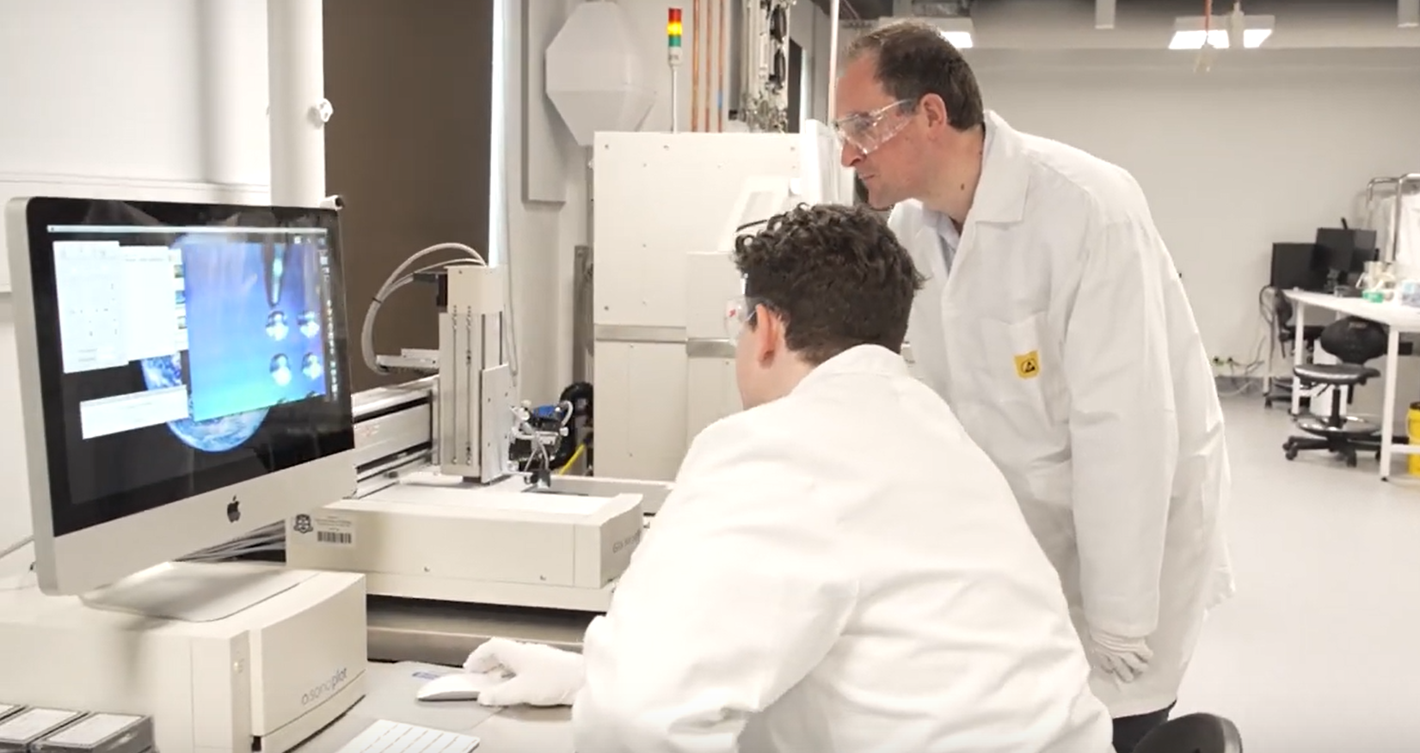
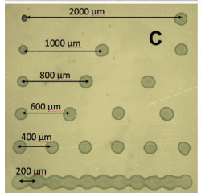
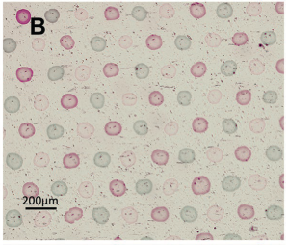
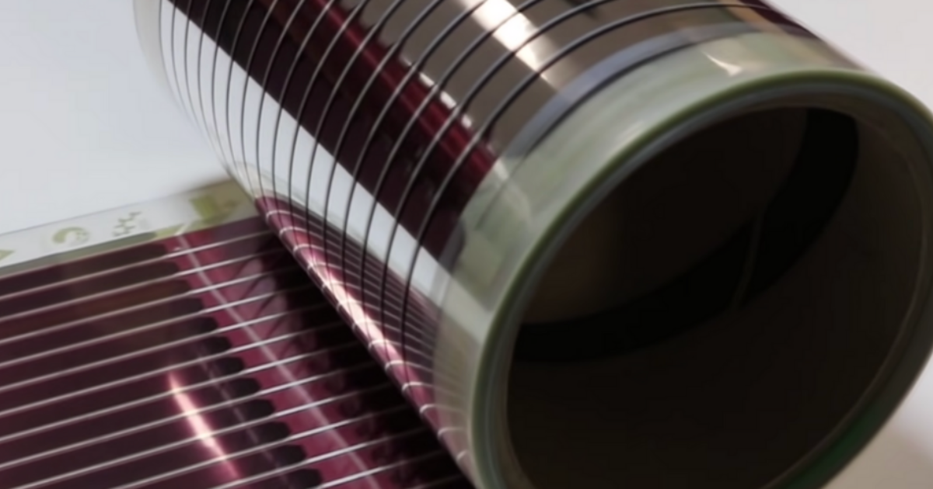
Example of Printability
Organic semiconductors were Inkjet printed onto flexible Kapton substrates
Droplets = 185 ± 30 µm
Sherwood CP, Crovador R, Posar JA et. al. Adv. Mater. Interfaces 2023, 2202229

Slide 19
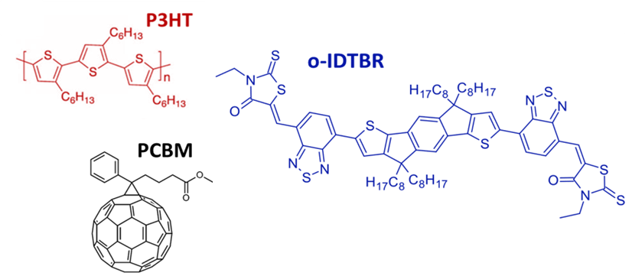
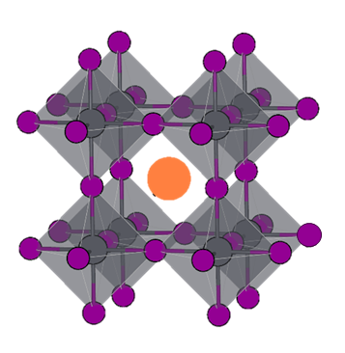
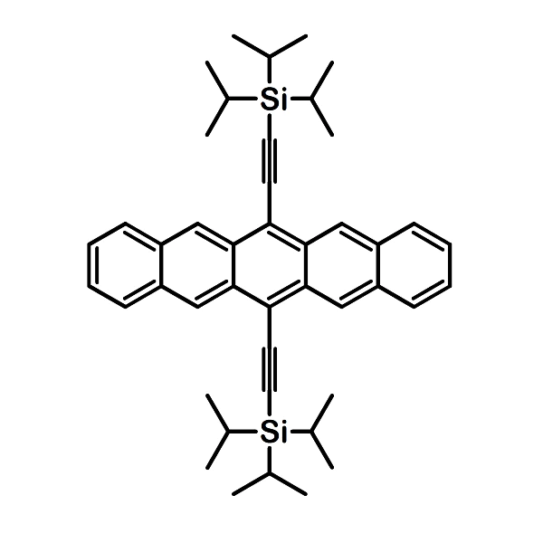
Two Solution Processable Materials for Radiation Detection
Organic Semiconductors
Carbon, hydrogen and other light elements
Disordered or amorphous structure
Lower optical/electrical properties (low charge carrier mobilities)
Mechanically flexible and highly compatible with low-cost techniques
Perovskites
Lead, Iodide, bismuth and other heavy elements
Well-defined crystal structure
Excellent optical/electrical properties (high absorption coefficients and long carrier diffusion lengths)
TIPS-pentacene
MAPbI3

Slide 20
Interaction of Ionizing Radiation with Matter
Why does the material of the radiation detector matter?
Novel Solution Processable Materials
Perovskites:
  High-Z
  Great for x-ray imaging
Organic Semiconductors:
  Low-Z matching human tissue
  Great for dosimetry

Slide 21
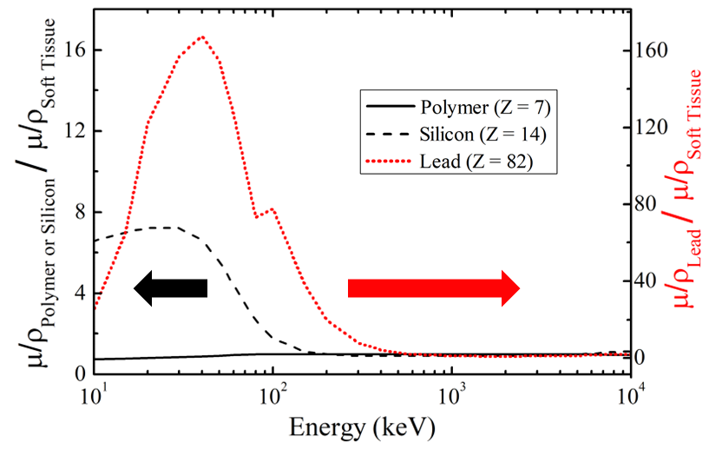
Impact of Detecting Material on Dosimetry
Aim of Dosimetry: Measure the dose absorbed in the human body using a radiation detector
But the dose absorbed varies depending on the atomic number of the material
Need to calibrate the response of the detector to the human body
Benefit to carbon-based detectors

Slide 22
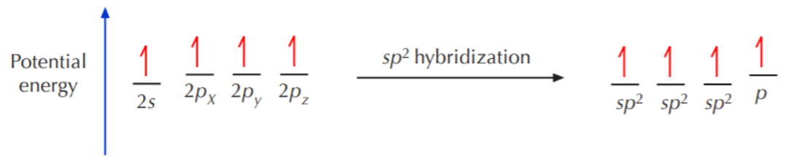
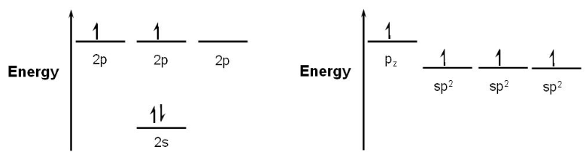
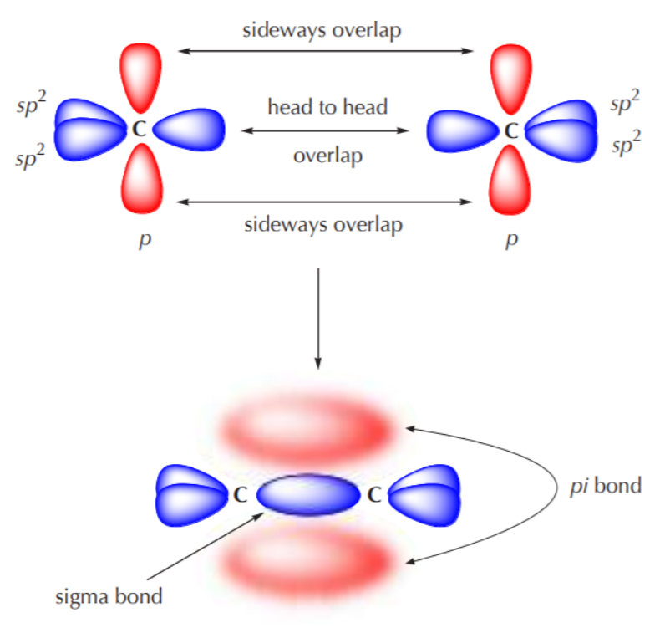
Basic Operation of Organic Semiconductors
Why we need to develop new models for radiation detection
Notes:
In its ground state, an isolated carbon atom has two electrons in the 1s orbital and two electrons in the 2s orbital. It also has two unpaired electrons in the 2p orbitals, specifically in the 2px and 2py orbitals. To form stable chemical bonds, carbon undergoes hybridization by rearranging its valence electrons to form 4 unpaired electrons (Hund’s rule, electrons must be equally distributed).
This structure is extremely important when it comes to how carbon-bonds and how electrons transport in these materials.
These pi-bonds are where the double bonds are formed.
molecular orbital is called a sigma-orbital

Slide 23
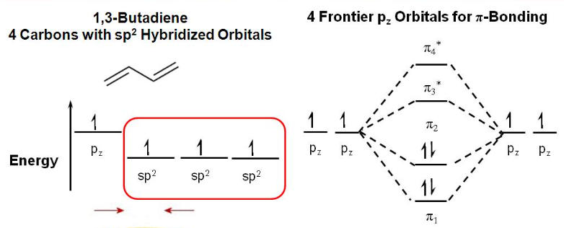
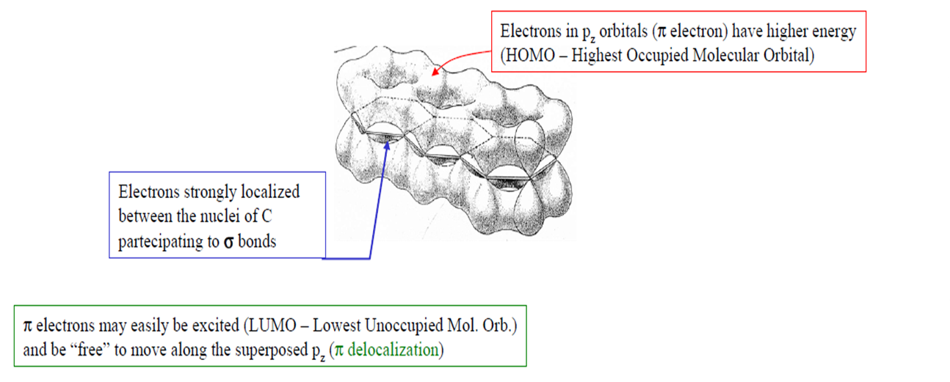

Molecular Structure of Organic Semiconductors
Exciton
LUMO
HOMO
Notes:
This is just for 1 molecule with 4 carbon-atoms – but most organic electronic materials have 10^23

Slide 24
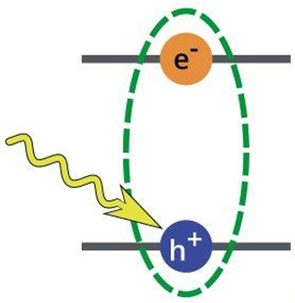
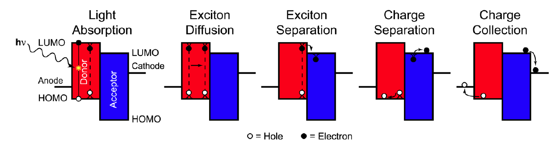
Charge Transport in Organic Semiconductors
Known transport mechanism for optical excitation in OSCs:
Charges are “sticky” (excitons)
Need multiple materials to create free charge with complex nanostructures to maximize interfacial area
Charges ‘hop’ across segments of the polymer chain
Unknown charge transport mechanism for x-rays (direct ionization)
Cannot use models developed for silicon radiation detectors
Notes:
The reason I am explaining this is because this means that we cannot rely on any the models of charge transport or stability of ionizing radiation detectors developed for inorganic materials because their fundamental photophysics is completely different.

Slide 25
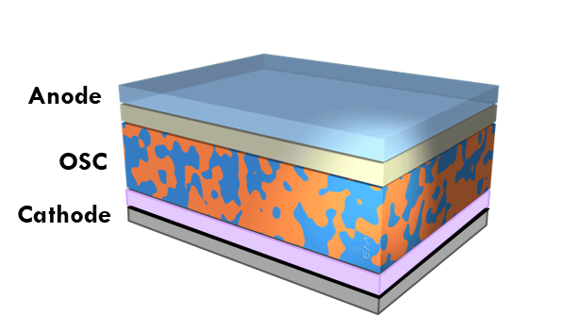
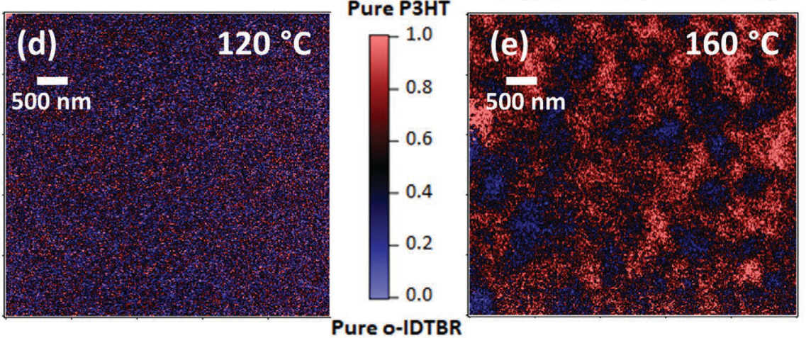
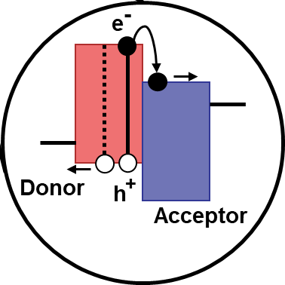
BHJ Morphology Optimization
Exciton diffusion length ~ 20 nm
Polymer Scanning Transmission X-Ray Microscopy (STXM)
Results in improved electrical performance to detect ionizing radiation
J.A. Posar et. al. Adv. Mater. Technol. 2021, 2001298, doi: 10.1002/admt.202001298
Notes:
scanning X-ray transmission microscopy provides high- resolution (≈25 nm) imaging with chemical sensitivity to collect X-ray maps of the blend morphology

Slide 26
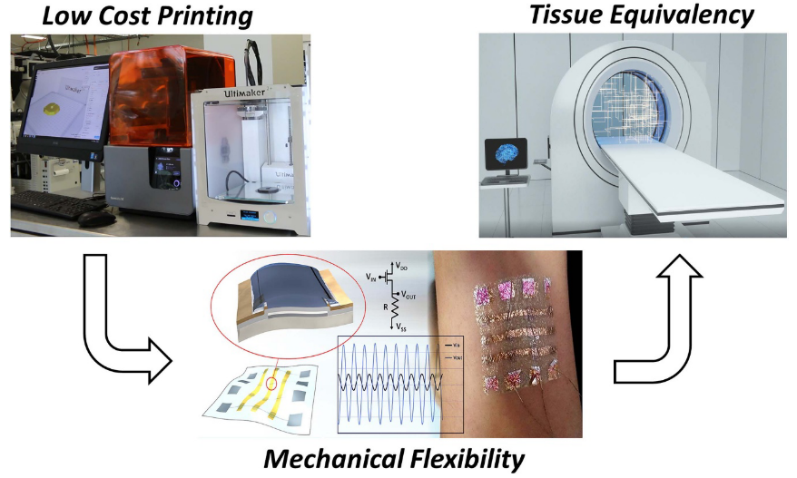
Organic Semiconductors
New Frontiers in Radiation Detection

Slide 27

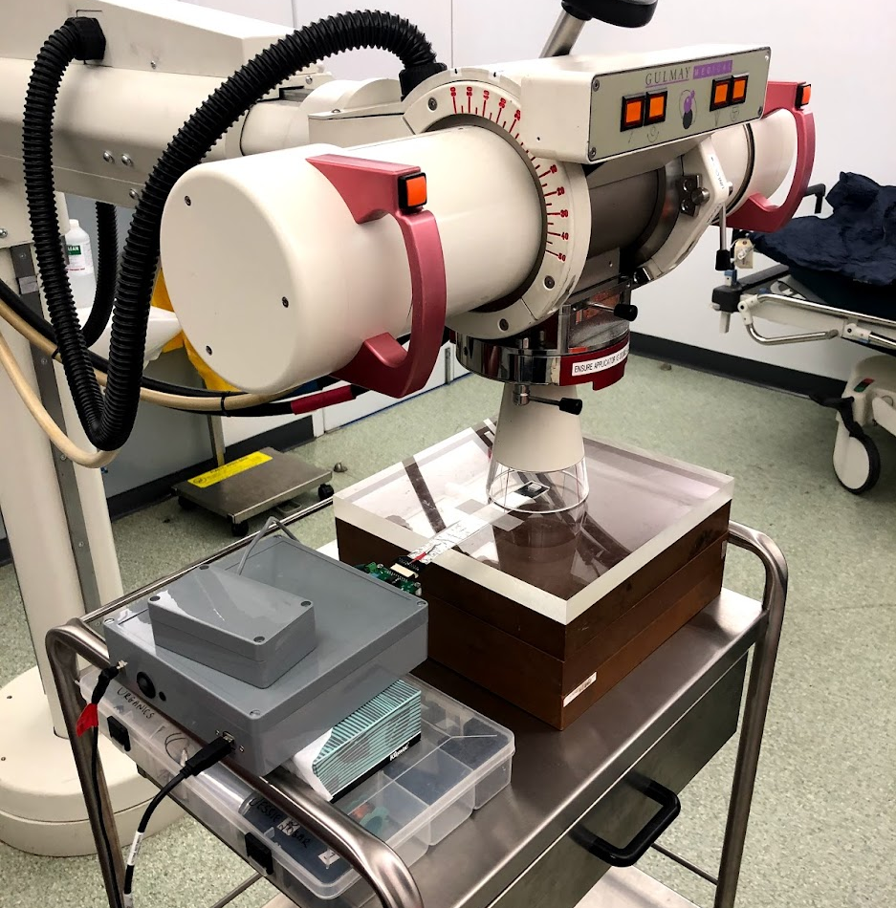
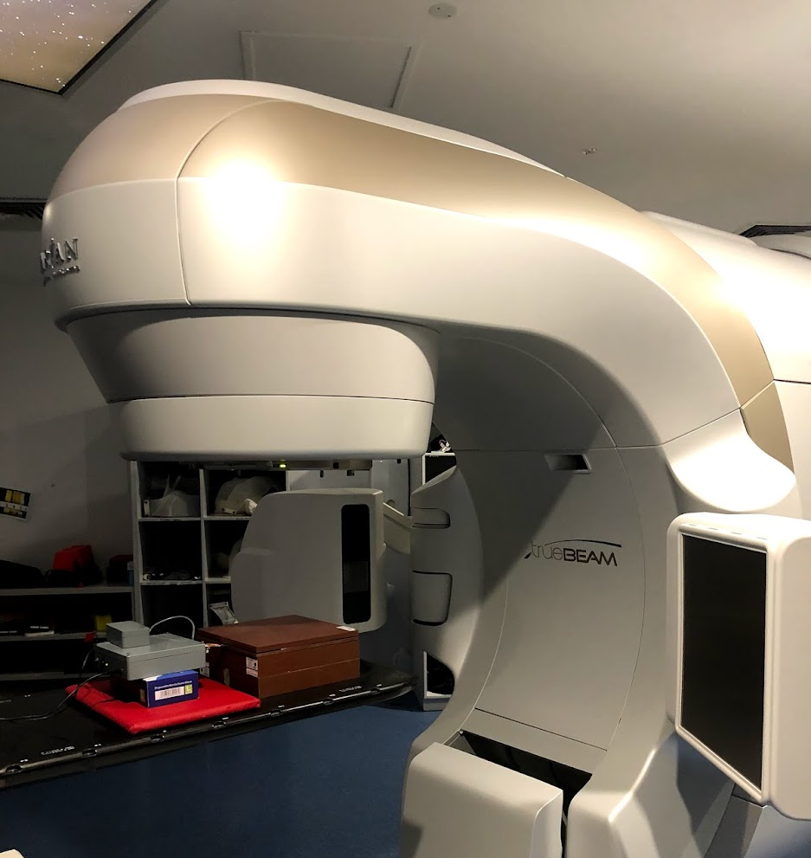
Clinical Measurements
Illawarra Cancer Care Centre, Wollongong Hospital
Linear accelerator (LINAC):
  6 MV pulsed x-rays (3.6 µs)
  Rotates around the patient to treat all body sites with specific techniques such as I/VMRT, IGRT or SBRT
Orthovoltage:
  50 to 200 keV x-rays
  Treat skin cancers in sensitive locations, nose, eyelids or ears
Notes:
Intensity or volume modulated, image guided, stereotactic body

Slide 28
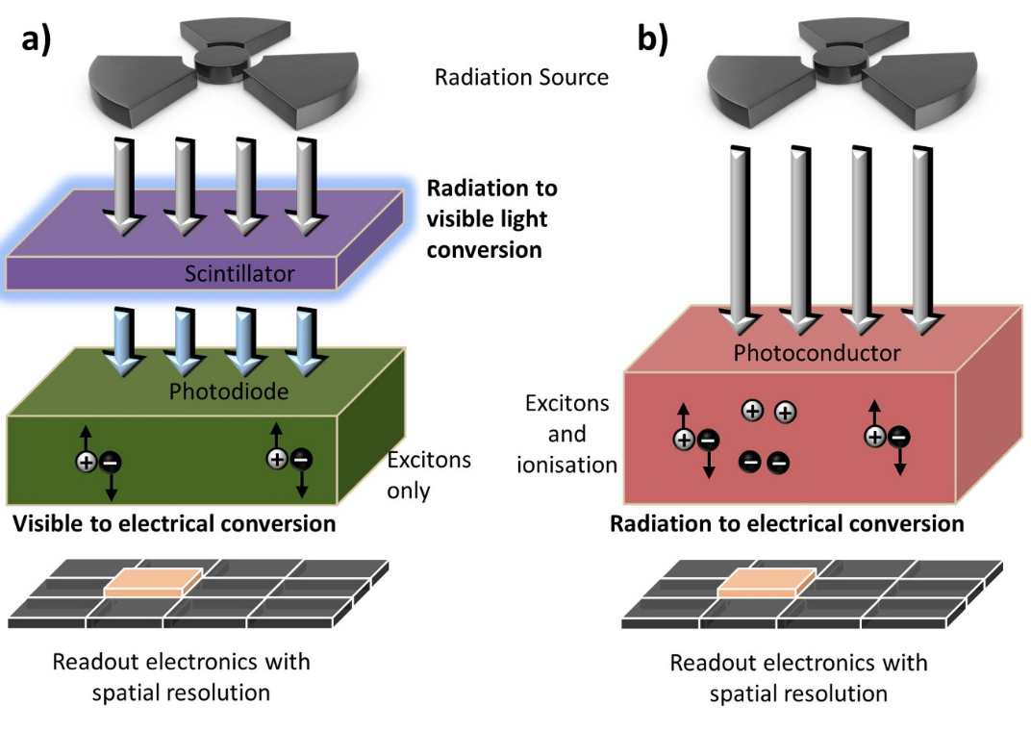
Direct and Indirect Detection
Indirect
Direct
Direct Detection
Requires a material with both a strong x-ray absorption and high electrical performance
Indirect Detection:
Range of scintillator materials with different shapes/sizes/forms, efficiencies, optical wavelengths emission, decay times to match the application
Known transport mechanism for optical excitation in organic semiconductors

Slide 29
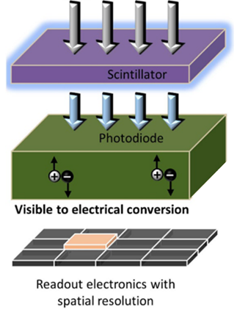
Indirect Detection with Organic Materials
X-rays
Organic Scintillators
Organic Semiconductors
Visible luminescence
Transfer x-ray to visible
Tissue equivalent
Used to profile radiation treatment fields
High radiation tolerance
Tissue equivalent
Low x-ray attenuation
High visible absorption with known photophysics
Unknown radiation tolerance
2. Sensitivity
Scintillator | Yield (ph/MeV) | Sensitivity (pC/cGy) | Tissue Equivalent
Organic | 10,150 | 51 | Yes
Inorganic | 33,200 | 22x10³ | No
50 keV X-ray Source
J.A. Posar et. al. Flex. Print. Electron. 6 (2021) 043005
Notes:
There are many types of scintillators, we chose a plastic scintillator because it is inherently tissue equivalent. However, it is not as efficient as shown in the table therefore the detector sensitivity is lower.

Slide 30
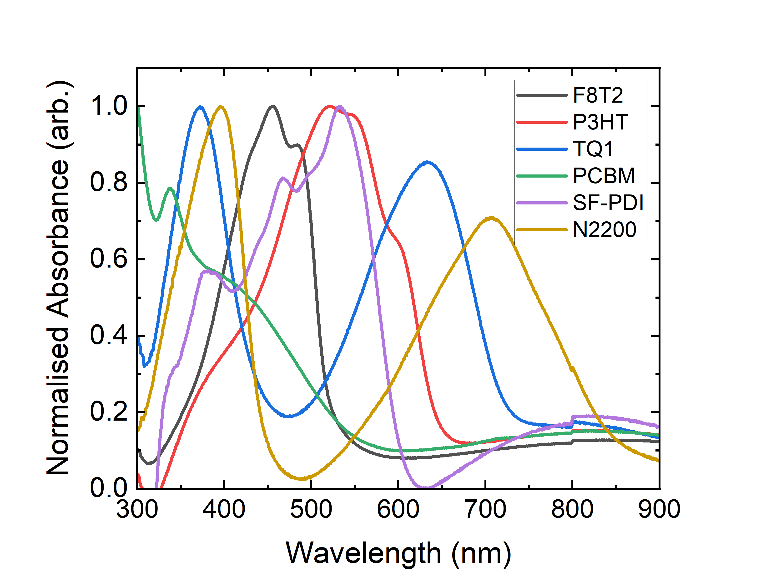
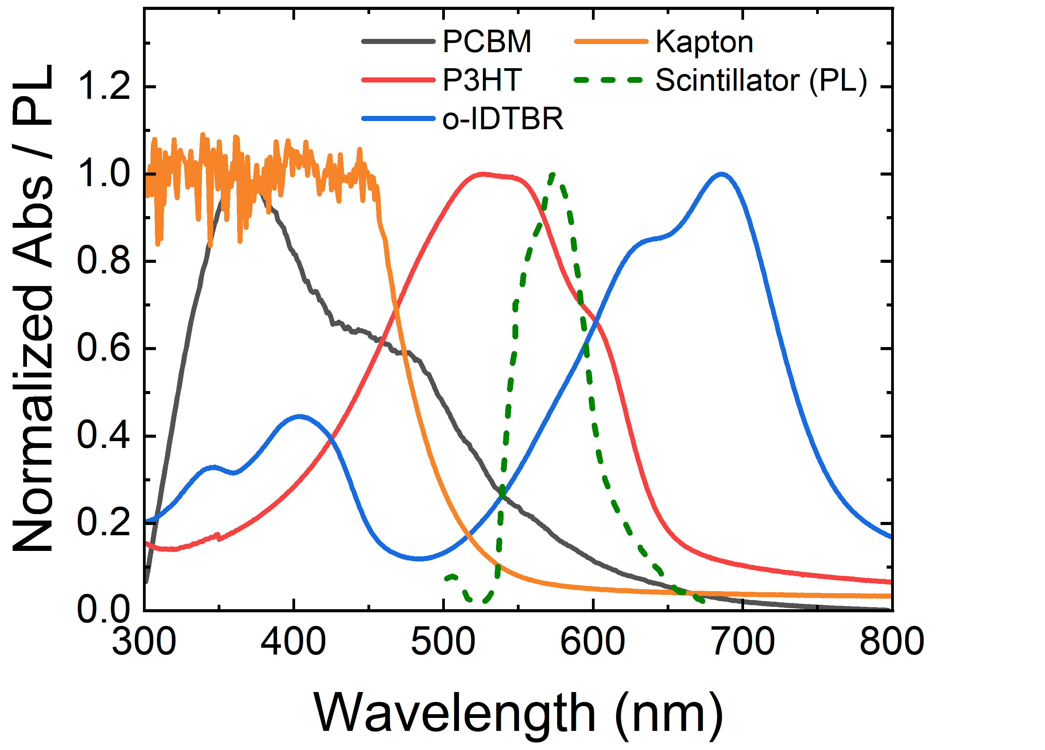
Indirect Detection with Organic Materials
Organic semiconductors can be tuned to absorb specific visible wavelengths
Comparison to a red emitting scintillator
J.A. Posar et. al. Flex. Print. Electron. 6 (2021) 043005

Slide 31


Dose-Rate Dependence (Direct vs Indirect Detection)
Dose rate [Gy/s]:
how quickly the radiation dose is deposited in a given area/volume
Can vary during treatment/across the treatment volume
Impacts treatment time and has radiobiological effects
A dose-rate dependent detector will under/over-estimate the dose deposited impacting:
Dosimetry of treatment volume in RT
Contract in x-ray imaging
Direct detection
Indirect detection
Dose-rate dependence is observed in organic semiconductors only when used as direct radiation detectors
J.A. Posar et. al. Med. Phys.47 (8) (2020) 3658-3668
Notes:
Why indirect detection for dosimetry in clinical applications?
The beam is focused on the target but it is shaped to avoid “critical organs” which means that you would expect to have low dose rate in organ that are sensitive to radiation.
BUT, dose rate dependence means that your detector is over-estimating the dose delivered to these volumes outside the main target….it measures the wrong thing exactly where you want to have more information….
Also true for x-ray imaging - High response to low dose rate affects the contrast of the image, which is one of the main quantitative parameters for imaging quality.

Slide 32
Dose Deposited in Depth
Direct detection
Indirect detection
Expected
Percentage Depth Dose Curve (PDD):
Provides valuable information about the radiation dose delivered by a treatment beam as a function of depth in a patient's body
PDD decreases with depth due to the inverse square law and attenuation of the radiation beam (solid red line in plot)
A dose-rate dependent detector will under/over-estimate the dose deposited as a function of depth within the patient where the tumor is located
J.A. Posar et. al. Med. Phys.47 (8) (2020) 3658-3668

Slide 33


A Flexible X-ray Detector for In-vivo Dosimetry
No bias applied
In-vivo dosimetry requires a detector to sit on the patient during treatment:
X-ray sensitivity vs transparency
Organic Detector:
X-ray transmission is 99.6%
Sensitivity is linear with dose (114 pC/cGy)
Fast temporal resolution to resolve the LINACs pulsed output matching Silicon
M.J. Large, J.A. Posar et. al. ACS Appl. Mater. Interfaces 2021, 13(48), p5770

Slide 34

Energy Dependence
A tissue equivalent detector has a response that matches the human body:
Example is the response to energy when normalised to soft tissue
Plastic scintillators are termed tissue equivalent
Energy Dependence impacts detection of radiation fields with mixed energy
e.g., Image Guided Radiation Therapy
M.J. Large, J.A. Posar et. al. ACS Appl. Mater. Interfaces 2021, 13(48), p5770
Notes:
Image guided radiation therapy – if you want to know the total dose the patient is experiencing

Slide 35



Novel Radiation Treatment Modalities
Using organic semiconductors to safety treat untreatable tumours

Slide 36


Microbeam Radiation Therapy
RT treats 50% of cancer patients, however the large variety of tumor sizes/locations present a challenge to safely directing external beams to small target volumes while avoiding normal tissue and vital organs:
  Glioblastoma multiforme (brain tumor) is resistance to conventional therapy leading to exceptionally poor prognosis (5% of patients survive 5 years following diagnosis)
Microbeam Radiation Therapy is a novel form of spatially fractionated RT with extremely high dose-rates
  Clinical research shows that normal tissue can recover from MRT whilst cancerous cells are destroyed

Slide 37



Synchrotron Sources
MRT uses synchrotron-generated x-ray microbeams
Only two sources in the world capable of generating MRT fields:
  European Synchrotron Radiation Facility (ESRF)
  Australian Synchrotron
Synchrotron Radiation:
Electrons accelerated to 99.9997% of the speed of light (LINAC)
Energy increased from 100 MeV to 3,000 MeV (3 GeV) in ~half a second (booster ring)
As the electrons are deflected through the magnetic field created by the magnets, they give off synchrotron radiation (storage ring)
Flux 1000x higher than conventional RT (dose rate= 3.6kGy/s)

Slide 38



MRT Dosimetry
Before clinical implementation, all RTs require routine quality assurance to ensure treatment efficacy and patient safety
Unique challenges for MRT dosimetry:
  Radiation Tolerance (Flux 1000x higher)
  Spatial Resolution (50 µm beams)
PET Barrier film
25 µm
Top contact
Move Laterally
Active layer
500 nm
Bottom contact
PCB
1.5 mm

Slide 39


MRT Dosimetry with Organic Semiconductors
Radiation Damage
(Stabilised after 35 kGy)
Reconstruction of Microbeams
(Highest dose-rate beam 3.6 kGy/s)
800 Patients
(51 ±1.5) µm
J.A. Posar et. al. J. Synchrotron Rad. 2021, 28, p1444, doi: 10.1107/S1600577521006044

Slide 40
Radiation Hardness
Radiation hardness is necessary for:
Measurement accuracy and reliability
Longevity and stability
Unknown radiation damage mechanism in organic semiconductors:
Is there a correlation between material structure and radiation stability?
Planar structure of o-IDTBR exhibits higher photostability compared to PCBM*
*J. Luke et. al. Adv. Energy Mater. 2019, 9, 1803755

Slide 41


Insights into Radiation Damage
Degradation occurs in P3HT:
Deep trapping sites
Unique features of planar o-IDTBR improve radiation stability
Radiation Exposure > 10 kGy
M.J. Large, J.A. Posar et. al. ACS Appl. Mater. Interfaces 2021, 13(48), p5770

Slide 42
Lecture Summary
Active monitoring (in-vivo dosimetry) during Radiation Therapy is necessary to guarantee safe treatment however it requires innovative material solutions
Radiation detection for dosimetry has unique challenges where detectors must have:
  High spatial and temporal resolution
  Flexible, large-area and low-cost manufacturing
  Radiation hardness
  Electrical output independent of beam properties (energy, dose-rate and angle) termed tissue-equivalent
Solution processable semiconducting materials are a potential solution to fabricate flexible, large-area and low-cost radiation detectors
Organic semiconductors exhibit unique material properties for dosimetry, particularly:
  Carbon-based composition that permits a tissue-equivalent response
  Simple material tunability to optimize the absorption properties and radiation hardness
  However, before widespread use we must understand the charge transport mechanism under ionizing radiation fields and develop a model for radiation hardness to further optimize their performance

Slide 43





Collaborative Effort
Researchers with expertise in:
Organic Electronics
Radiation Dosimetry
Clinical/ beamline capabilities

Slide 44


Thank you for you attention
Dr Jessie Posar
jessie.posar@sydney.edu.au
jposar@uow.edu.au

Slide 45
References
A. Kohler, & H. Bassler. Electronic Processes in Organic Semiconductors: An Introduction. 2015 Wiley-VCH.
G.F. Knoll. Radiation Detection and Measurement (4th ed). 2010 Wiley.
F.H. Attix Introduction to radiological physics and radiation dosimetry. 1986 Wiley-VCH.
J. A. Posar, et. al., Adv. Mater. Technol. 2021, 6, 2001298. https://doi.org/10.1002/admi.202202229
M. J. Large, J. A. Posar, et. al., ACS Appl. Mater. Interfaces 2021, 13(48). https://doi.org/110.1021/acsami.1c16914
J. A. Posar, et. al., Med. Phys. 2020, 47, 3658. https://doi.org/10.1002/mp.14229
J. A. Posar, et. al., J. Synchrotron Radiat. 2021, 28, 1444. https://doi.org/10.1107/S1600577521006044
J. A. Posar, M. Petasecca, M. J. Griffith, Flex. Print. Electron. 2021. https://doi.org/10.1088/2058-8585/ac32aa
L. Basiricò, et. al., Nat. Commun. 2016, 7, 13063. https://doi.org/10.1038/ncomms13063
L. Basiricò, A. Ciavatti, B. Fraboni, Adv. Mater. Technol. 2021, 6, 2000475. https://doi.org/10.1002/admt.202000475
A. Ciavatti, et. al., Adv. Funct. Mater. 2019, 29, 1806119. https://doi.org/10.1002/adfm.201806119
A. Ciavatti, et. al., Adv. Mater. 2015, 27, 7213. https://doi.org/10.1002/adma.201503090
F.A. Boroumand, et. al. Appl. Phys. Lett., 91(3), 3–6. https://doi.org/10.1063/1.2748337
Australian Radiation Protection and Nuclear Safety Agency (ARPANSA) https://www.arpansa.gov.au/understanding-radiation
nanoHUB-U: Organic Electronic Devices Course https://nanohub.org/courses/OED/ and Physics of Electronic Polymers https://nanohub.org/courses/PEP
Deutsches Rontgen-Museum https://roentgenmuseum.de/en/home-en/

Slide 46
Interaction of Ionizing Radiation with Matter
Very quick overview of the different interaction processes:

