Slide 1
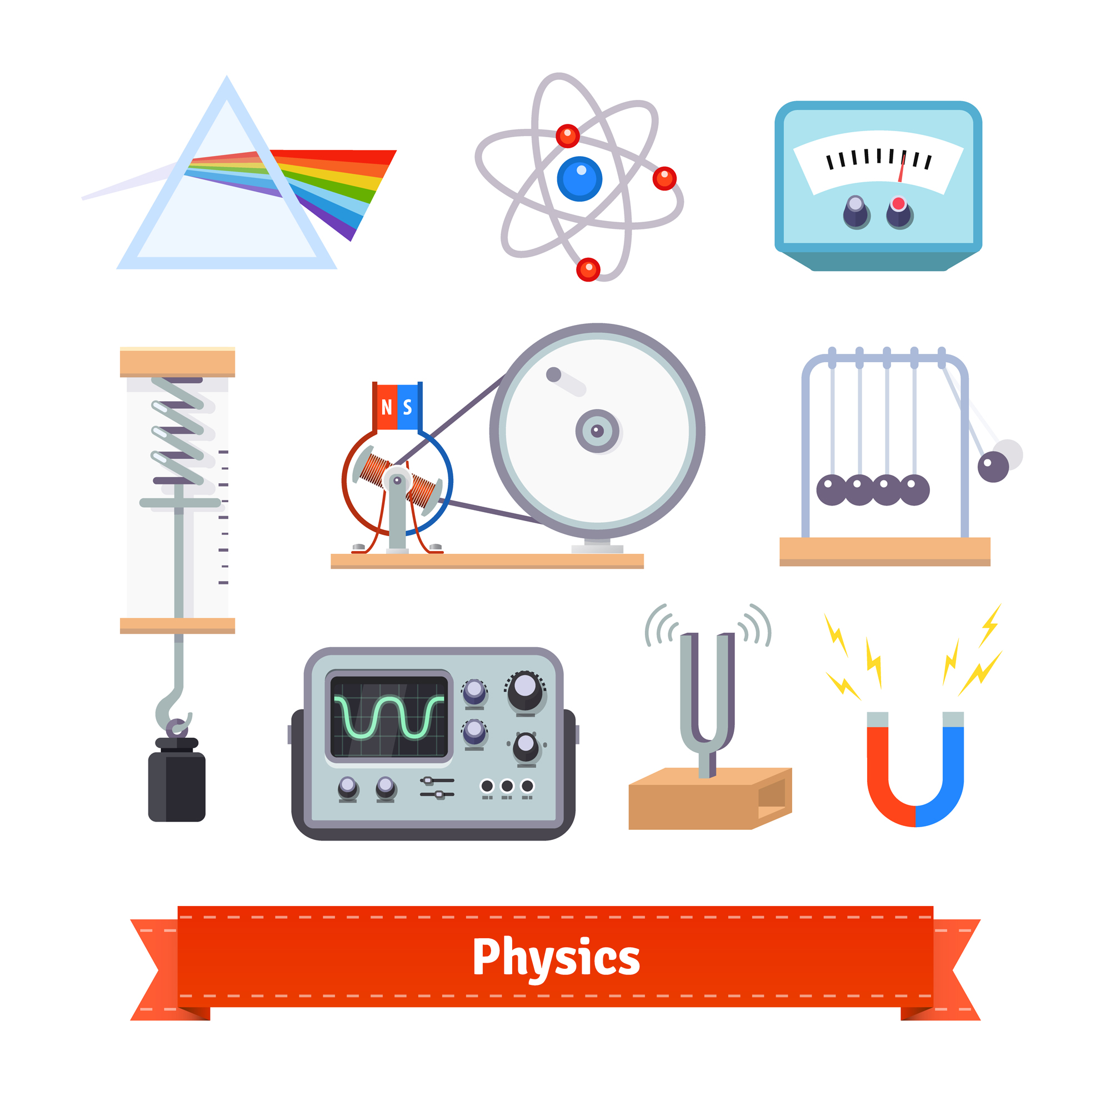
Laboratory of applied physics
Title
Introducing low-field NMR devices for profiling biological tissues
Objective
Discriminate morphological differences among the three layers of the cartilage by determining 4 NMR parameters
SUMMER SCHOOL on
PHYSICAL SENSING & PROCESSING – V EDITION
Department of Physics & Astronomy – University of Bologna
July 17-21, 2023
Images by iconicbestiary on Freepik

Slide 2
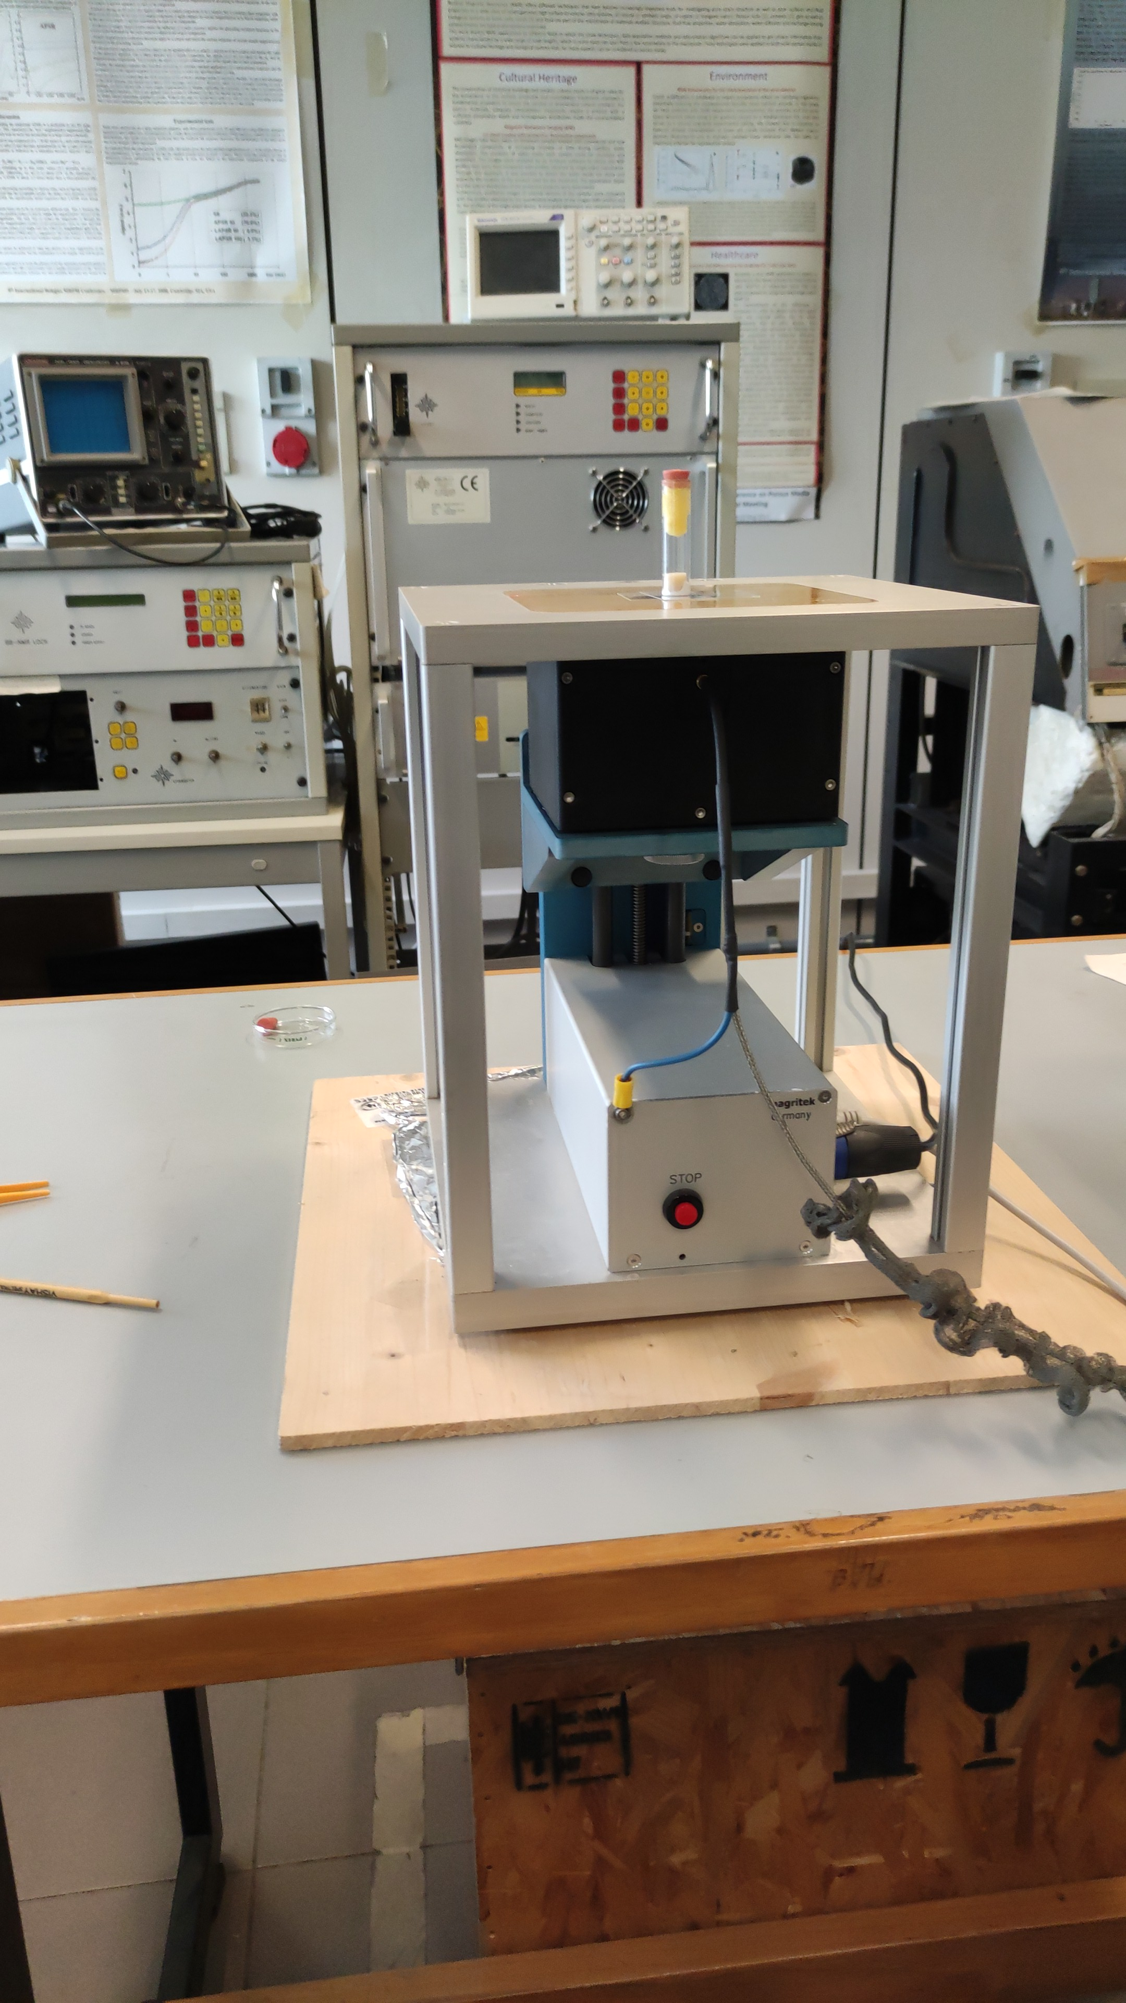
Laboratory of applied physics
Instruments
NMR-MOUSE PM10
More details …………………………………………………
Tutor:
Carlo Golini
SUMMER SCHOOL on
PHYSICAL SENSING & PROCESSING – V EDITION
Department of Physics & Astronomy – University of Bologna
July 17-21, 2023
Images by iconicbestiary on Freepik

Slide 3
Laboratory of Astrophysics
Title
Characterization of optical (and IR) solid state detectors
Measuring conversion parameter to retrieve the number of detected photons
Objective
SUMMER SCHOOL on
PHYSICAL SENSING & PROCESSING – V EDITION
Department of Physics & Astronomy – University of Bologna
July 17-21, 2023
Images by iconicbestiary on Freepik

Slide 4
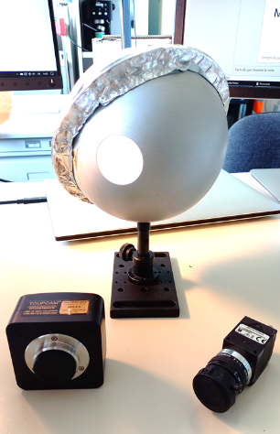
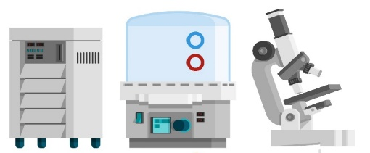
Laboratory of Astrophysics
Instruments
CMOS camera, integrating sphere
By means of simple acquisition of flat-field images it is possible to retrieve the detector conversion parameter
More details
Tutor:
Alessandro
Gesuato
SUMMER SCHOOL on
PHYSICAL SENSING & PROCESSING – V EDITION
Department of Physics & Astronomy – University of Bologna
July 17-21, 2023
Images by iconicbestiary on Freepik

Slide 5
Laboratory of atmospheric physics
Title
Environmental
Thermography
Measuring heat transfer through an evaporating surface
Objective
SUMMER SCHOOL on
PHYSICAL SENSING & PROCESSING – V EDITION
Department of Physics & Astronomy – University of Bologna
July 17-21, 2023
Images by iconicbestiary on Freepik

Slide 6
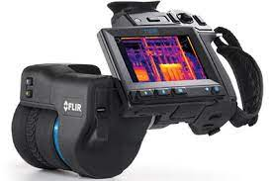
Laboratory of atmospheric physics
Instruments
Infrared camera
The fast-sampling rate of the camera captures the thermal transient of a wet surface while evaporating under different external forces
More details
Tutor:
Luigi Brogno
SUMMER SCHOOL on
PHYSICAL SENSING & PROCESSING – V EDITION
Department of Physics & Astronomy – University of Bologna
July 17-21, 2023
Images by iconicbestiary on Freepik

Slide 7
Laboratory of Condensed Matter Physics
Title
Introducing MEDIPIX2: a high resolution pixelated spectrometer for ionising radiation
Objective
This hands-on experience aims to make the student familiar with advanced silicon-based pixelated detection technologies developed for tracking, energy deposition and identification of ionising radiation particles.
SUMMER SCHOOL on
PHYSICAL SENSING & PROCESSING – V EDITION
Department of Physics & Astronomy – University of Bologna
July 17-21, 2023
Images by iconicbestiary on Freepik

Slide 8
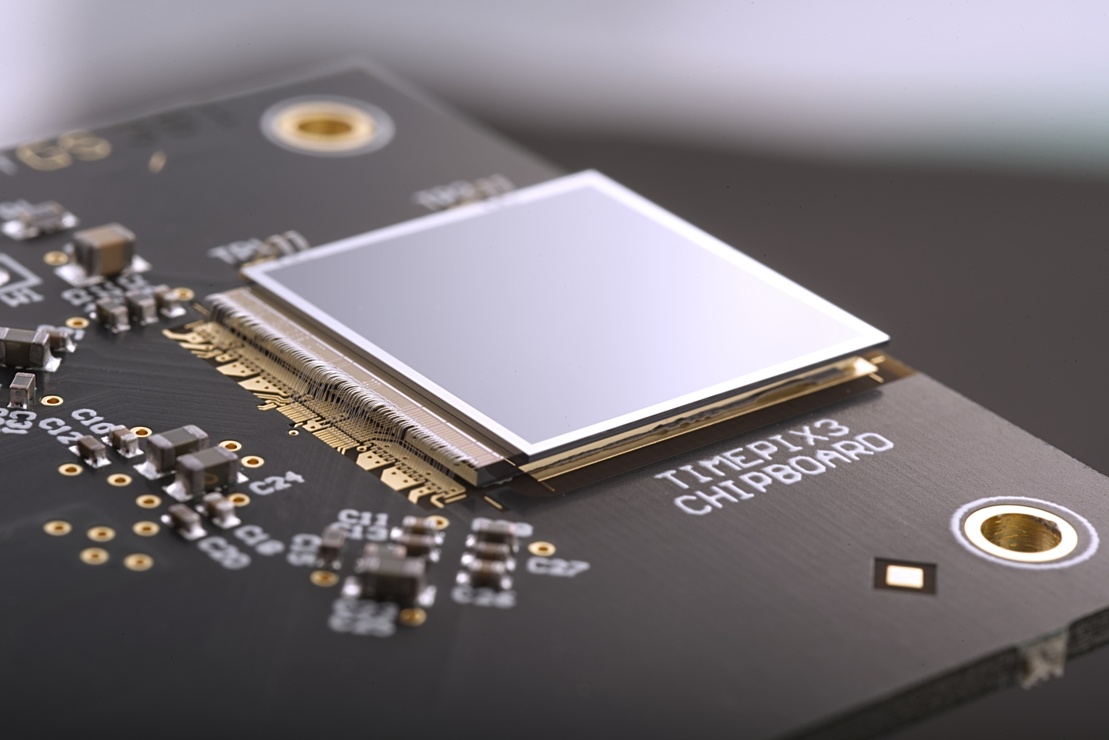
Laboratory of Condensed Matter Physics
Instruments
MEDIPIX
More details
Introduction to MEDIPIX
Measuring the spectrum of a radiation source
Measuring the divergence of a collimated radiation beam
Tutor:
Jessie Posar
SUMMER SCHOOL on
PHYSICAL SENSING & PROCESSING – V EDITION
Department of Physics & Astronomy – University of Bologna
July 17-21, 2023
Images by iconicbestiary on Freepik

Slide 9
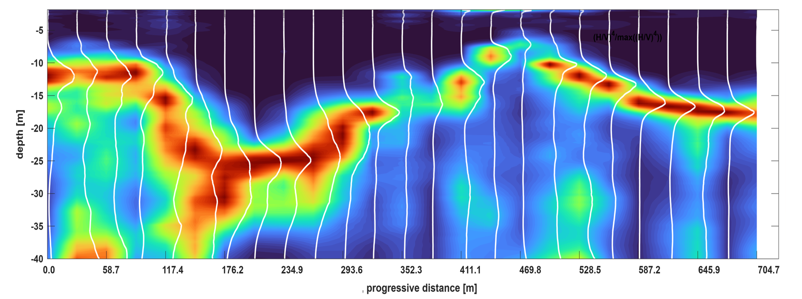
Lab. of exploration geophysics
Exploiting ambient noise to map the Earth interior
Title
Objective
SUMMER SCHOOL on
PHYSICAL SENSING & PROCESSING – V EDITION
Department of Physics & Astronomy – University of Bologna
July 17-21, 2023
Images by iconicbestiary on Freepik

Slide 10
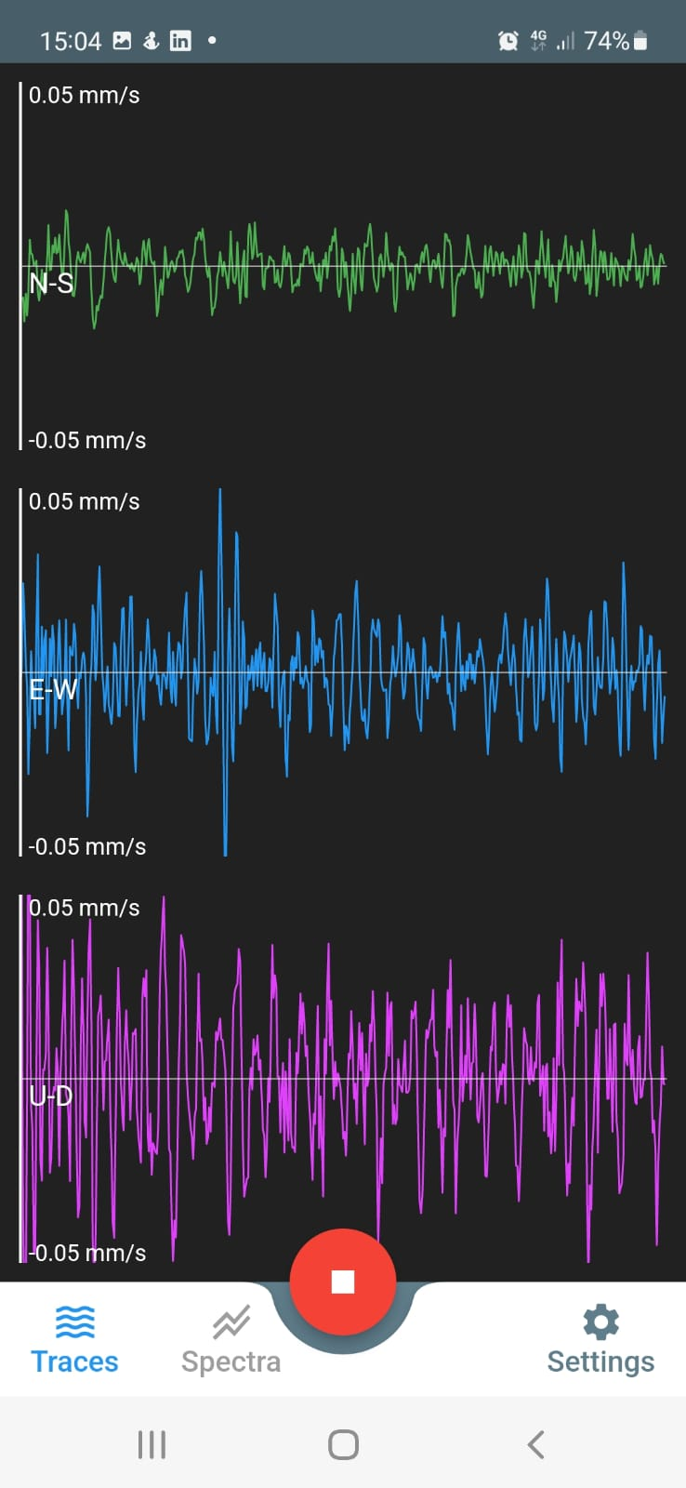
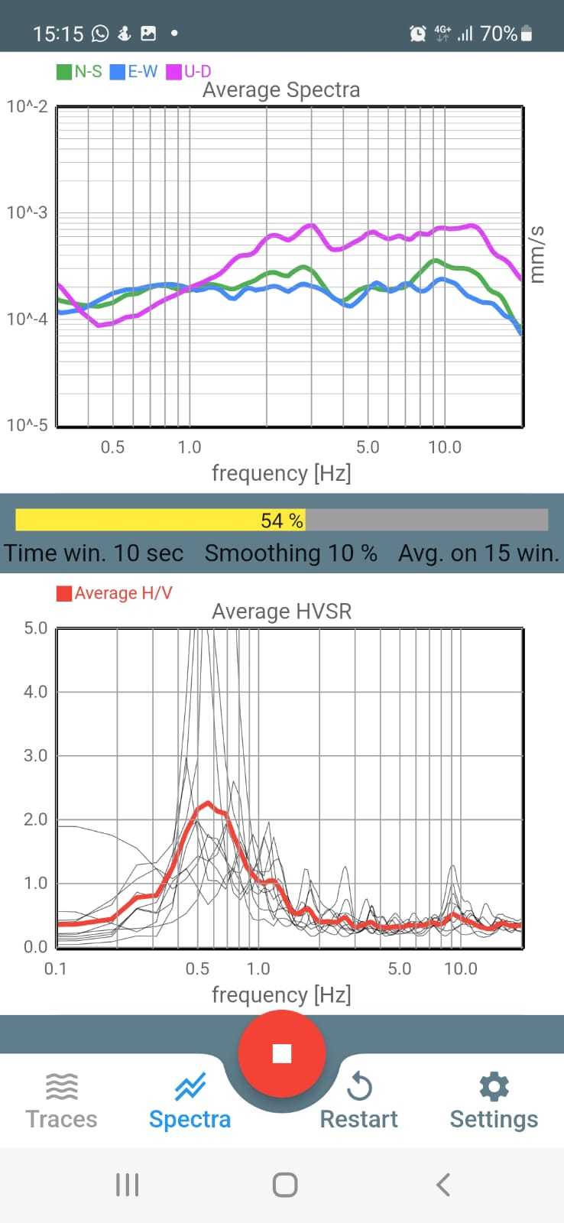
Lab. of exploration geophysics
By using seismometers, we measure resonances of soils and structures to understand their geometrical and mechanical properties, as well as their dynamic (earthquake, wind) behavior.
Instruments
More details …………………………………………………
Tutor:
Valentina Cicero
SUMMER SCHOOL on
PHYSICAL SENSING & PROCESSING – V EDITION
Department of Physics & Astronomy – University of Bologna
July 17-21, 2023
Images by iconicbestiary on Freepik

Slide 11
Laboratory of nuclear physics
Title
Scintillators for particle detection
Objective
Studying the main features of different scintillators and readout modalities commonly used for particle detection
in nuclear and particle physics
SUMMER SCHOOL on
PHYSICAL SENSING & PROCESSING – V EDITION
Department of Physics & Astronomy – University of Bologna
July 17-21, 2023
Images by iconicbestiary on Freepik

Slide 12
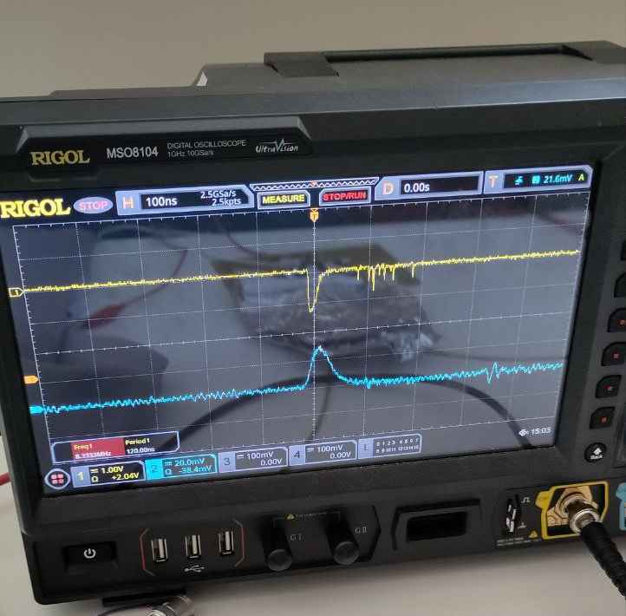
Laboratory of nuclear physics
Instruments
Oscilloscope
Scintillators
Nuclear electronics
Power supply
Cosmic rays from space
Tutor:
Riccardo
Ridolfi
SUMMER SCHOOL on
PHYSICAL SENSING & PROCESSING – V EDITION
Department of Physics & Astronomy – University of Bologna
July 17-21, 2023
Images by iconicbestiary on Freepik

